Slide 1
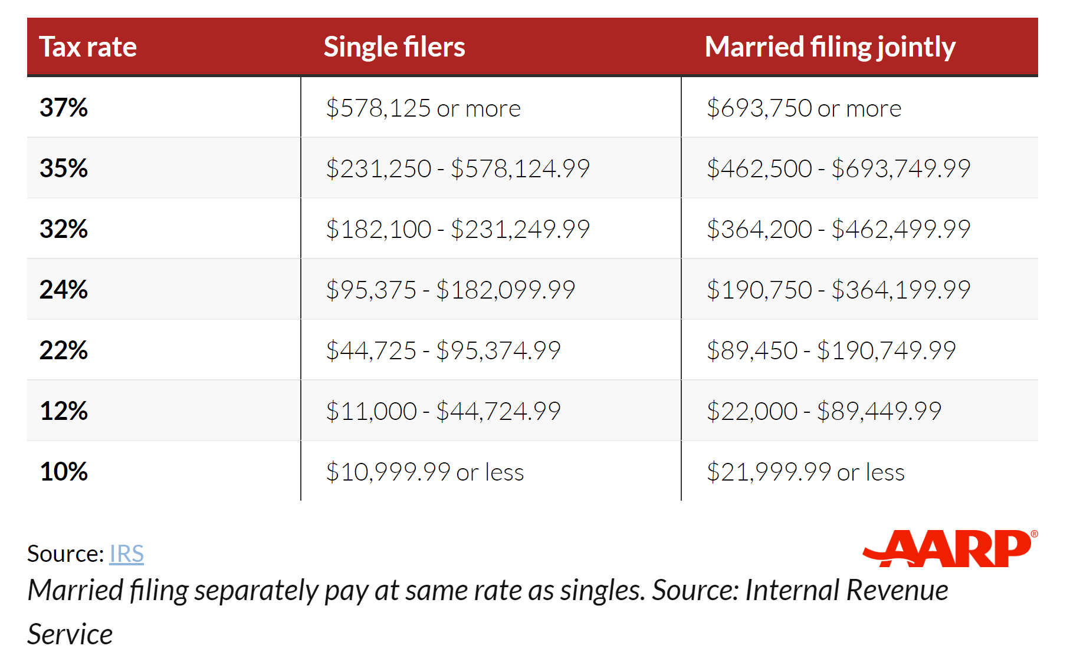
Federal Income Tax Brackets for 2024

