Slide 1
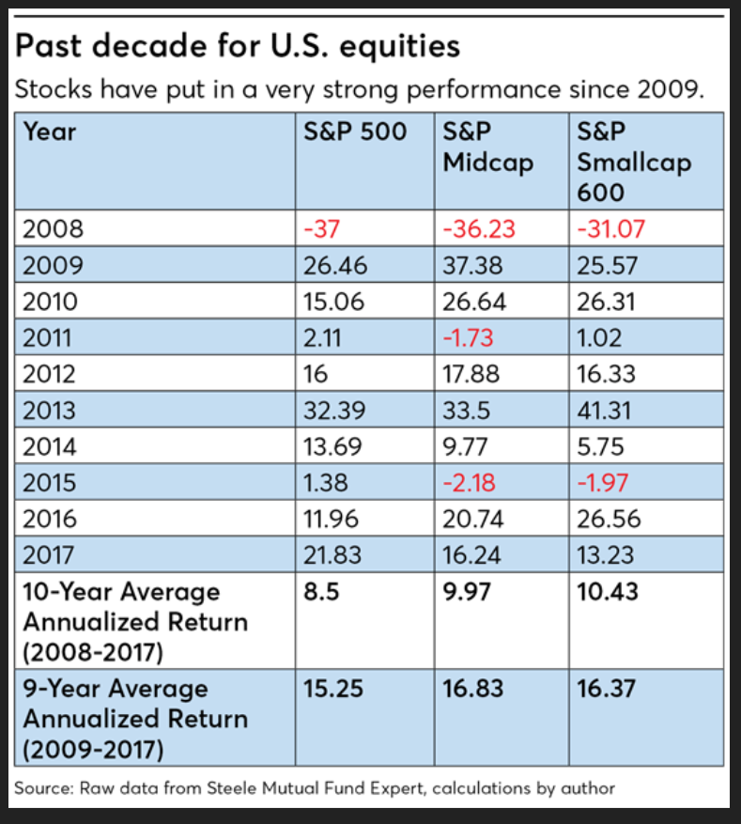
S & P performance 2009-2017

