Slide 1

Fiscal Cliff & Philanthropy:
More questions than answers
James E. Connell FAHP, CSA
Charitable Estate and Gift Planning Specialists
P.O. Box 3335, Pinehurst, NC 28374
Email: jec42644@aol.com
Internet: www.connellandassoc.com
Notes:
..

Slide 2
Looking back:
Giving by Income 2007-2009
Cash gifts fell 9.7% while security and non-cash gifts declined 46%
90% of the decline in giving from
2007 - 2009 can be traced to donors with incomes of $200,000+
Under $200,000 reduced their giving by 4.3%
$100,000 to $200,000 incomes reduce their giving by >.05%
Notes:
In looking back we can anticipate the future effect of the Fiscal Cliff increasing taxes on individuals who make $200,000 or more . Increased taxes will effect their net worth and the ability to continue there gifting at the same or increased levels of support.
Lower income individuals may not be effected as much.
Overall effect is estimated to be $5.9 billion annually.

Slide 3
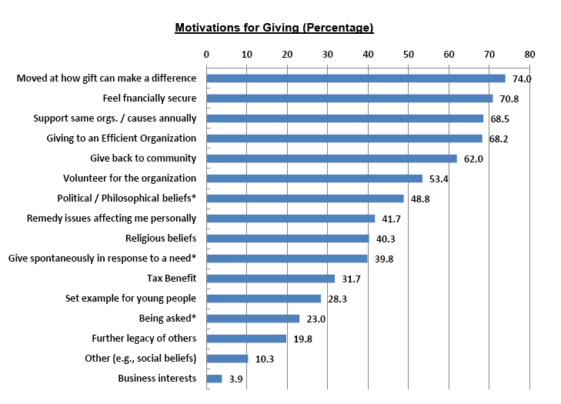
What Drives Major and Campaign Donors to Give
Notes:
Americans are a generous people and there are several important factors that determine their support of non-profit organizations. The strongest factors center on the mission of the charity and the impact there gift will make on the programs of the charity.
Wile tax benefits rank low at 31% they effect an individuals discretionary income .
Source: Bank of America 2012 Study of High Net Worth Philanthropy

Slide 4
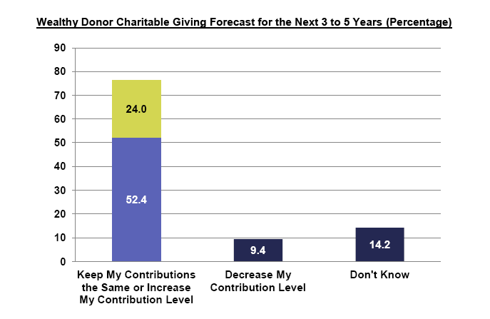
Wealthy Donor Giving Forecast
Notes:
While a recent Bank of America study revealed most individuals were expecting to increase (24%) or gift about the same amount (52.4%) as in previous years. This survey was completed several months before the extensive public discussion of the full impact of the Fiscal Cliff .
Source: Bank of America 2012 Study of High Net Worth Philanthropy

Slide 5
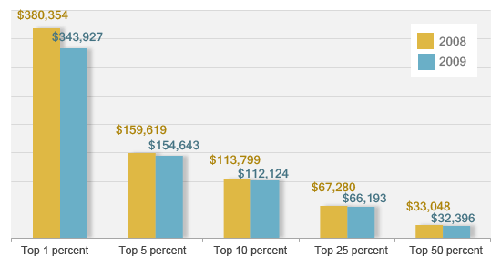
How Much You Have to Make to be in the Top 50% of Earners
Source: IRS, Statistics of Income Division, July 2011
The income thresholds are for the amount of AGI on a return, not per taxpayer.
--Taxes on the 1% could rise and average of $121,000.
--Top quintile will owe an additional $1,141
Notes:
This slide shows how much earnings it takes to make the top 50% of wage earners. The top 5% of earners will be effected the most by the tax increases proposed under the Fiscal Cliff.

Slide 6
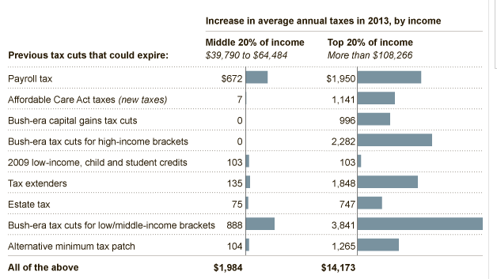
Fiscal Cliff Middle & Top Income Impact
DOWN FOR ALL - The top 1% of taxpayers paid an average tax rate (i.e., federal income taxes paid as a percentage
of adjusted gross income) of 34.5% in 1980, but only paid 24.0% in 2009 (the latest year that data is available).
The bottom 50% of taxpayers paid an average tax rate of 6.1% in 1980, but only paid 1.8% in 2009 (source: IRS)
Notes:
While all wage earners will be effected in some manner the top earners (those most generous to charities) will be effected the most.

Slide 7
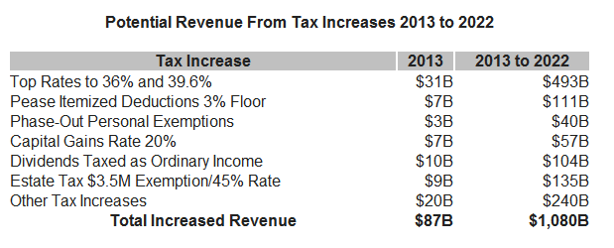
Tax Revenue Increases 2013 to 2022
Source: Committee for Responsible Federal Budget (CRFB)
Nonprofit sector could lose $5.6 Billion per year in charitable giving if the
charitable deduction is cut. Higher income taxpayers account for the majority of
individual giving. Taxpayers with $100,000 in 2008 provided 58% of charitable giving
Notes:
The cumulative effect of the tax increases will be significant overtime. Again with the top earners being effected the most. Charities are expected to lose upwards of $5.9 billion in 2013.
Total giving for the last reporting year 2011 was $298 billion of which 73% was from individual donations.

Slide 8
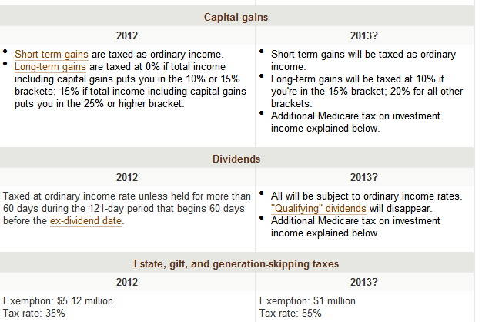
Fiscal Cliff & Philanthropy:
More questions than answers
Notes:
In addition to income, capital gains, dividend taxes perhaps the most significant change that will take place is the estate tax.
In is currently estimated the estate tax will increase the number of individuals effected by 1,580%.
In 2012 it is estimated 3,300 estates will pay estate tax, 0.13% of total deaths.
If the estate tax exemption decreases to a $1 million threshold the Congressional Budget Office estimates 52,500 estate will be effected each year or about 2% of deaths.

Slide 9
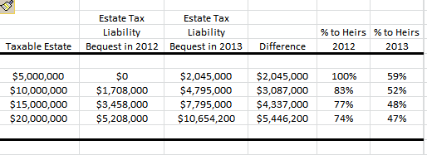
Fiscal Cliff & Philanthropy:
More questions than answers
Notes:
This chart shows the significant effect of the estate tax liability for various size estates mostly due to decease in the exempt amount and the increase in the estate tax maximum rate to 55%.

Slide 10
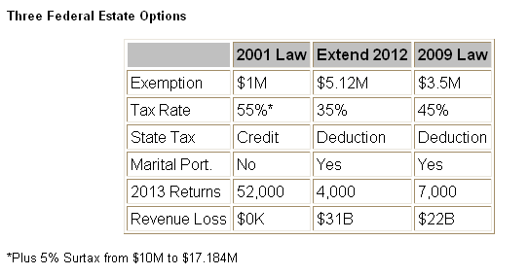
Three Federal Estate Tax Options
Notes:
Congress could chose to go back to the 2001 estate tax law where there was a $1 million estate exemption or could go back to the 2009 law with a $3.5 million exemption. Estate taxes under the 2009 law produced $22 billion in Federal revenue. Extending the current 2012 law will cost an estimated $11 billion.

Slide 11
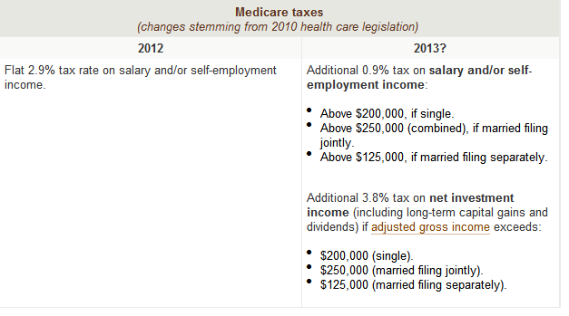
Fiscal Cliff & Philanthropy:
More questions than answers
Notes:
All high income individuals ($200,000 for singles and $250,000 for married) will be paying increased Medicare tax of 0.9%, and higher net investment income taxes of 3.8% for the Affordable Care Act.

Slide 12
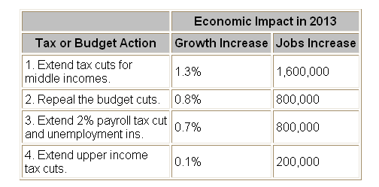
Congressional Budget Office and Fiscal Cliff
Notes:
If one of the goals for Congress is to get people back to work then they will look to modifying those taxes that will produce the greatest job growth over time. The conclusion is to extend the tax cuts for most middle income taxpayers.

Slide 13
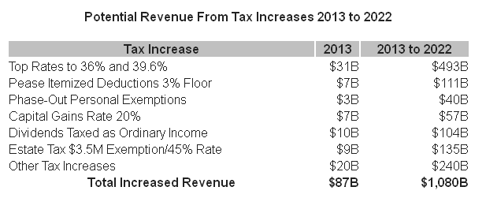
Tax revenue 2013 to 2022
Notes:
The nonpartisan Committee for a Responsible Federal Budget published a report on Nov 15th which outlines the major proposals for tax increases and the expected revenue generation.

Slide 14
Fiscal Cliff & Philanthropy:
More questions than answers
Upper income clients may want to consider shifting income from 2013 to 2012
Sell appreciated assets before tax increase
  Avoid the 3.8% Medicare surtax on investments
Clients over age 70 ½ might consider taking withdrawals in excess of their RMD
  Convert excess of regular distributions to Roth IRA
Increase charitable gift deductions
Consider a Non-Grantor Charitable Lead Annuity Trust to reduce estate taxes
Notes:
Upper income individuals have several decisions to make and little time to make them if they wish to make maximum use of the current income and estate tax laws.
If they have the flexibility shifting income to a low tax year makes sense.
Harvesting capital gains before being subject to the net investment income tax of 3.8% in addition to the capital gains tax makes sense.
Taking withdrawals in addition to the RMD from retirement plans and shifting that income to a Roth IRA makes sense.
Now that taxable income is increased in 2012 consider increasing charitable contributions up to the 50% limit to reduce taxes makes sense.
It is important to note for every $1.00 of Federal charitable deduction created it can be used to offset $1.88 in capital gains captured at the Federal level . There may be additional state tax benefits.
To reduce estate taxes a Non-Grantor Charitable Lead Annuity Trust should be considered by individuals who know they will have a taxable estate and have the financial capacity to give up the income from assets which will be payable to charity for a term of year before the asset is transferred to heirs with no additional taxes.

Slide 15
Charity and Fiscal Cliff:
Give today or wait until 2013
 | Give in 2012 | Give in 2013 | Difference
Value | $10,000 | $10,000 | $0
Tax savings 28% in 2012 36% in 2013 | $2,800 | $3,600 | $800
Net cost of gift | $7,200 | $6,400 | $800
Taxes paid in 2012 | $0 | $2,800 | $2,800
Net cost of gift | $7,200 | $9,200 | $2,000
Notes:
As the end of year approaches I always get the questions is it better to wait until next year to make the gift? All things considered one should never forgo taking charitable deductions in a tax year.
As the above chart illustrates if an individual has earned income of $10,000 available for gifting in 2012 they should complete the gift in 2012. They receive the government bonus for being charitable this year which reduces the net cost of the gift.
By waiting until next year to make the gift they will have to pay taxes on the earned income in 2012 which will result in negative cash flow in 2013 . The effect is the net cost of the 2013 gift is increased.
Under the proposed tax increases it will only take a few dollars more in taxable adjusted gross income to experience a 28% increase in tax rates.

Slide 16
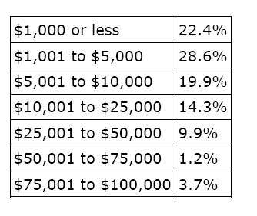
A Guide to IRA Charitable Rollovers
Senate Finance Committee approved for 2012*
Part of Tax Extender Act
IRA account owners 70 ½ or older may make a direct transfer to charity up to $100,000 per year
Donor profiles
  Convenience donor
  Standard deduction
    donor
  Generous donor
  Major donor
  Social security
    donor
Amount received in IRA gifts
of Various Size
(Source: PPP survey 2009)
*Family and Business Tax Cut Certainty Act of 2012
Notes:
While the IRA Chartable Rollover option for 2012 has been approved by the Senate it has yet to be fully approved by Congress.
It allows individuals in the RMD years to transfer up to $100,000 to charity without reporting the transfer as income. In essence individuals receive the full benefit of a charitable deduction with having it reported on their tax reports.
The single largest category of potential users of the IRA rollover strategy are those with sufficient IRA balances but do not itemize their taxes.
Only 32.5% of the 141 million tax returns filed by American taxpayers for the 2009 tax year (the latest year for which tax data has been released by the government) claimed itemized deductions (source: Internal Revenue Service).
There are several additional rules to make an effective IRA rollover gift and individuals should consult their advisors for full details.

Slide 17
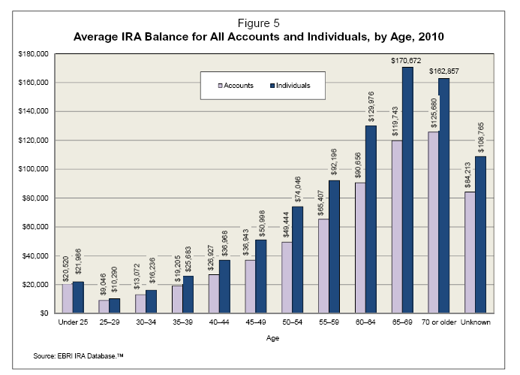
A Guide to IRA Charitable Rollovers
Notes:
Individuals approaching retirement or over 70 ½ years old have significantly higher IRA balances than other age categories.

Slide 18
A Guide to IRA Charitable Rollovers
  Allows for IRA rollovers to charity
    Both regular IRA accounts and Roth IRA accounts are eligible, IRA check books
  Charity must be eligible
  Individual must be 70 ½ or older on the date of contribution
    Qualified Charitable Distribution will qualify for the Required Minimum Distribution requirements of IRA
  $100,000 limit
    $200,000 from couple with separate accounts
  Transfers from other pensions and profit sharing plans, i.e. Keogh, 401k, 403b, etc., are not allowed
    Possible to rollover above accounts to IRA if plan and time permit
Notes:
The slide lists the basic requirements for an individual to be eligible and for a charity to receive a rollover from a IRA or Roth IRA account. It also lists those retirement plans which are not eligible for the transfer.

Slide 19
A Guide to IRA Charitable Rollovers
  Donor Profile – Non-Itemizers
    May be donors with modest IRA account balances, but sufficient retirement income from personal investments and tax-exempt accounts
    Taking MRD may not significantly increase their lifestyle
    Do not have significant tax deductions
      State and local income taxes
      Interest expenses
      Medical expenses
      Charitable deductions
    So the standard deduction applies (2012), over 65
      Married/Joint - $13,050 one / $14,200 two
      Single - $7,400
      Head of household - $10,150
Notes:
Non Itemizers are the most significant group who should consider the IRA rollover option.
Only 32.5% of the 141 million tax returns filed by American taxpayers for the 2009 tax year (the latest year for which tax data has been released by the government) claimed itemized deductions (source: Internal Revenue Service).

Slide 20
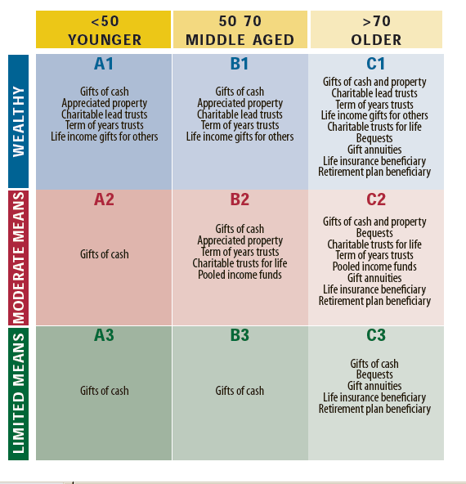
Wealth and Age Matrix
Notes:
To increase charitable deductions individuals have several options and the options increase with age and wealth.
The easiest method to create a charitable deduction and keep the economic value of the gifted asset is creating a split interest gift.
A split interest gift using the charitable gift annuity is the most popular life income agreement in America.
Those with significant assets should consider the advantages of a personally tailored charitable remainder trust arrangement.

Slide 21

Thank You
Notes:
James E. Connell FAHP, CSA
Charitable Estate and Gift Planning Specialists
P.O. Box 3335, Pinehurst, NC 28374
Email: jec42644@aol.com
Internet: www.connellandassoc.com
Phone 910-295-6800
Cell: 910-315-9636

