Slide 1


IRA Charitable Rollover
Strategy and Options
James E. Connell FAHP, CSA
Charitable Estate and Gift Planning Specialists
P.O. Box 3335, Pinehurst, NC 28374
Email: jec42644@aol.com
Internet: www.connellandassoc.com

Slide 2
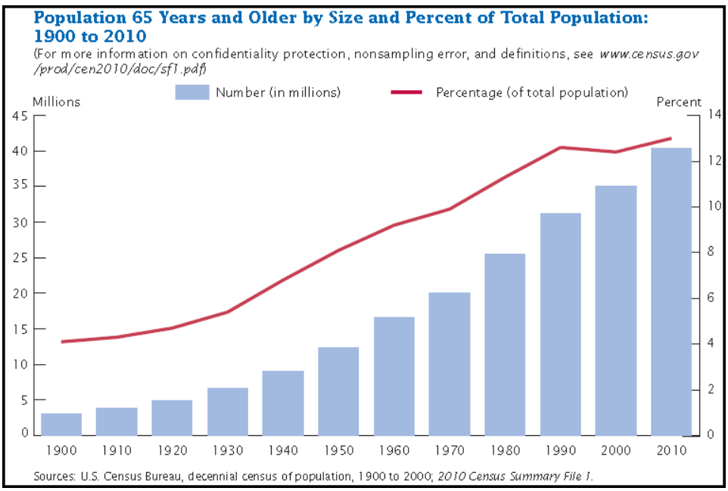
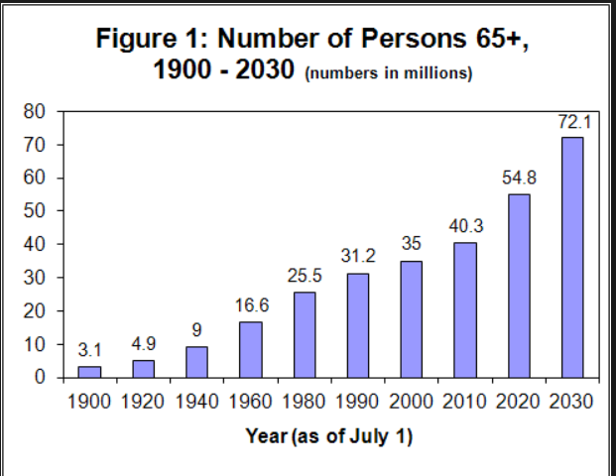
Likelihood you will spend 30 years in retirement
U.S. average population: 19%
Upper middle class: 43%
Upper middle class in 2029: 50%

Slide 3
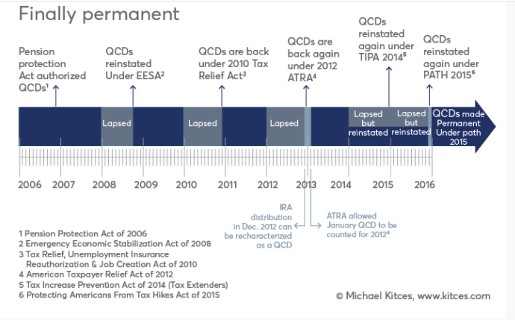
History of the QCD

Slide 4

IRA statistics
2.5 million people turn 70 this year
First baby boomers take their RMD in 2016
Ed Slott: DOL fiduciary rules require advisors to explain the charitable rollover option to those who qualify: www.ira help.com

Slide 5
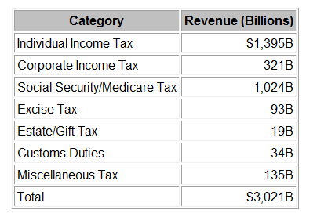
Where do Federal Taxes come from?
IRA Statistics
9,000 account have accumulated at least $5 million
1,100 accounts exceeded $10 million including 314 with more than $25 million
99% of taxpayers have less than $1,000
Collection of federal estate taxes amounts
to approximately $18 billion annually, equal
to what Uncle Sam spends in 44 hours (source: Tax Foundation)

Slide 6
About the IRA Rollover Law
On December 18, 2015, IRA rollover became permanent part of tax code
IRAs available for tax-free lifetime gifts
Donors must be 70½
Up to $100,000 per IRA holder per year
May satisfy the required minimum distribution requirement (RMD)

Slide 7
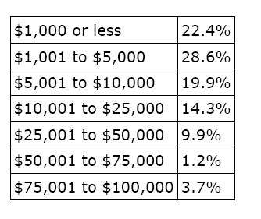
A Guide to IRA Charitable Rollovers
IRA account owners 70½ or older may make a direct transfer to charity up to $100,000 per year
Donor profiles
  Convenience donor
  Standard deduction donor
  Generous donor
  Major donor
  Social security donor
Amount received in IRA gifts
of Various Size
Notes:
While the IRA Chartable Rollover option for 2012 has been approved by the Senate it has yet to be fully approved by Congress.
It allows individuals in the RMD years to transfer up to $100,000 to charity without reporting the transfer as income. In essence individuals receive the full benefit of a charitable deduction with having it reported on their tax reports.
The single largest category of potential users of the IRA rollover strategy are those with sufficient IRA balances but do not itemize their taxes.
Only 32.5% of the 141 million tax returns filed by American taxpayers for the 2009 tax year (the latest year for which tax data has been released by the government) claimed itemized deductions (source: Internal Revenue Service).
There are several additional rules to make an effective IRA rollover gift and individuals should consult their advisors for full details.

Slide 8
A Guide to IRA Charitable Rollovers
Allows for IRA rollovers to charity
    Both regular IRA accounts and Roth IRA accounts (5 year rule) are eligible, IRA checkbooks (must be payable to charity)
Charity must be eligible
Individual must be 70½ or older on the date of contribution
    Qualified Charitable Distribution (QCD) will qualify for the Required Minimum Distribution requirements of IRA
$100,000 limit
    $200,000 from couple with separate accounts
Transfers from other pensions and profit sharing plans, i.e. Keogh, 401k, 403b, etc., are not allowed
    Possible to rollover above accounts to IRA if plan and time permit
Notes:
The slide lists the basic requirements for an individual to be eligible and for a charity to receive a rollover from a IRA or Roth IRA account. It also lists those retirement plans which are not eligible for the transfer.

Slide 9
A Guide to IRA Charitable Rollovers
Permitted transfers/gifts
Qualified Charitable Distribution (QCD)
  Outright gifts only
  No charitable gift annuities (CGA)
  No charitable remainder unitrusts (CRT)
  No charitable remainder annuity trusts (CRAT)
  No pooled life income funds (PIF)
  No “quid pro quo” gifts
    No personal benefits
    No special events
    No athletic tickets

Slide 10
A Guide to IRA Charitable Rollovers
Suggested procedures
  Notify charity of potential gift
  Instruct custodian/trustee of IRA on the proper form and if no form send a complete letter of instructions with payment/gift to the charity as a “third party payment”
  Transfer will be mostly cash but in-kind transfers (i.e. securities) are permitted
  Keep records of transfer and substantiation from charity
  If appropriate, elect out of withholding

Slide 11
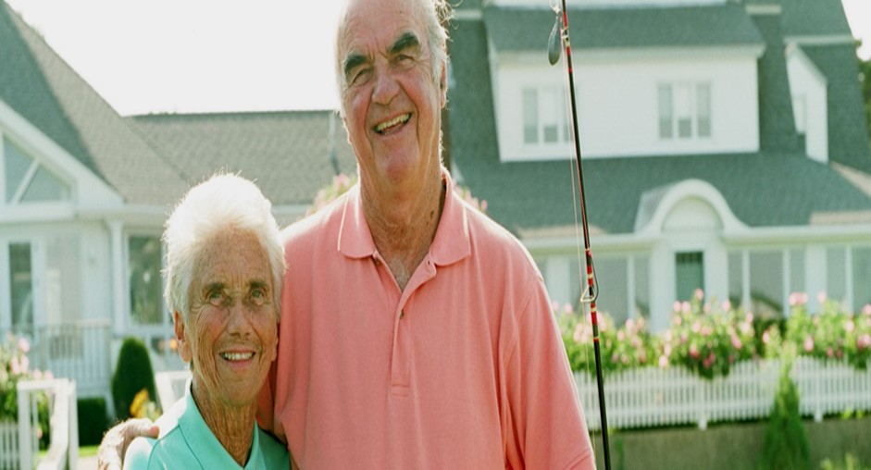
Questions to help clients decide
1. Are your planning to leave a charitable legacy through your estate plan?

Slide 12

Questions to help clients decide
2. Have your designated your favorite cause as the beneficiary of retirement assets?

Slide 13
A Guide to IRA Charitable Rollovers
Donor Profile – Convenience Donor
  Most delay taking distributions until the last quarter of the year in order to grow the remaining funds tax-free
  If actively making charitable gifts may consider the benefits of making gifts from their IRA account(s)
      No inclusion in income
      No income tax deduction
      Qualifies for Minimum Required Distribution (RMD)

Slide 14

Questions to help clients decide
3. Have your retirement savings and investments growth exceeded your expectations?

Slide 15
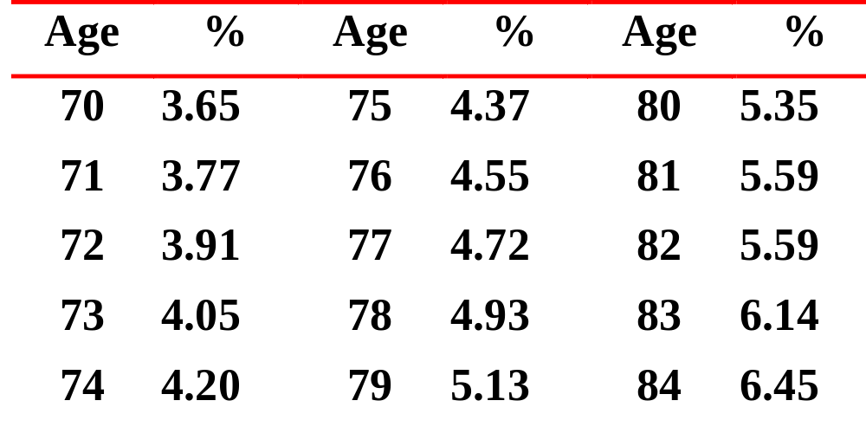
Minimum Required Withdrawal

Slide 16
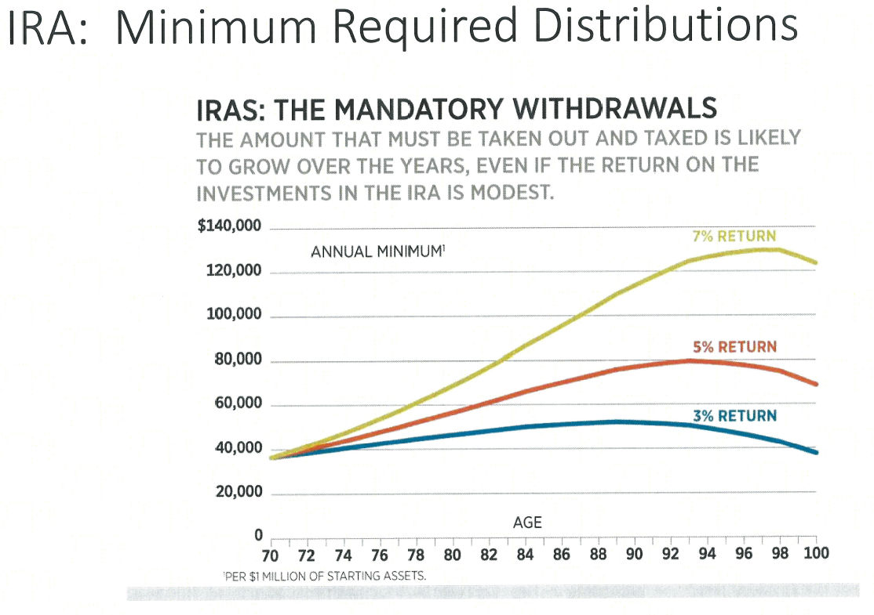

Slide 17
Questions to help clients decide
4. Are your itemized deduction reduced by 3% because of the reduction on itemized deductions for higher income individuals?
For example: A married couple filing jointly has $500,000 in adjusted gross income (AGI) and because their AGI exceeds the $305,050 threshold, the 3 percent reduction applies to this couple’s itemized deductions.
AGI $500,000
Excess of couple’s AGI over $305,050 = $194,950
3% reduction x 3%
_______________
Reduction of itemized deductions $5,848.50

Slide 18
Questions to help clients decide
5. Do you take the standard deduction on your tax return and make annual gifts to your favorite charities?
For example: the standard deduction for a married couple is $15,100 in 2016; if donors have no mortgage and low state/property taxes, they may not itemize and deduct charitable contributions—the new law allows for charitable contributions from IRAs to be excluded from income which is a special advantage for non-itemizers.

Slide 19
A Guide to IRA Charitable Rollovers
Donor Profile – Non-Itemizers
    May be donors with modest IRA account balances, but sufficient retirement income from personal investments and tax-exempt accounts
    Taking MRD may not significantly increase their lifestyle
    Do not have significant tax deductions
      State and local income taxes
      Interest expenses
      Medical expenses
      Charitable deductions
    So the standard deduction applies (2016), over 65
      Married/Joint - $13,850 one / $15,100 two
      Single - $7,850
      Head of household - $10,850
Notes:
Non Itemizers are the most significant group who should consider the IRA rollover option.
Only 32.5% of the 141 million tax returns filed by American taxpayers for the 2009 tax year (the latest year for which tax data has been released by the government) claimed itemized deductions (source: Internal Revenue Service).

Slide 20

Questions to help clients decide
6. Do your take minimum distributions from your IRA but have adequate alternative sources of income?
For example: By age 70 ½, individuals must start to withdraw funds from their IRAs based on an IRS schedule, a 75 year old with $1,000,000 in IRAs must distribute at least $44,000.

Slide 21
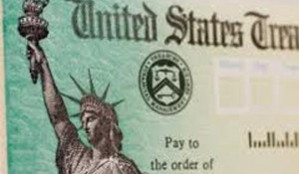
Questions to help clients decide
7. If you take greater distributions from your retirement plans, does doing so affect the amount of Social Security benefits that are taxed?
For example: provisional income < $32,000, no tax on SS;
$32,000 to $44,000, 50% of SS is taxable; greater than $44,000, 85% of SS is taxable

Slide 22

Questions to help clients decide
8. Is there a special cause you care about?
Would you like to benefit your community?
Do you want your charitable gifts to have the greatest impact?

Slide 23
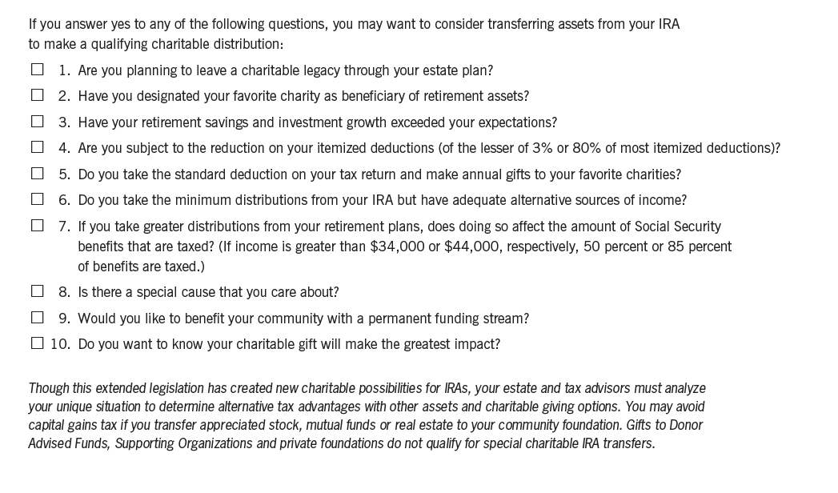
Sample questionnaire

Slide 24
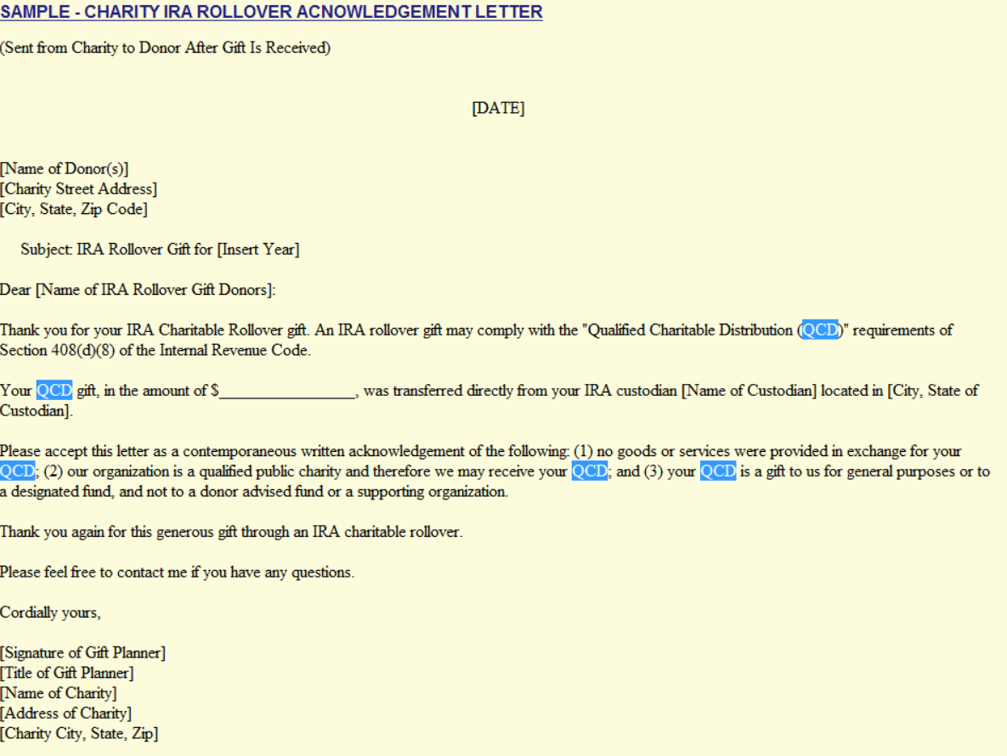
Charity acknowledgement letter

Slide 25
Split-Interest Gifts
Charitable gift annuities &
Charitable remainder trusts
Allows a donor to make a charitable gift while retaining certain rights and benefits to the gifted property, increased income and decreased taxes
Part gift, part investment
Charitable income tax deduction for the portion gifted to charity
Donor may also avoid capitals gains taxes, gift and estate taxes

Slide 26
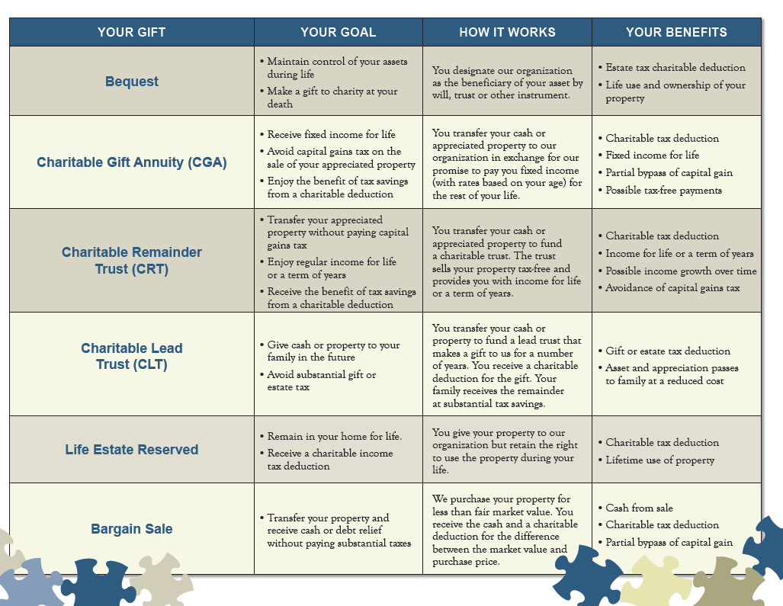


Slide 27

IRA and split interest agreements
Q. Can I transfer my funds directly from my IRA and establish a…..
  Charitable gift annuity?
  Charitable remainder unitrust?
A. Yes and NO….let me explain

Slide 28

IRA and split interest agreements
NO…there may be no direct transfer of funds from your IRA to a charitable gift annuity (CGA) or charitable trust (CRT) without first receiving and reporting taxable income from your withdrawal
YES…you can set up a CGA or CRT
  Q. Will it be a tax smart transactions?

Slide 29
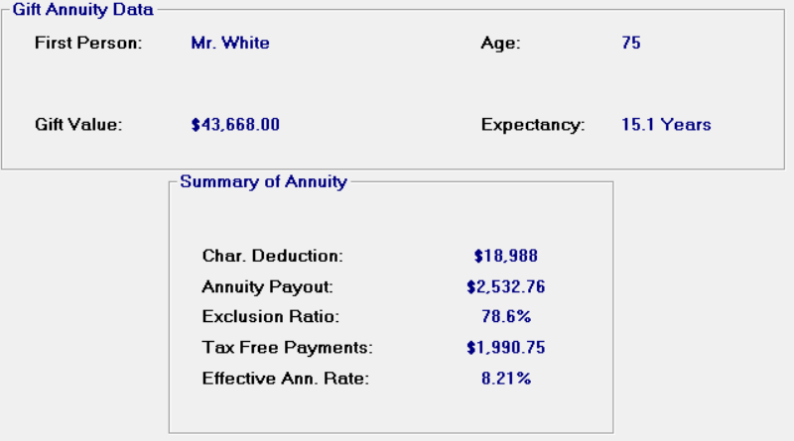
Mr. White age 75 has $1,000,000 in his IRA. The MRD is $43,668 in 2016.
The one-life rate for a CGA is 5.8%
The charitable deduction is $18,988
$24,680 taxable unless offset by other charitable deductions

Slide 30
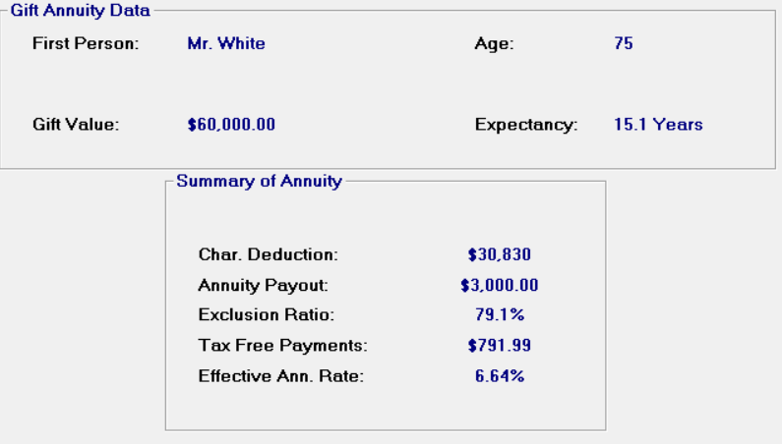
Mr. White age 75 has $1,000,000 in his IRA.
He has $60,000 in Apple stock, cost $20,000. The MRD is $43,668.
The maximum one-life rate for a CGA is 5.8% but Mr. White accepts 5.0%
The charitable deduction is $30,830
$12,838 taxable unless offset by other charitable deductions

Slide 31
Sara, age 62 has seen her IRA grow to over $750,000. She wants to make a $10,000 gift to charity this year.
Sara may withdraw $10,000 from her IRA to make the gift
  Alternative: withdraw $5,000 and hold funds for taxes
Sara reports the IRA withdrawal as income added to her wage earnings and investment income
Sara taxes a $10,000 - 50% of AGI charitable deduction, a tax wash
Is this a smart transaction?
  What is she giving up?

Slide 32

IRA Legacy act: the future
Legacy IRA Act (HR 5171), new federal legislation that would significantly expand the current-law IRA Rollover to allow for life-income gifts, including charitable gift annuities and charitable remainder trusts.
CGAs and CRT, no PIF
$400,000 ceiling for 65+ individuals
Minimum payout 5%
Payments: all ordinary income
4 year trial period
Cost: $100 million over 10 years

Slide 33
QCD – pledges and delivery
IRA Rollovers To Pay Pledges – Because the IRA funds are owned by the IRA owner, they may be used to fulfill a legally-binding pledge. The transfer from the IRA owner to the charity is treated as a receipt by the owner under Sec. 4975(d)(9) and therefore the IRA rollover is not a prohibited transaction.
IRA Owner Delivers Check – Most IRA custodians transfer IRA rollover funds by check or electronic transfer directly to the charity. However, some IRA custodians issue a check payable to the charity, but send the check to the donor for forwarding to the charity. This transaction will still qualify under Sec. 408(d)(8)(A) as an IRA rollover if the check is issued payable to the charity and the owner delivers the check prior to December 31 of the applicable year.
IRA Custodian May Rely on IRA Owner Representation of charity

Slide 34

IRA charitable beneficiary options
Charity
  Stated amount, percentage amount
Charitable gift annuity
  Beneficiary is provided fixed lifetime payments, favorite charity benefits
Charitable remainder trust
  Beneficiary is provided fixed or variable payments, favorite charities benefit

Slide 35
IRA loan to charity
An IRA owner may make a loan to a public charity, not a disqualified person
Charity must pay a fair rate of return
  Sept, 2016 = 2.48%, long term rate, annual
Donor may gift the balance on death to charity

Slide 36


IRA Charitable Rollover
Strategy and Options…
Thank You

