Slide 1

Changing landscape of charitable giving
Gift annuity strategies
Charitable trusts return
September, 2016
James E. Connell FAHP, CSA
Charitable Estate and Gift Planning Specialists
P.O. Box 3335, Pinehurst, NC 28374
Email: jec42644@aol.com
Internet: www.connellandassoc.com

Slide 2
Partners in philanthropy
Grand Traverse Regional Community Foundation
  www.gtrcf.org
Munson Healthcare Foundations
  www.munsonhealthcare.org/foundation
Northwestern Michigan College Foundation
  www.nmc.edu/foundation

Slide 3

Agenda
Part 1: Changing landscape of charitable giving
  Conducting the charitable discussion
  What prompts a charitable discussion
Gift annuity strategies for difficult assets
Charitable remainder trust returns
Part 2: IRA charitable rollover rules and options

Slide 4
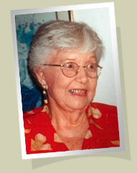
Life cycle giving
Advisor Input
40s - 50s - 60s - 70s - 80s
Age / Assets / Plans
Financial / Retirement Life
Charitable Life / Lifestyle
Charitable Intent / Motivation
Charity Input
“Advisors who truly understand the power of charitable planning
are few and far between”..… Trust and Estates. August 23, 2016

Slide 5

Life cycle giving
Financial Life
Charitable Life
Notes:
For a gift annuity program to be successful it must be consistently presented to donors and it must fit into the fabric of their financial and charitable life.

Slide 6
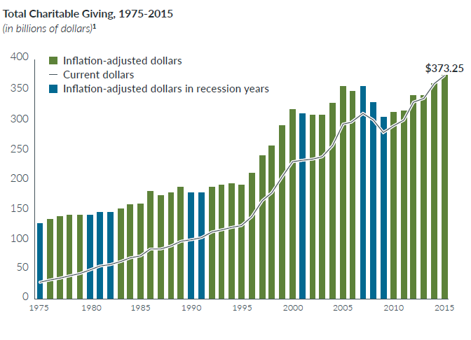
America gives
A Billion dollars a day to charities

Slide 7
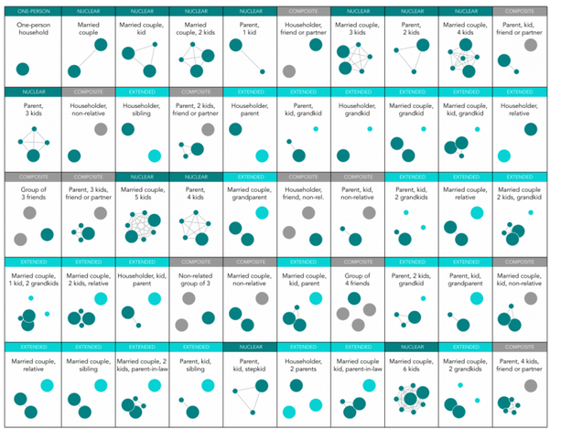
50 different family types -
118 million households split between family (82), single (36) and multigenerational (5)
One person
Nuclear
Composite
Extended

Slide 8
Professionals are invaluable for several reasons
1. Number of cultivation and solicitation visits a PG officer can make by themselves are limited
2. Professionals may speak on behalf of a charity in ways a paid staff never can
3. Philanthropy is now a wealth management tool for high net worth individuals (HNW)
  “Philanthrocapitalism” - 80% of HNW individuals give time, money and expertise to good causes (Source: Scorpio Partnership)
4. Professionals may provide access to individuals otherwise out of reach

Slide 9

Professionals are invaluable for several reasons
5. Professionals provide continuity and will remain committed to the charity long after paid staff has left
6. Professional inspire others by example
  Promoting practical planned gift strategies which fit into the donor’s financial and charitable goals
7. Professionals are prospects themselves
    Top prospects for flexible deferred CGAs

Slide 10
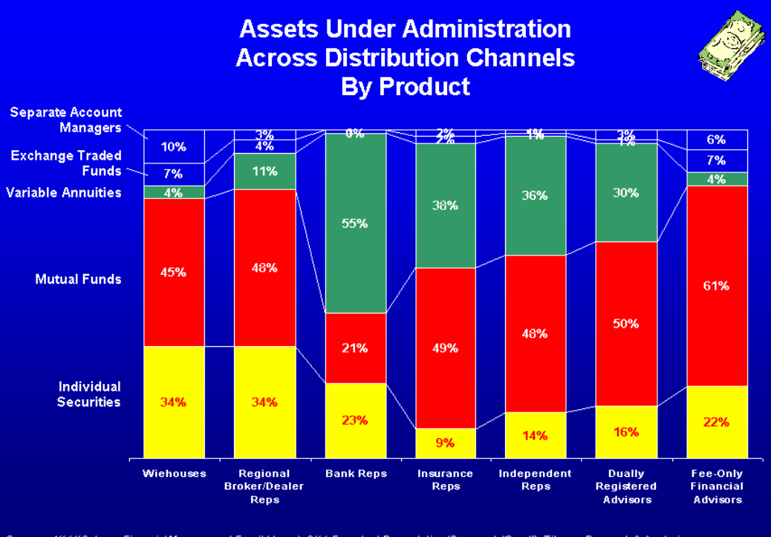
Investment products advisors sell

Slide 11

Advisors need to think beyond cash
Checkbook giving cash $$$$$
Publicly traded appreciated securities
  Owned more than a year
    Stocks, bonds, mutual funds, ETFs
Complex, non-publicly traded appreciated assets
  Private or restricted company stock
  Shares of privately owned business
  Real estate
Life insurance
Fixed and variable annuities

Slide 12
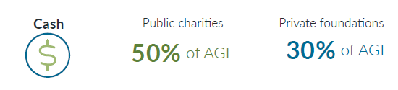
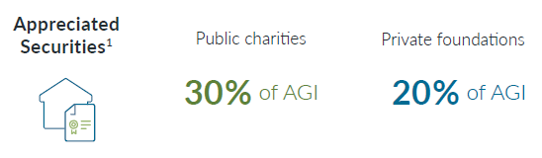
Tax advantages
Income tax
Appreciated securities
Carry forwards: initial year plus five
Short term: lesser of FMV or cost basis

Slide 13
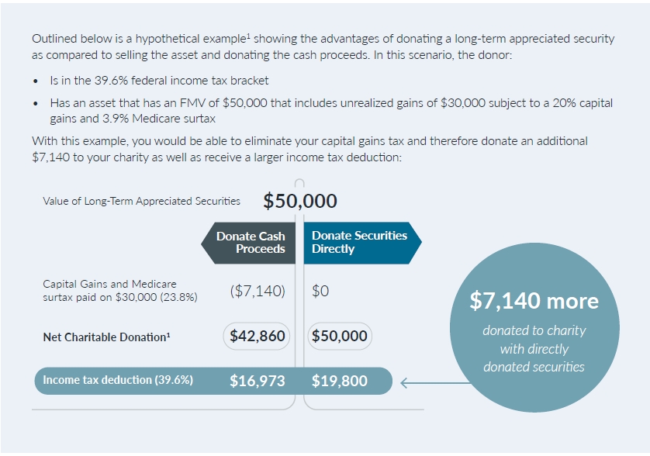
Cash or LTAA

Slide 14
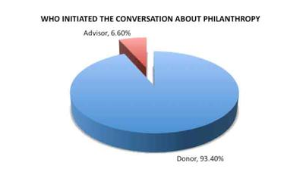
Who motivates giving?
Giving USA study, 2012
US Trust study: clients report advisors initiated charitable discussion
17% of the time, and only 10% donated for tax benefits, October 2013
Advisors who initiate philanthropy conversation attract more High Net Worth Clients

Slide 15



What motivates giving?
Belief in the Mission
Feeling financially secure
Fiscal stability of the charity
Regard for staff leadership
Regard for volunteer leadership

Slide 16
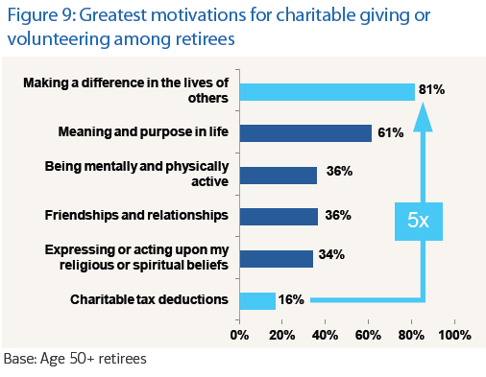
Retirees lead the nation in giving

Slide 17
Signs your clients need help with charitable planning
Clients frustrated with charitable process, wonder about their impact, don’t know where to give, don’t feel a sense of pride and satisfaction that should result from their donations
Wealthy clients have no heirs and despise paying taxes, but have not started to give significantly to charity or included charity in their estate plans
Give regularly and getting ready to sell a business or other major asset (real estate)

Slide 18
Signs your clients need help with charitable planning
Donate several times a year
Give to organization not 501(c)3 tax-exempt
Difficulty keeping track of donations
Don’t donate because of income or asset concerns
Donate varying amount year to year to same charity
Donated assets not optimally tax-efficient
Client is generous but children not generous and/or involved
Clients have assets children do not want and/or need

Slide 19
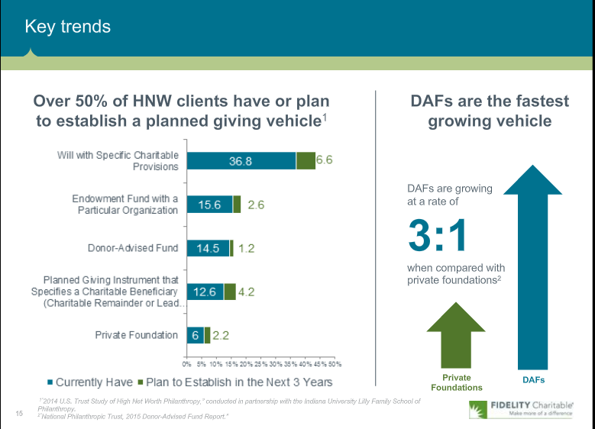
Fidelity Charitable: Key trends

Slide 20
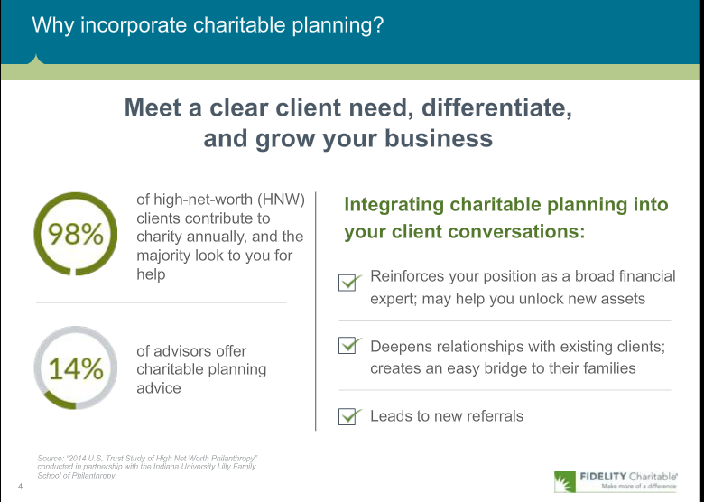
Fidelity Charitable: financial advisors

Slide 21
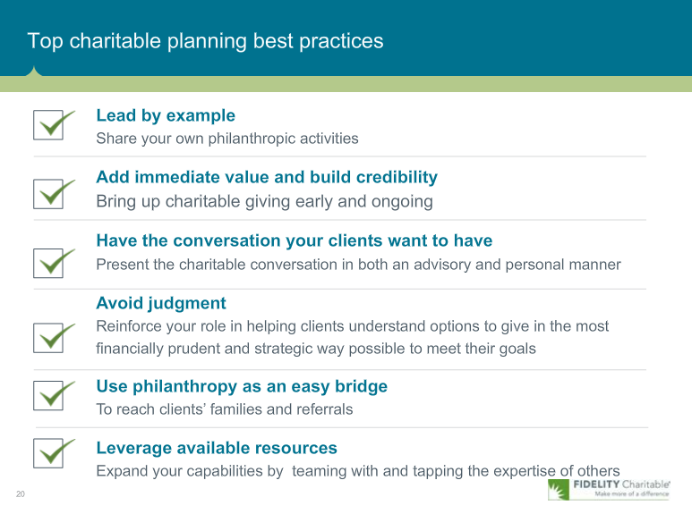
Fidelity Charitable: Top charitable planners

Slide 22
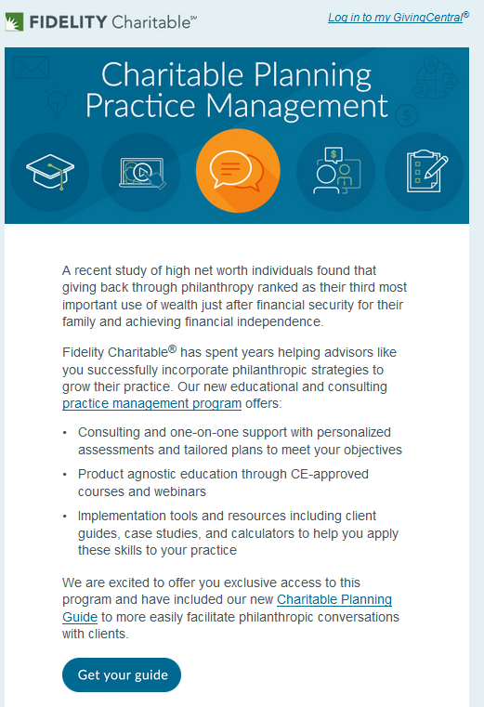
Fidelity Charitable: Practice Management
As more financial advisors get training in wealth option strategies of charitable giving it is increasingly necessary for charities to assume their rightful place as the charity of choice

Slide 23
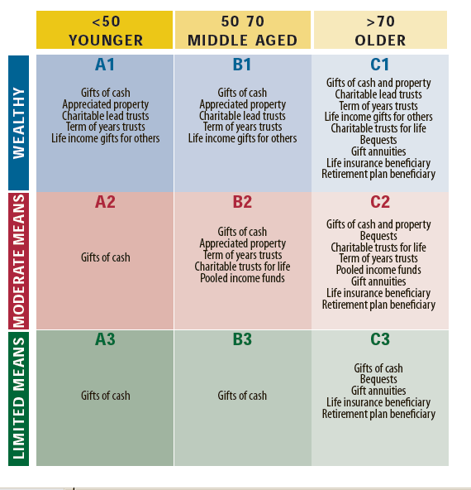
Wealth and Age Matrix

Slide 24

Addressing donor fears
The Fear: Dying too soon
The Solution: Gifts via estate, charitable lead trust, life income gifts to benefit loved ones.
The Fear: Illness, economic misfortune
The Solution: Charitable bequests at death, gift annuities and charitable remainder trusts
The Fear: Living too long
The Solution: Bequests via will & trusts, retirement plans and life insurance, gift annuities, charitable trusts, life estate agreements
The Fear: Mental and/or physical disability
The Solution: Gift annuities, charitable remainder trusts

Slide 25
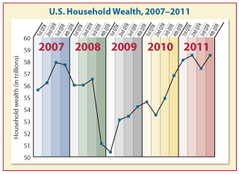
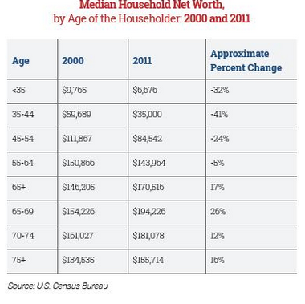
Wealth and net worth returns
Bull market for 90+ months
+ 5 years
30% of Americans age 65-69 are still in the workforce

Slide 26
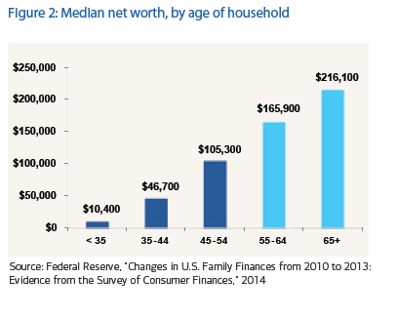
Retirees lead the nation in giving
80% of 65+
contribute to charity

Slide 27
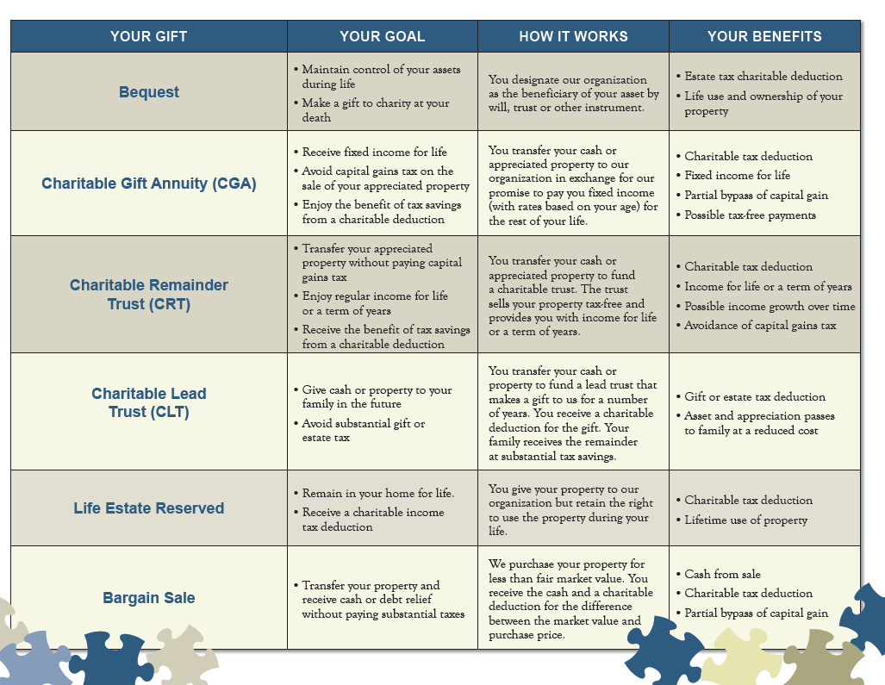

Slide 28
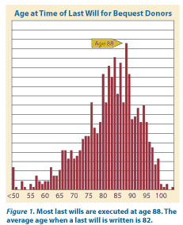
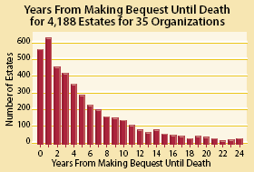
Bequest Statistics:
Gifts by Will, Trust or Beneficiary Designation

Slide 29

Bequest Facts and Figures
8% will include a charitable bequest
50% of bequests come from nontaxable estates
90% of bequests come from those who die after 70
77% - Idea came from donor (5% charity material)
47% - Left specific amount
51% - In will from 1-5 years
9% - Bequest removed
75% - Did not notify charity
44% - 10% or less of estate

Slide 30
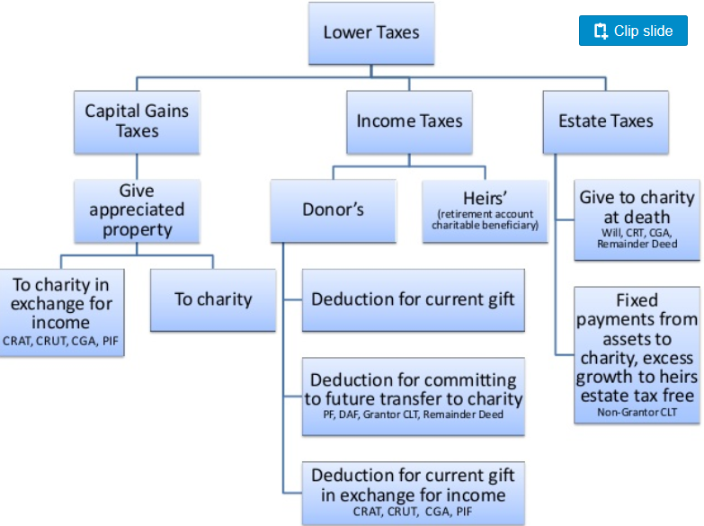

Slide 31
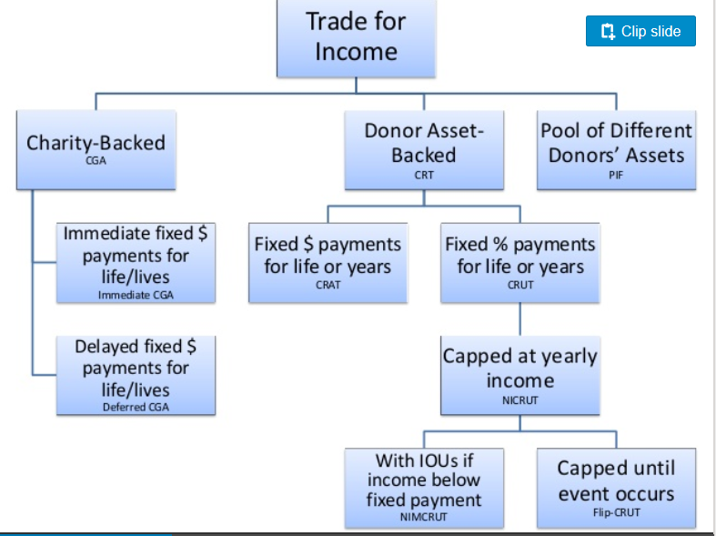
Trade for Income
Key: CGA – charitable gift annuity
CRT – charitable remainder trust, CRUT – Unitrust, CRAT Annuity trust,
NICRUT – net income makeup unitrust, Flip-CRUT
PIF – pooled income fund

Slide 33

What is a charitable gift annuity?
Contract with Charity…gift arrangement
Assets are irrevocably transferred
Donor receives fixed guaranteed lifetime payments
Payments begin immediately or may be deferred
Payments depend upon age, number of beneficiaries and type of annuity
Part Gift –
Part Investment

Slide 34
Gift annuity prospects research
American Council on Gift Annuities (ACGA) reports the average gift annuity is established by a 77 year old female donating $18,000 cash
  Donors with charitable intent
  Donors interested in fixed payments
  Donors interested in diversification of appreciated assets reduced/eliminate capital gains taxes
  Donors wishing to supplement retirement income

Slide 35

Immediate Payment
Gift annuity donor cycle
life
Beneficiary
Donor(s)
life
Payment
Asset
fixed
Annuity

Slide 36
Immediate Payment
Gift annuity donor cycle
Beneficiary
Donor(s)
life
Payment
Asset
fixed
Annuity

Slide 37

Flexible Deferred Payment
Gift annuity donor cycle
Donor(s)
Donor(s)
Target date
Age ranges for payments
Payment
life
Asset
fixed
Annuity

Slide 38

Types of gift assets
Life Insurance
Variable Annuity
Personal Property
Business Interests
  S - corp
  C – corp
Retirement Assets
  IRA
  Keogh
  Pension & Profit Sharing plans
  401k, 403b plans
Cash
Securities
Bonds - Corporate
Bonds - Municipal
Bonds - US Savings
Real Estate
  residence
  vacation home
  investment property
Mutual Funds

Slide 39


Annuity payment rates
Single Life
Age of Donor
60
65
70
75
80
Payment Rate
4.40%
4.70%
5.10%
5.80%
8.20%
Two Life
Age of Donors
60/60
65/65
70/70
75/75
80/80
Payment Rate
3.90%
4.40%
4.60%
5.00%
5.90%
ACGA rates effective since January 1, 2012,
renewed in 2016

Slide 40
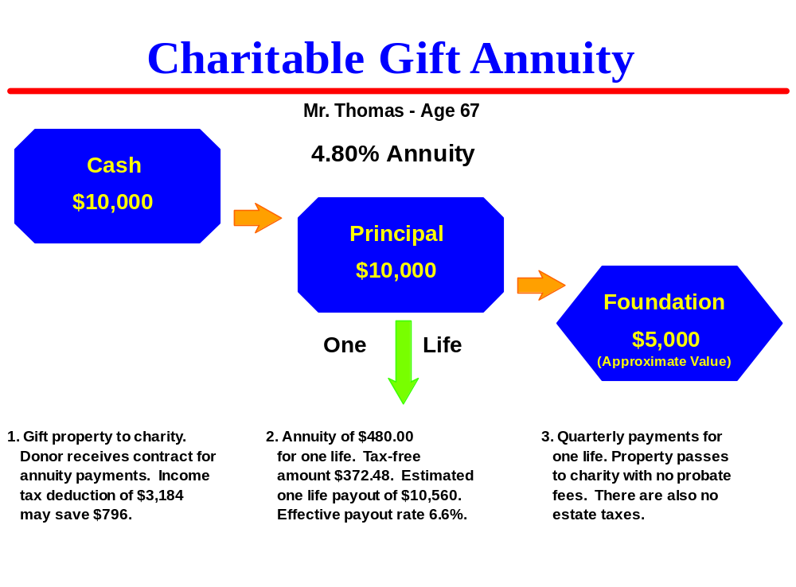
1. Single-life, immediate gift annuity -Cash

Slide 41
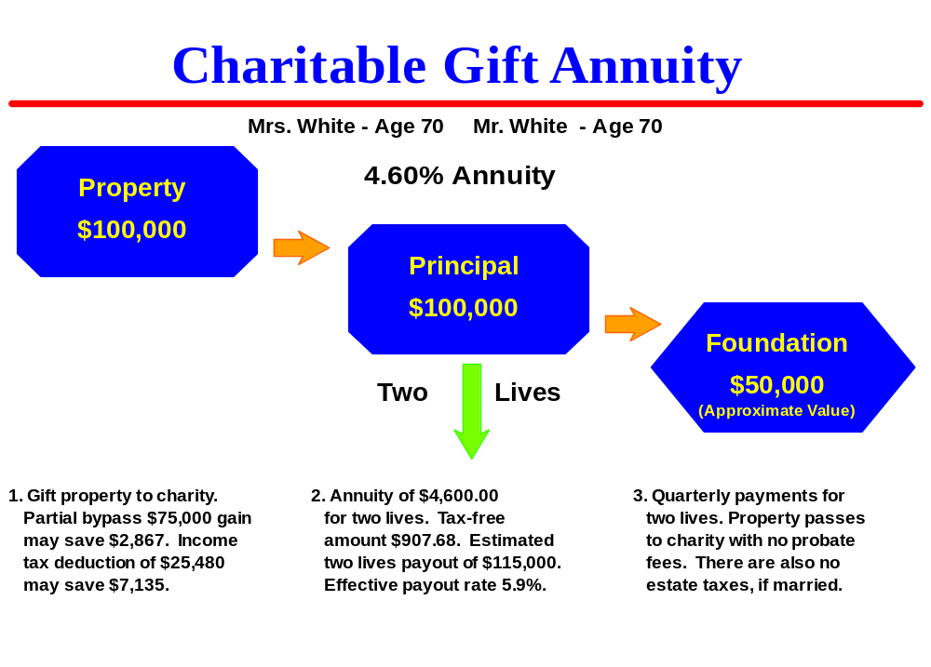
2. Two-life, immediate gift annuity –Appreciated stock
Cost basis $25,000

Slide 42
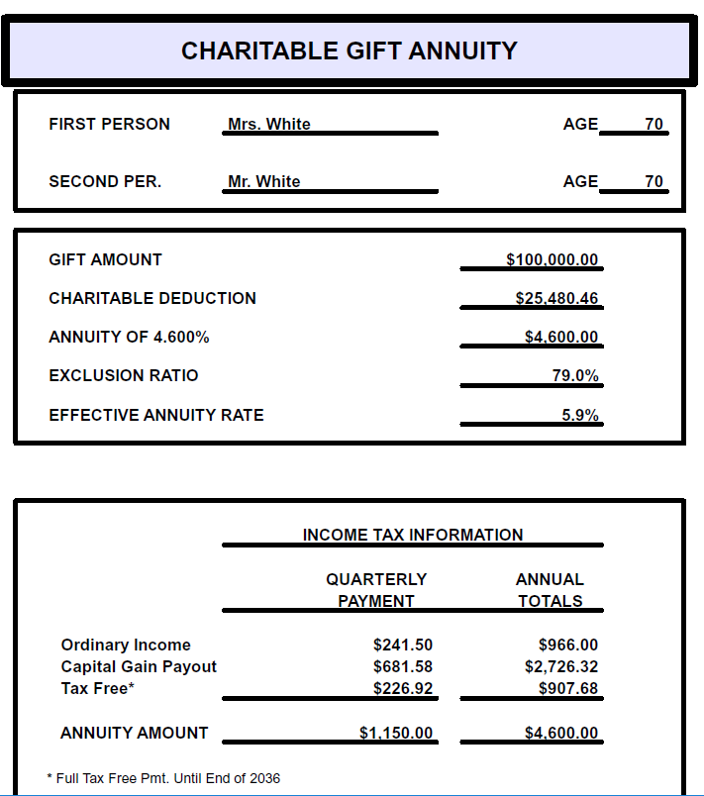

Slide 43
Gift annuity income enhancement- Stock
Prior to Gift
Invested in stock | $100,000
Dividends (2%) | 2,000
Tax (15%) | $300
Net spendable | $1,700
Capital if Sold
Fair market value | $100,000
Cost basis | 25,000
Capital gains tax (15%) | $11,250
Net capital | $88,750
After the Gift
Contributed | $100,000
Cost basis | $25,000
Payment rate | 4.60%
Total payment | $4,600
Ordinary income | $966
Capital gains | $2,726
Tax-free* | $907
Tax OI 28% | -$270
Tax CG 15% | -$408
Net spendable | $3,922
Bonus savings | $7,134
*tax-free to 2036
Notes:
Strategy 2: Comparison of Pre and Post Gift Annuity Financial Comparision

Slide 44
3. Tangible personal property CGA
Stamp and coin collections, artworks, antique autos
  Appraisal required, cost of selling considered
  28% tax rate if sold
FLIPCRT option if FMV is large
  No deduction for remainder interest, or income until sold
  Lesser of FMV or cost basis, adjusted for remainder interest
  CGA provides immediate payments and deduction
Related or unrelated use?
  CGAs and CRTs are unrelated uses
If sold capital gain related to the gift value reduces the charitable deduction
Alternatives: Bargain sale or installment bargain sale

Slide 45

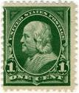
3. Tangible personal property CGA
Mr. and Mrs. Morgan, ages 88/89, have stamp collection appraised at $160,000 with a cost basis of $18,000
Charity creates a 4.0% CGA, (ACGA 7.7%)
Charitable deduction: $13,262 ($117,889)
Annual payments: $6,400.00
  Tax free: $618
  Cap gain: $4,853
  Ordinary: $929

Slide 46


4. CGA with life insurance
Rita, age 75 and Joseph, age 76
Rita has $10,000 paid up policy, bought in 1963, considerable cash value
  Gain if surrendered taxed as ordinary income
Cash value including dividends of $12,426
A cashed in policy results in a $7,008 taxable gain, $1,752 (tax 25%).
Cost basis $5,418
Notes:
IRA BALANCE
This chart illustrates the IRA balance for many individuals with substantial plans. In their 20’s, this person’s employer begins to contribute to a pension plan of one of the many different types available. Prior to age 59-1/2, the penalty period, the plan grows tax free. This tax free growth is actually a much better benefit than even the initial contribution of pre-tax dollars. Tax free growth greatly increases the total value of the plan and is the primary reason why plan balances are one of the most rapidly growing assets in many estates.
After 59-1/2, the plan owner can take withdrawals, but he or she chooses to leave the balance intact to maximize the benefit by age 70-1/2. While the employer contributions may cease at retirement age of 65, the plan continues to grow to age 70-1/2. Beginning at age 70-1/2 (actually by April 1 of the following year), the distributions must commence from the plan. However, since distributions typically begin at about 5.5-6% and many plans earn 8% or 9% or more, the plan actually may grow in size until the person is in his or her late 70’s or even early 80’s. While the distribution percentage increases each year, it may take 7-10 years for the distribution percentage to finally equal the annual income and appreciation of the plan.
Therefore, it is quite probable that the average person age 70 who lives to age 90 will still have perhaps 90% of his or her plan when he or she passes away. The plan balance has been an excellent concept, but there now is a significant estate planning problem that can have dramatic tax impact.

Slide 47
4. CGA with life insurance
Two life gift annuity payment rate is 5.1%
Annual payment $633.76
Charitable deduction is $1,838, only for cost basis in policy
Benefits: policy cash converted tax-free into lifetime income plus charitable deduction to offset in part tax liability, first annuity payments paid resulting tax
Notes:
IRA BALANCE
This chart illustrates the IRA balance for many individuals with substantial plans. In their 20’s, this person’s employer begins to contribute to a pension plan of one of the many different types available. Prior to age 59-1/2, the penalty period, the plan grows tax free. This tax free growth is actually a much better benefit than even the initial contribution of pre-tax dollars. Tax free growth greatly increases the total value of the plan and is the primary reason why plan balances are one of the most rapidly growing assets in many estates.
After 59-1/2, the plan owner can take withdrawals, but he or she chooses to leave the balance intact to maximize the benefit by age 70-1/2. While the employer contributions may cease at retirement age of 65, the plan continues to grow to age 70-1/2. Beginning at age 70-1/2 (actually by April 1 of the following year), the distributions must commence from the plan. However, since distributions typically begin at about 5.5-6% and many plans earn 8% or 9% or more, the plan actually may grow in size until the person is in his or her late 70’s or even early 80’s. While the distribution percentage increases each year, it may take 7-10 years for the distribution percentage to finally equal the annual income and appreciation of the plan.
Therefore, it is quite probable that the average person age 70 who lives to age 90 will still have perhaps 90% of his or her plan when he or she passes away. The plan balance has been an excellent concept, but there now is a significant estate planning problem that can have dramatic tax impact.

Slide 48
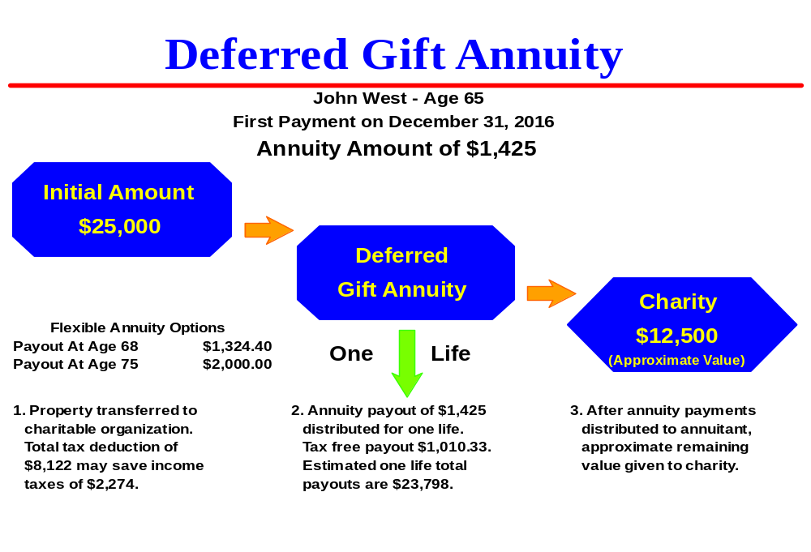
6. CGA with savings bonds
$5,000 bond cost $2,500, FMV $10,236, interest $7,736

Slide 49

7. Commercial annuities to CGA
DOB February 25, 1941, age 69, Married
Assets:
  2 USAA annuity contracts
  #1 FMV $23,988
    Taxable gain $13,988
  #2 FMV $17,057
    Taxable gain $7,057
  Total assets: $41,045
  Total gain: $21,045
  AGI $175,000
  Tax rates 33%, 15%
  Charitable intent
  Cash in annuity assets
  Offset gain with charitable gifts
  Possible immediate or future income
  No income for spouse
  Other charitable gifts this year

Slide 50
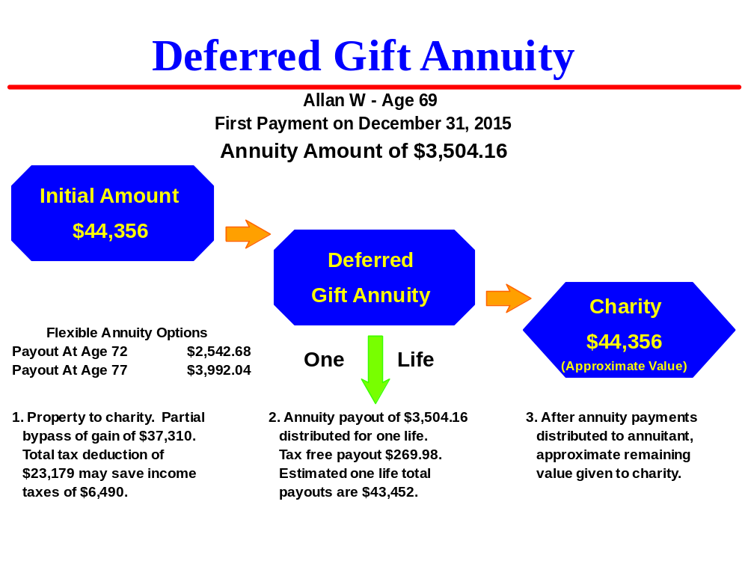
7. Commercial annuities to CGA
  2,600 shares Genworth Financial, FMV $44,356, Cost $7,045, Deduction $23,179

Slide 51
7. Commercial annuities to CGA
Deferred/Retirement annuity selected
Funded with appreciated stock
  2,600 shares Genworth Financial
  FMV $44,356
  Cost $7,045
  Deduction $23,178
  Deduction limit 30%

Slide 52

8. Mother – cash annuity for daughter
$6,971 life interest for daughter, right to revoke language

Slide 53

8. Mother – stock annuity for son
Cost basis $10,000
Reportable gain $28,314
Reportable gift $35,393

Slide 54

9. Real estate gift annuity
Former marketing executive
  one son employed by world bank in India
No gift annuity experience
David initiated call to retirement community on what they could do if they gifted home for life income
Preliminary attorney suggested gifts that were unworkable
  Charitable remainder annuity trust
  Appraisal issues
David and Peggy
Active retirees, ages 77 and 80
Moving from NC to MD into a retirement community for her health reasons

Slide 55
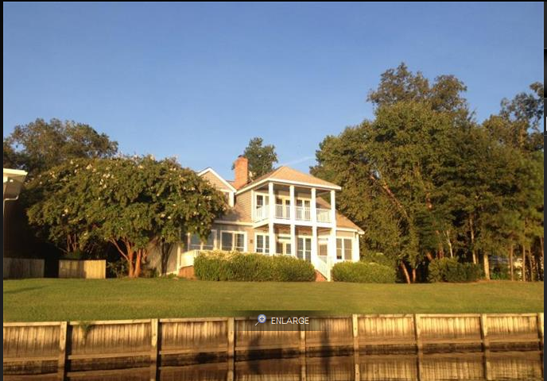
9. Real estate gift annuity
Elected $500,000 exclusion
Solution:
  90% to CGA
  10% outright gift
  5% payment rate (5.5% acga)
Appraisals:
  Donor appraisal $549K
  Charity appraisal $540K
  FMV for CGA, outright $549K
Deductions:
  CGA $232,844
  Outright $54,000
Payments: $24,705
  OI - $7,856
  Tax-free - $16,849
Home listed for sale, $650K, $625K, then $599K
Local attorney recruited for paperwork
One personal visit, balance by email and phone

Slide 57
What is a charitable trust?
Individually designed tax-exempt trust agreement
Assets are irrevocably transferred
Donor(s) or Beneficiaries receives fixed or variable payments for life or term of years
Payments are not guaranteed
Payments depend on rate selected with a minimum of 5% payout
(IRS regulation)
Payments depend upon type of trust selected
Part Gift --- Part Investment

Slide 58
Types of charitable trusts
Total return or standard payment CRT
  Beneficiary receives X% (minimum 5%) of the annual fair market value of the trust assets
  As the value of the assets increase or decrease the beneficiary payment increases or decreases
Income only CRT
  Beneficiary receives only the ordinary income (interest and dividends) generated by the trust investments
  Payments change as the income generated by the trust investments change
  May include a makeup provision when income would exceed the
  payout rate in future years
  Capital gains may be defined as income

Slide 59
Types of charitable trusts
FLIP Charitable Remainder Trust
  established first as an income only CRT which changes or FLIP’s to a standard payment or total return CRT upon the occurrence of a stated trigger event
  The trigger event may be a set date (age 65?), an event (death of spouse), or a combination of a date or event (age 65 or my remarriage which
  ever occurs first)
  Normally sale of asset

Slide 60
Types of charitable trusts
Charitable Remainder Annuity Trust
  beneficiary receives a fixed percentage or a set dollar amount of the initial trust assets (minimum 5%)
  no additions to the trust allowed
  Must pass 5% exhaustion test

Slide 61
IRS gives Annuity Trusts new life
Annuity trust qualifications
  5% payout
  10% charitable deduction
  5% exhaustion test
    AFR = assumed growth rate (currently 1.4%)
Qualified contingency
  “In application, this provision requires that at the beginning of each payment the trustee subtract the next payment from the current trust value. The remaining balance of the trust is then discounted at the interest rate in effect when the trust was created.”
  When less than 10% remainder trust terminates

Slide 62

9. Case study: Standard CRT
Donors age 73 & 71
Stryker Corp @ $54/share
Cost $0.44/share
Return $1.63/share, $3,260($2,771net)
2,000 shares transfer to CRT
Value $108,000
1,000 shares of Stryker stock recently traded @ $112 added to existing CRT

Slide 63
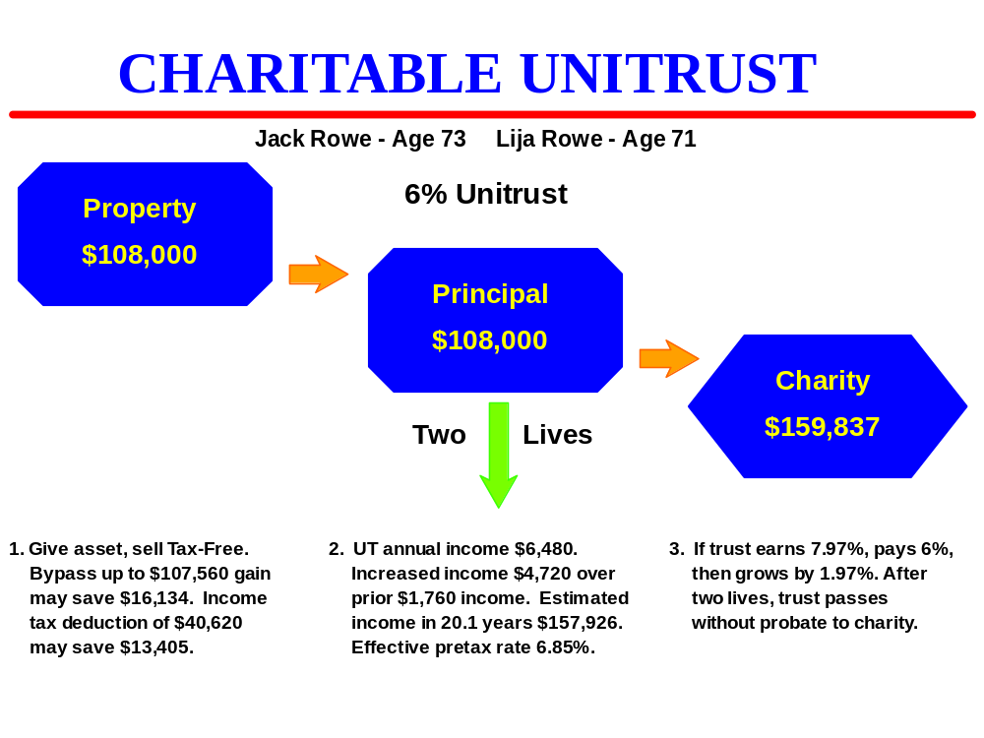
9. Standard payout unitrust @ 6.0%
No cap gain
Increased income
Decreased taxes

Slide 64
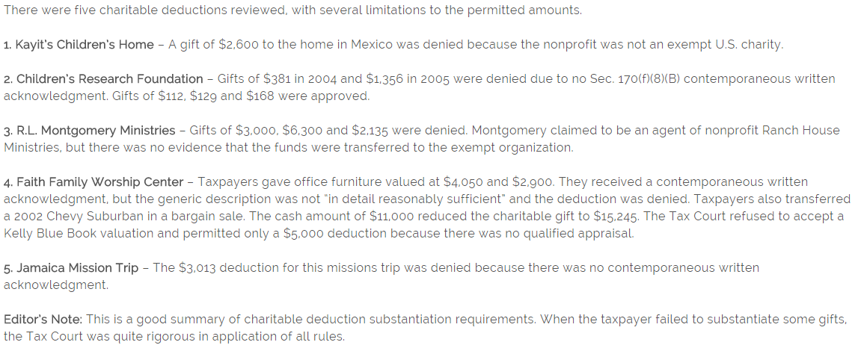
Gift substantiation on audit

Slide 65

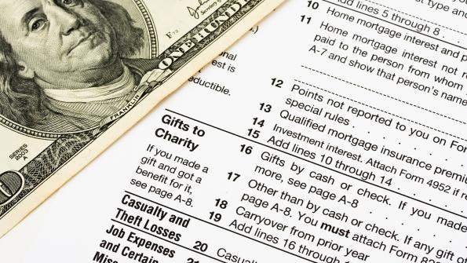

Changing landscape of charitable giving
September, 2016…
Thank You

