Slide 1
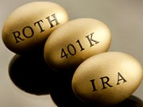

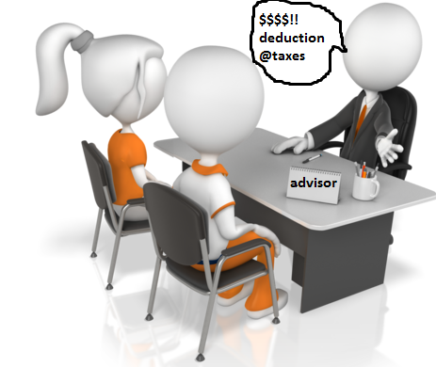
Qualified Charitable Distribution(QCD)
Professional Advisor Strategies
Testamentary Charitable Gift Annuities
James E. Connell FAHP, CSA
Charitable Estate and Gift Planning Specialists
P.O. Box 3335, Pinehurst, NC 28374
Email: jec42644@aol.com
Internet: www.connellandassoc.com
Copy of this presentation available at:
www.connellandassoc.com/articles.html

Slide 2
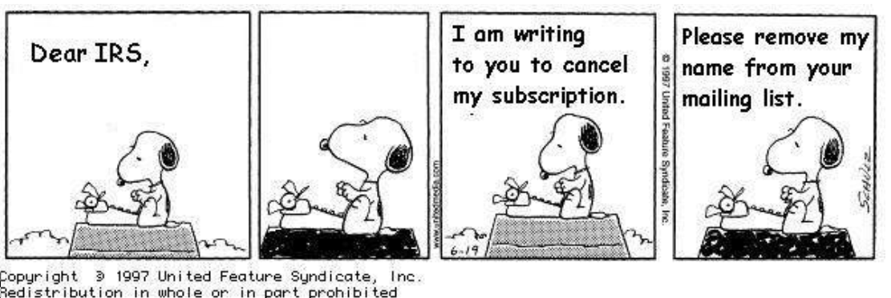
Snoopy and the IRS

Slide 3
5 things to know about RMD
You may begin to withdraw anytime after age 59 ½ in any amount for any reason
When you need to take your first RMD?
  For IRAs take by April 1 of the year after you turn 70½ ---regardless of whether or not you are retired.
    Taking in the year after means two RMDs in same year.
  For each year following must take RMD by December 31st.
  Take in one lump sum or spread throughout the year.

Slide 4
Which accounts require distributions?
IRAs
  Traditional
  Rollover
  SEP-IRA - Simplified Employee Pension
  Simple IRA- Savings incentive match plan for employees
Roth – do not require RMDs
Employer-Sponsored Retirement Plans
401k*
403b*
Governmental section 457 deferred compensation
*if working past age 70 ½ may be able
to delay until retirement

Slide 5
How do I calculate RMDs?
Calculated each year based on your current age and account balance at prior year-end
  Single or married – spouse or any beneficiary, Uniform Lifetime Table
  Married-life – spouse only beneficiary & more than 10 years younger, Joint life expectancy Table
If individual does not take 50% excise tax

Slide 6
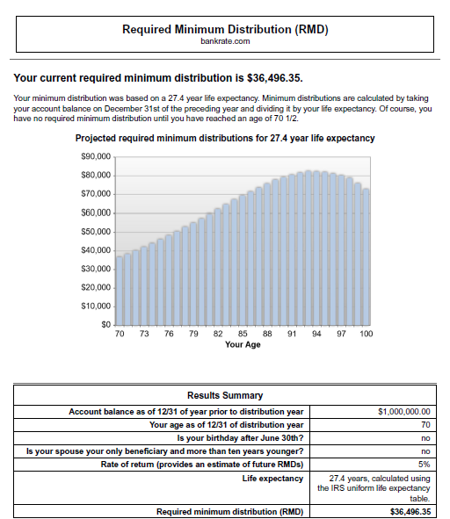

Slide 7

Multiple IRAs and RMDs?
1. Calculate RMDs for all accounts
2. Take RMD from each account OR
3. Take RMD from one account

Slide 8
What if I don’t need my RMD?
Reinvest the money in taxable account
Add money to rainy day fund
Invest in 529 plan for grandchildren
Be charitable:
  Outright gift
  Keep funds and make a stock gift to a DAF
  Do a Q ualified C haritable D istribution

Slide 9
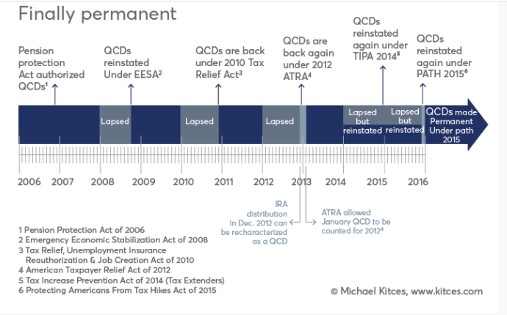
History of the QCD

Slide 10
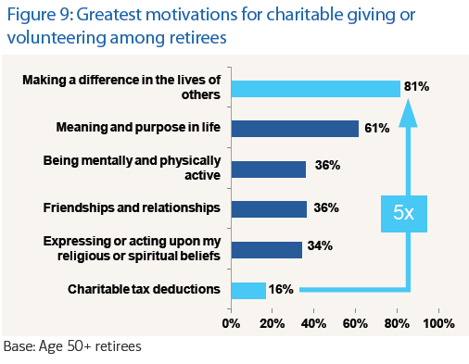
Retirees lead the nation in giving

Slide 11
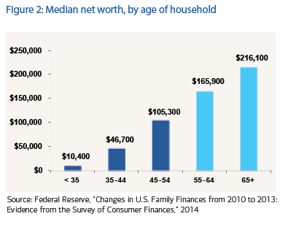
Retirees lead the nation in giving
80% of 65+
contribute to charity

Slide 12
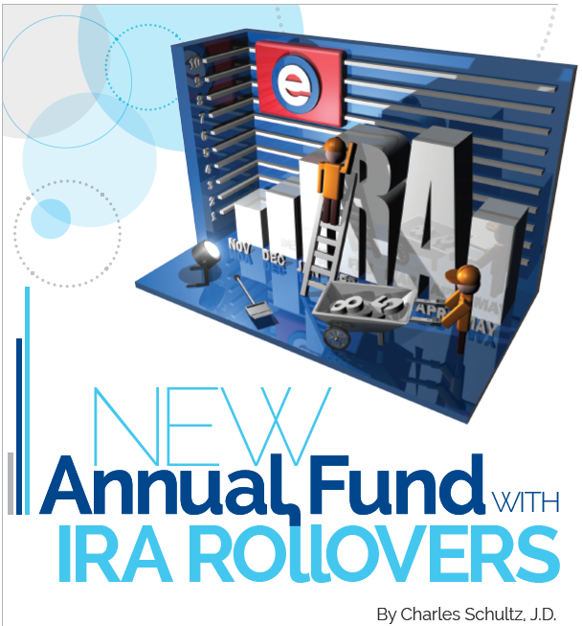

Slide 13
What to call it?
Fundraisers call it the “IRA Charitable Rollover”
  But it is not a rollover at all
  Rollovers are when an individual takes one retirement account and transfers the assets to another type of retirement account, normally an IRA account
Tax law names it the Qualified Charitable Distribution (QCD)

Slide 14
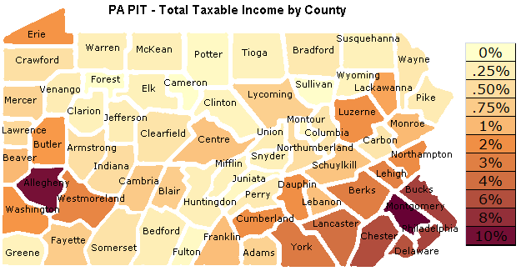
Pennsylvania income tax system
Pennsylvania does not tax Social Security benefits or any eligible Pennsylvania public or private pension plan
No tax on distributions from 401k, 403b, IRAs, deferred-compensation plans or other retirement accounts
Property taxes can be steep in some communities

Slide 15
Pennsylvania income tax system
Pennsylvania has one of the highest percentage of people age 65+ at 15% of the population
No deduction for charitable gifts
Charitable gifts receive only the Federal Income Tax benefits

Slide 16

IRA statistics
2.5 million people will turn 70 this year
First baby boomers take their RMD in 2016
  10,000 baby boomers turn 65 each year
$7.4 trillion invested in IRA account
  Vast majority of the funds are held by those over 65
Ed Slott: DOL fiduciary rules require advisors to explain the charitable rollover option to those who qualify: www.ira help.com

Slide 17
About the IRA Rollover Law(QCD)
On December 18, 2015, IRA rollover became permanent part of tax code
IRAs available for tax-free lifetime gifts
Donors must be 70½
Up to $100,000 per IRA holder per year
Satisfies all or a portion of an individuals required minimum distribution requirement (RMD)

Slide 18
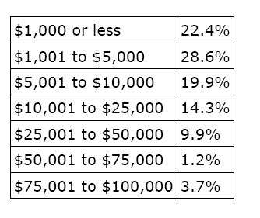
A Guide to IRA Charitable Rollovers(QCD)
5 Donor profiles
  Convenience donor
  Standard deduction donor
  Generous donor
  Major donor
  Social security donor
Amount received in IRA gifts
of Various Size
Notes:
While the IRA Chartable Rollover option for 2012 has been approved by the Senate it has yet to be fully approved by Congress.
It allows individuals in the RMD years to transfer up to $100,000 to charity without reporting the transfer as income. In essence individuals receive the full benefit of a charitable deduction with having it reported on their tax reports.
The single largest category of potential users of the IRA rollover strategy are those with sufficient IRA balances but do not itemize their taxes.
Only 32.5% of the 141 million tax returns filed by American taxpayers for the 2009 tax year (the latest year for which tax data has been released by the government) claimed itemized deductions (source: Internal Revenue Service).
There are several additional rules to make an effective IRA rollover gift and individuals should consult their advisors for full details.

Slide 19
A Guide to IRA Charitable Rollovers (QCD)
Allows for IRA distributions to charity
    Both regular IRA accounts and Roth IRA accounts (5 year rule) are eligible
    IRA checkbooks (must be payable to charity)
Charity must be eligible
Individual must be 70½ or older on the date of contribution
    Qualified Charitable Distribution (QCD) will qualify for the Required Minimum Distribution requirements of IRA
$100,000 limit
    $200,000 from couple with separate accounts
Transfers from other pensions and profit sharing plans, i.e. Keogh, 401k, 403b, etc., are not allowed
    Possible to rollover above accounts to IRA if plan and time permit
Notes:
The slide lists the basic requirements for an individual to be eligible and for a charity to receive a rollover from a IRA or Roth IRA account. It also lists those retirement plans which are not eligible for the transfer.

Slide 20
Charities and those not eligible
Charities must be public 501(c)3
  Eligible for charitable deductions under IRS section 170
No private foundations
No donor advised funds at community foundations
  Field of interest funds are OK
No supporting organizations classified as 509(a)3

Slide 21
A Guide to IRA Charitable Rollovers(QCD)
NOT permitted transfers/gifts, QCDs
  Outright gifts only
  No split interest gifts
    No charitable gift annuities (CGA)
    No charitable remainder unitrusts (CRT)
    No charitable remainder annuity trusts (CRAT)
    No pooled life income funds (PIF)
  No “quid pro quo” gifts
    No personal benefits
    No special events
    No athletic tickets

Slide 22
A Guide to IRA Charitable Rollovers(QCD)
Suggested procedures
  1. Notify charity of potential gift
  2. Instruct custodian/trustee of IRA on the proper form and if no form send a complete letter of instructions with payment/gift to the charity as a “third party payment”
  Transfer will be mostly cash but in-kind transfers (i.e. securities) are permitted
  3. Keep records of transfer
    substantiation from charity
  If appropriate, elect out of withholding

Slide 23
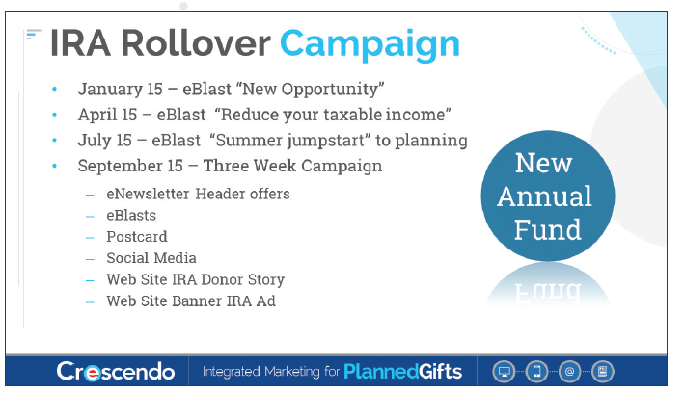
Marketing campaigns

Slide 24
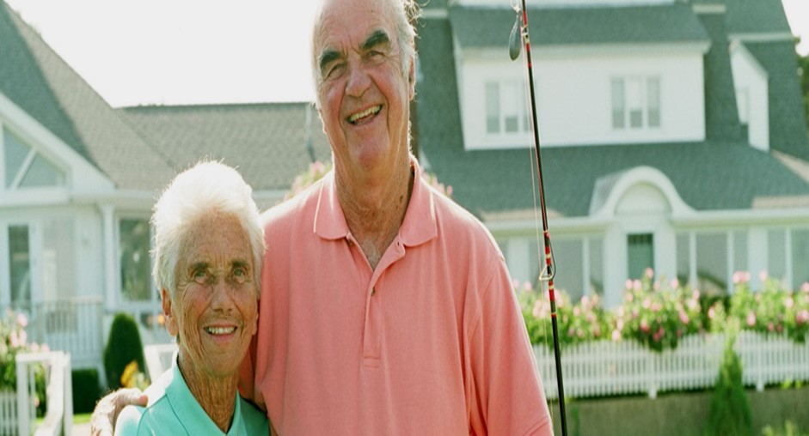
Questions to help donors decide
1. Are your planning to leave a charitable legacy through your estate plan?

Slide 25

Questions to help donors decide
2. Have your designated your favorite cause as the beneficiary of retirement assets?

Slide 26
A Guide to IRA Charitable Rollovers(QCD)
Donor Profile – Convenience Donor
  Most delay taking distributions until the last quarter of the year in order to grow the invested funds tax-free
  If actively making charitable gifts may consider the benefits of making gifts from their IRA account(s)
      No inclusion in income
      No income tax deduction
      Qualifies for RMD

Slide 27

Questions to help donors decide
3. Have your retirement savings and investments growth exceeded your expectations?

Slide 28
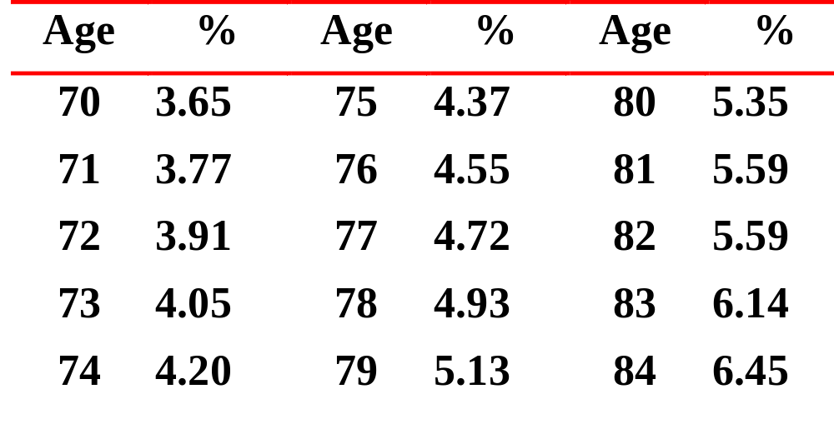
Required Minimum Distribution (RMD)
IRS table percentages

Slide 29
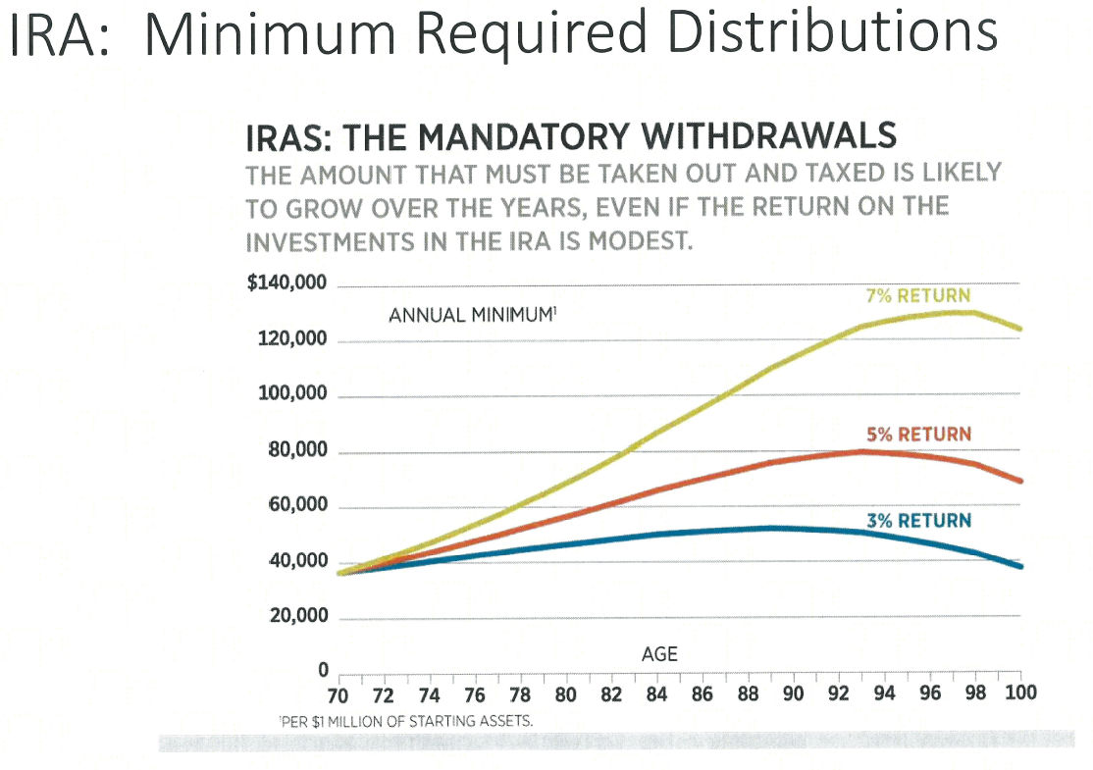

Slide 30
Questions to help donors decide
4. Are your itemized deduction reduced by 3% because of the reduction on itemized deductions for higher income individuals?
For example: A married couple filing jointly has $500,000 in adjusted gross income (AGI) and because their AGI exceeds the $305,050 threshold, the 3 percent reduction applies to this couple’s itemized deductions.
AGI $500,000
Excess of couple’s AGI over $305,050 = $194,950
3% reduction x 3%
_______________
Reduction of itemized deductions $5,848.50

Slide 31
Questions to help donors decide
5. Do you take the standard deduction on your tax return and make annual gifts to your favorite charities?
For example: the standard deduction for a married couple is $15,100 in 2016; if donors have no mortgage and low state/property taxes, they may not itemize and deduct charitable contributions—the new law allows for charitable contributions from IRAs to be excluded from income which is a special advantage for non-itemizers.

Slide 32
A Guide to IRA Charitable Rollovers(QCD)
Donor Profile – Non-Itemizers
    May be donors with modest IRA account balances, but sufficient retirement income from personal investments and tax-exempt accounts
    Taking MRD may not significantly increase their lifestyle
    Do not have significant tax deductions
      State and local income taxes
      Interest expenses
      Medical expenses
      Charitable deductions
    So the standard deduction applies (2016), over 65
      Married/Joint - $13,850 one / $15,100 two
      Single - $7,850
      Head of household - $10,850
Notes:
Non Itemizers are the most significant group who should consider the IRA rollover option.
Only 32.5% of the 141 million tax returns filed by American taxpayers for the 2009 tax year (the latest year for which tax data has been released by the government) claimed itemized deductions (source: Internal Revenue Service).

Slide 33
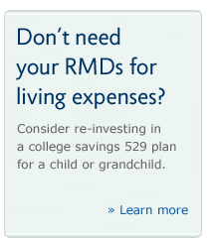
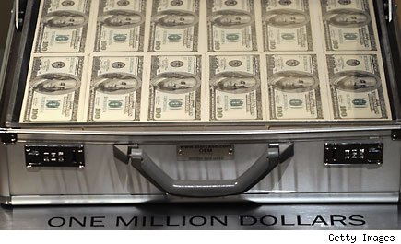
Questions to help donors decide
6. Do your take minimum distributions from your IRA but have adequate alternative sources of income?
  You do not need it for your lifestyle!
For example: By age 70 ½, individuals must start to withdraw funds from their IRAs based on an IRS schedule, a 75 year old with $1,000,000 in IRAs must distribute at least $44,000.
TRowe Price suggestion

Slide 34

Questions to help donors decide
7. If you take greater distributions from your retirement plans, does doing so affect the amount of Social Security benefits that are taxed?
For example: provisional income < $32,000, no tax on SS;
$32,000 to $44,000, 50% of SS is taxable; greater than $44,000, 85% of SS is taxable

Slide 35




Questions to help donors decide
8. Is there a special cause you care about?
Would you like to benefit your community?
Do you want your charitable gifts to have the greatest impact?

Slide 36
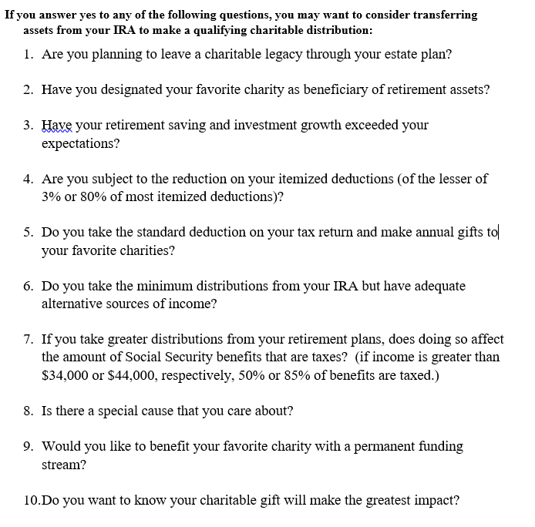
Sample questionnaire

Slide 37
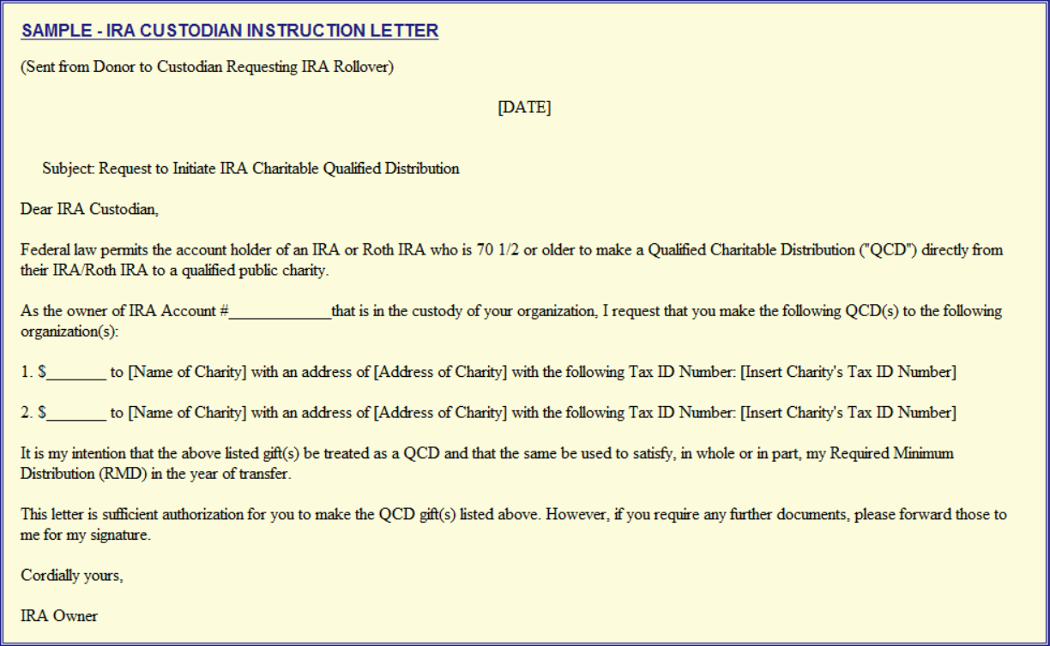
Custodian notification letter

Slide 38
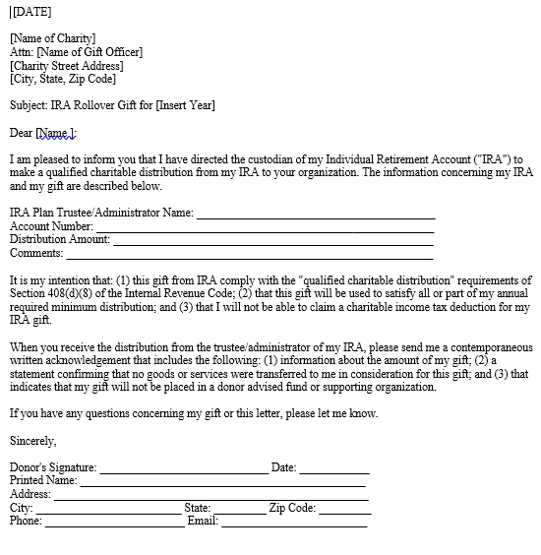
Charity notification letter

Slide 39
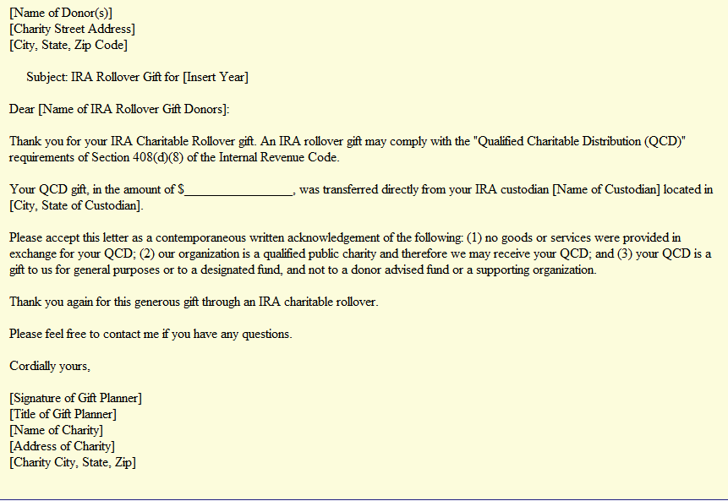
Charity acknowledgement letter

Slide 40

IRA Legacy act: the future
Legacy IRA Act (HR 5171), proposed federal legislation that would significantly expand the current-law IRA Rollover (QCD) to allow for life-income gifts, including charitable gift annuities and charitable remainder trusts.
CGAs and CRT, no PIF
$400,000 ceiling for 65+ individuals
Minimum payout 5%
Payments: all ordinary income – no tax-free
4 year trial period
Cost: $100 million over 10 years

Slide 41
QCD – pledges and delivery
IRA Rollovers To Pay Pledges – Because the IRA funds are owned by the IRA owner, they may be used to fulfill a legally-binding pledge. The transfer from the IRA owner to the charity is treated as a receipt by the owner under Sec. 4975(d)(9) and therefore the IRA rollover is not a prohibited transaction.
IRA Owner Delivers Check – Most IRA custodians transfer IRA rollover funds by check or electronic transfer directly to the charity. However, some IRA custodians issue a check payable to the charity, but send the check to the donor for forwarding to the charity. This transaction will still qualify under Sec. 408(d)(8)(A) as an IRA rollover if the check is issued payable to the charity and the owner delivers the check prior to December 31 of the applicable year.
IRA Custodian May Rely on IRA Owner Representation of charity

Slide 42

IRA and split interest agreements
Q. Can I transfer my funds directly from my IRA and establish a…..
  Charitable gift annuity?
  Charitable remainder unitrust?
A. Yes and NO….let me explain

Slide 43

IRA and split interest agreements
NO…there may be no direct transfer of funds from your IRA to a charitable gift annuity (CGA) or charitable trust (CRT) without first receiving and reporting taxable income from your withdrawal
YES…you can set up a CGA or CRT
  Q. Will it be a tax smart transactions?

Slide 44
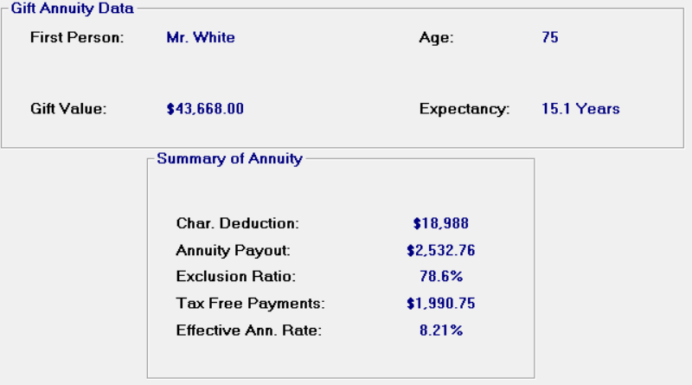
Mr. White age 75 has $1,000,000 in his IRA. The MRD is $43,668 in 2016.
The one-life rate for a CGA is 5.8%
The charitable deduction is $18,988
$24,680 taxable unless offset by other charitable deductions

Slide 45
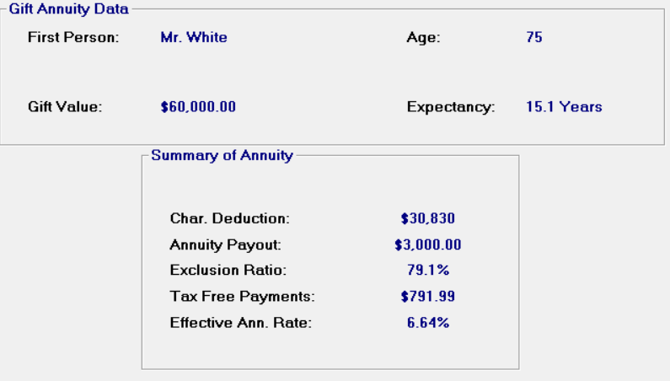
Mr. White age 75 has $1,000,000 in his IRA.
He has $60,000 in Apple stock, cost $20,000. The MRD is $43,668.
The maximum one-life rate for a CGA is 5.8% but Mr. White accepts 5.0%
The charitable deduction is $30,830
$12,838 taxable unless offset by other charitable deductions

Slide 46
Sara, age 62 has seen her IRA grow to over $750,000. She wants to make a $10,000 gift to charity this year.
Sara may withdraw $10,000 from her IRA to make the gift
Sara reports the IRA withdrawal as income added to her wage earnings and investment income
Sara taxes a $10,000 - 50% of AGI charitable deduction, a tax wash
Is this a smart transaction?
  What is she giving up?

Slide 47

Advisors

Slide 48
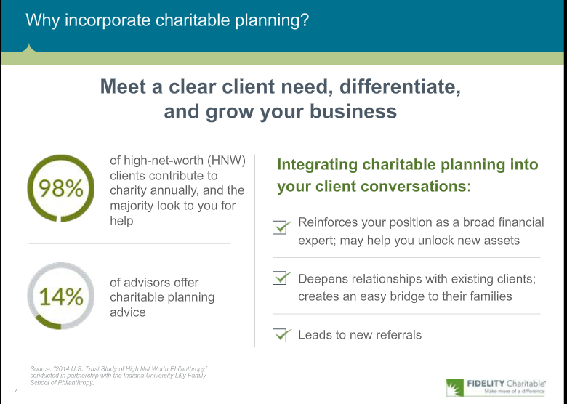
Fidelity Charitable:
Webinar for financial advisors

Slide 49
Professionals are invaluable for several reasons
1. Number of cultivation and solicitation visits a PG officer can make by themselves are limited
2. Professionals may speak on behalf of your charity in ways a paid staff never can
3.Philanthropy is now a wealth management tool for high net worth individuals (HNW)
  “Philanthrocapitalism” - 80% of HNW individuals give time, money and expertise to good causes (Source: Scorpio Partnership)
3. Professionals give you access to individuals otherwise out of reach to PG officer

Slide 50

Professionals are invaluable for several reasons
4. Professionals provide continuity and will remain committed to the charity long after paid staff has left
5. Professional inspire others by example
  Promoting practical planned gift strategies which fit into the donor’s financial and charitable goals
6. Professionals are prospects themselves
    Top prospects for flexible deferred CGAs

Slide 51
Survey says: Involve professionals for the right reasons
1. PGO must demonstrate competency and instill confidence in your ability to work with professionals and their clients
2. May give visibility and exposure to charity and its work
3. Have a broad base of current contacts with relationships that may open doors
4. Possible assistance with areas of law, money management, insurance, banking and accounting

Slide 52
Survey says: Involve professionals for the right reasons
5. Possible training for higher leadership positions
6. Participate in ad hoc committees to help develop events for prospects and other professional
  Be seminar participants themselves
  Attend events and encourage their peers to attend
7. Must be able to put own economic self-interests aside

Slide 53
Survey says: Involve professionals for the right reasons
8. Involved professional may prevent the “torpedo” of your gift proposal
  Modification to prevent lost or severely altered plans
9. Targets of opportunity for sponsorships of seminars, etc.
10. Not every charity is a candidate to form a PAC

Slide 54
Agents of Wealth
Successful program tips
Identify professionals with appropriate mindset and skills
Recruit using roles and responsibilities
Educate at each meeting on mission and tools and techniques
Involve in mission event
Recognize by giving tasks to complete
Reward find ethical ways to compensate
Crescendo presentation on website
  www.connellandassoc.com/articles.html

Slide 55




Slide 56
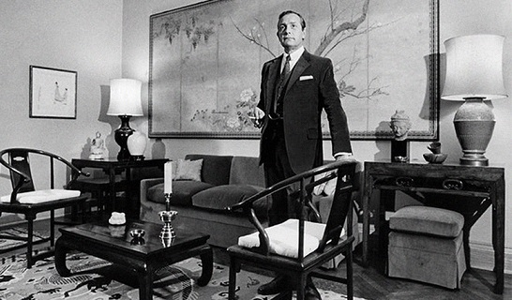
Testamentary CGA
Will, Trust or IRA beneficiary designation provides funding of a CGA for named beneficiary, one or two lives
Funding assets could be a specific amount or percentage of estate or a named asset/account
IRA funds are IRD assets
  Subject to income and/or estate taxes
Annuity may be immediate or deferred

Slide 57
Testamentary CGA
Prospects are individuals who wish to provide income but not assets to friends or family
Supporters who have previously established
  Scholarships
  Endowments
  Named facilities
Maybe their only CGA

Slide 58
Testamentary CGA
Sample language
Sample language: "I give to the Habitat for Humanity of the NC Sandhills, a North Carolina not-for-profit corporation, federal tax ID Number 56-1596170, located in Aberdeen, North Carolina the sum of $10,000, provided Habitat shall pay an annuity to my spouse, Mary Doe, 123 Main St., Pinehurst, NC, DOB 11-12-42, during her lifetime at the then rate being paid by Habitat to annuitants of my spouse’s age and sex at my death.
The annuity shall be non-assignable.
The payments are to be made quarterly and shall end with the quarterly payment, preceding my spouse’s death. I intend to make a charitable gift to Habitat and to provide an annuity for my spouse.
If Habitat has no annuity program or for any other reason is unable to obligate itself to make annuity payments to my spouse, I give $2,000 to Habitat for its general purposes and direct my executor to purchase for $8,000 from a life insurance or annuity company of good standing in the United States a non-assignable annuity contract providing for the payment of an annuity, quarterly, to my spouse during her lifetime at the then rate being paid by such company to annuitants who are my spouse’s age and sex at the time of the purchase of the annuity. If my spouse does not survive me, I give $10,000 to Habitat for general uses and purposes.

Slide 59

Testamentary CGA
Joe Shafer Estate
Joe Shafer died June 3, 2016, age 87
  Dorothy spouse died in 2008
  No children, many loving friends
Worked at Sears, Roebuck & Co, Atlanta from 1945, retired 43 years later as Warehouse Manager
  Started at $0.57/hour
Master Mason for over 60 years
On board of Gwinnett Hospital Authority
  Modest long term supporter, board members knowledge
  PG chair visits with Foundation Ex. Dir.
IRA beneficiary designation
  Shared with school system foundation
  $3.5 million largest single gift to Gwinnett Medical Center

Slide 60
Testamentary CGA
Joe Shafer Estate
December 2011 - gift and endowment agreement signed leaving his IRA to Gwinnett Medical Center(GMC ) to establish the Dorothy Shafer Healthcare Endowment
December, 2012 - Testamentary CGA bequest wording supplied to Joe & Atty. for Clark TCGA
March, 2014 – attorney supplied wording to GMC as updated with additional Brennan TCGA
Last probated will dated June 1, 2016
Ultimate TCGA residuum to Dorothy Shafer Healthcare Endowment

Slide 61
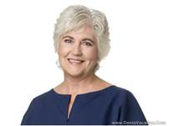
Clark – TCGA specifics
Clark dob 6-18-1950 (65)
  ACGA rate: 4.7%
  Georgia resident, friend & caregiver
  LE 24.6 yrs
$900,000 from Edward Jones Act.
  If less than $900,000 no make up
  “Rate paid by Foundation annuitants at time of my death, quarterly”
Payments commence when funded

Slide 62
Clark – TCGA specifics
Foundation option:
  If no annuity program or for any other reason does not want obligation….
  Give to Foundation the lesser of $450,000 or 50% of Edward Jones Act.
Executor responsibility:
  $450,000 or 50% Edward Jones Act.to purchase commercial annuity
  Death benefit of annuity to GMC

Slide 63

Brennan – TCGA specifics
Brennan dob 5-4-1948 (68)
  Rate: 5.0%, ACGA rate 4.9%
  Florida resident, sister-in-law
  LE 22.8 yrs
$1,000,000 from Merrill Lynch Act.
  If less than $1,000,000 no make up
  “Rate paid by Foundation annuitants at time of my death, quarterly”
Payments commence when funded

Slide 64
Brennan – TCGA specifics
Foundation option:
  If no annuity program or for any other reason does not want obligation….
  Give to Foundation the lesser of $500,000 or 50% of Merrill Lynch Act.
Executor responsibility:
  $500,000 or 50% Merrill Lynch Act.to purchase commercial annuity
  Not to exceed $50,000/year
  Death benefit of annuity to GMC

Slide 65
Issues
What was Joe’s intention?
  Income beneficiaries vs GMC endowment?
GMC not registered in Florida for CGAs
Present value analysis
Responsibilities of executors
Investment advisors on accounts
Residuum of estate goes to Community Foundation

Slide 66


Qualified Charitable Distribution(QCD)
Professional Advisor Strategies
Testamentary Charitable Gift Annuities
Thank You

Slide 67
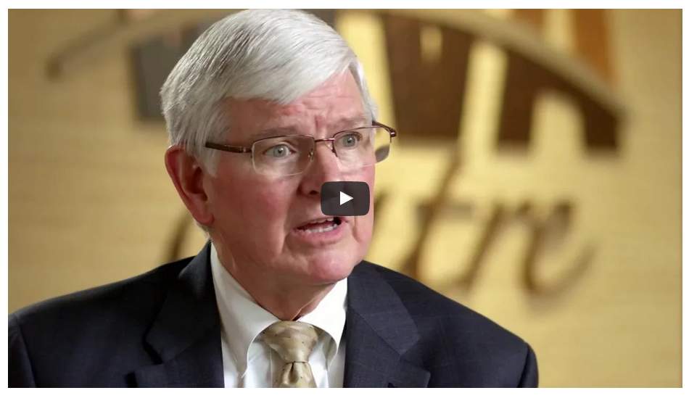
Video on QCD
http://www.goodnewsqcd.com/
Greg Pierce & CPA interview

