Slide 1
Creating an Omnipresent Legacy Bequest Program
James E. Connell FAHP, CSA
President, Connell and Associates
james@connellandassoc.com
March, 2020
Notes:
The Silver Tsunami is here and hospice providers need to take advantage of the biggest generational wealth transfer in U.S. history will boost heirs and charities.
Over the next 25 years, boomers will pass along nearly $48 trillion in assets to their heirs and charities, and Generation X will be the biggest beneficiary.
The Boston-based global research and consulting firm found that boomers will account for 70 percent of the $68 trillion in wealth that will be transferred by U.S. households during that period. Americans ages 50-plus to 70 will distribute some funds while they’re still alive, in the form of gifts and charitable donations, transferring the rest through bequests after their deaths.

Slide 2
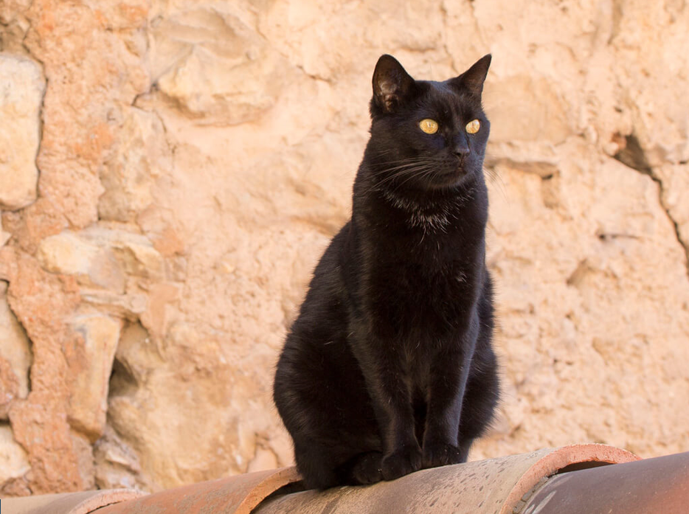
Woman leaves $13M fortune to pet cat
“Without putting in the hard work of generating planned gifts - 90% of donor mortality will simply result in lost current giving”
Only 5.3% of older Americans have made a charitable bequest commitment
While 33% are willing to consider such a gift
(source: Russell James)
Tommaso the Italian Cat, from the streets of Rome
to a villa in Milan and Calabria
Notes:
Meet Italy’s richest cat TOMMASO.
American is a generous society with gifts made during life and at death as noted 5.3% are the result of charitable bequests at death.
Today the majority of legacy gifts will be made from non-taxable estates.
The key for hospice is to put in the hard work to generate legacy gifts using the multiple contact and communications methods. Many prospects are willing to consider including hospice in their legacy plans if they are informed as the multiple methods they can use.
The major target for legacy gifts will be existing donors and their extended family members and partners.

Slide 3
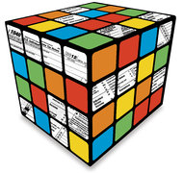
Agenda
Bequest demographics, facts and figures
Traditional vs Planned giving
Predictive factors
Bequest options
FreeWill.com
Marketing matrix
Sample marketing opportunities
Notes:
This slide shows what I am going to cover. It is important to note legacy planning mostly a contact process involving the donor, selected advisors and hospice personnel.
I want you to understand the big picture of planned giving, as well as, the special target of bequest opportunities.
I will finish with several marketing suggestions to consider as you expand your legacy gifts program.

Slide 4
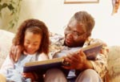

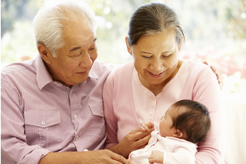
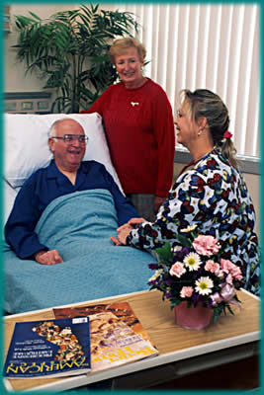
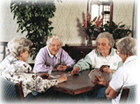
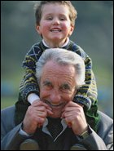

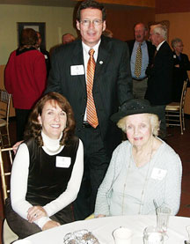
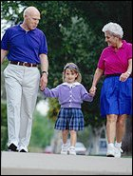


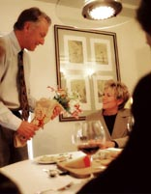
Prospect Goals
Notes:
Individual stories of some of the donors I have worked with (pictured here) indicate their special connection to the charities they supported. Some have received special recognition provided.
With their support they have fulfilled both their personal and financial goals. Lifetime giving is a major indicator of legacy giving.
They represent all financial situations, lifestyles and motivations.

Slide 5

Love takes action – agape https://www.newyorklife.com/who-we-are/agape
New York Life Insurance advertisement
“The ancient Greeks had four words for love.
The first three — philía, storgē, and érōs — describe the different kinds of love that people feel. But there is one love that stands out above the rest.
Selfless love. It’s called agápē (ah-gah-peh) — love as an action. Agápē is what inspires us to put others' needs before our own. It's about doing what's right, being our best selves, and building better futures.
Notes:
I would encourage everyone to review the commercial created by New York Life. It represents the kind of feeling and promotion hospice should consider in their promotional activities moving forward.
Some of the advertisement verbiage is listed above.
Legacy giving is an selfless love and action we do for others and not for ourselves.

Slide 6
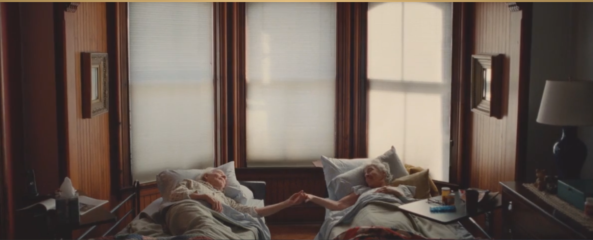
“….act on your love….. so looking back…you got it right”
Notes:
This is a powerful picture. It represents two seniors expressing their love and support for each other.
Whatever their estate plan was it included a recognition of life has many stages and challenges. When they reach the final stages of life they are content with all their planning. They could look to the future with contentment and smile and know they got it right.

Slide 7
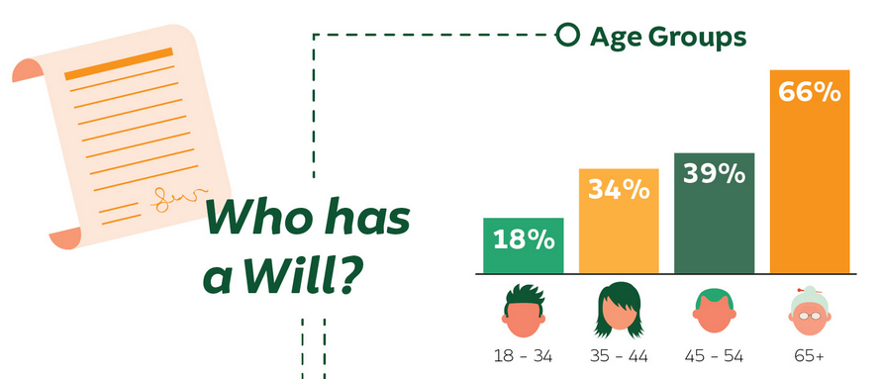
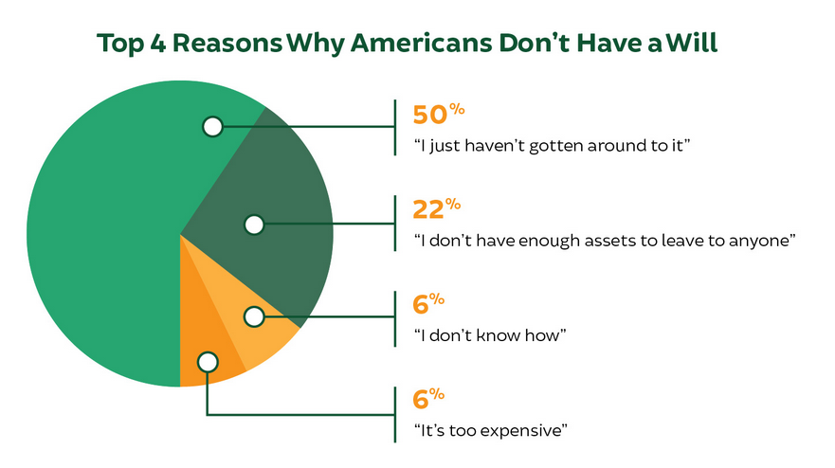
America’s estate planning
57% percent of U.S. adults do not currently have estate planning documents such as a will or living trust (Caring.com, 2019)
https://www.caring.com/caregivers/estate-planning/wills-survey/
Notes:
Many in USA do not plan for the distribution of their life’s work: the assets they have accumulated of a lifetime of involvement in our society.
While there are many ways to transfer assets to others one of the primary ways is to have a will or revocable trust document. We will discuss many of the ways in other slides.
(A will is a legal declaration of a person's wishes regarding the disposal of his or her property or estate after death) (A revocable trust is a trust whereby provisions can be altered or canceled dependent on the grantor. During the life of the trust, income earned is distributed to the grantor, and only after death does property transfer to the beneficiaries.)
Individuals have three stages of their financial life: Accumulation, Conservation and Distribution. A will or trust is the basic planning document appropriate at all stages.
While individuals have many excuses for not making a will it is a necessary document at all stages of life.

Slide 8
Three parts to a successful bequest program
Motivation
  Establish strong mission messaging to build motivation to give back
  Know your likely prospects
  High motivation strong indicator of potential bequest option
  Build a program of assistance
  “Gratefulness is not eternal”
    Hospice donor from Pennsylvania
Persistence
  Building program slowly
  Start with Legacy Society
  Add wills and bequests basics
  Investigate life income agreements as appropriate
Consistency
  Establish annual promotional plans
  Use found opportunities to leverage messaging
Notes:
As indicated in this slide there are three keystones to a successful charitable estate planning program: Motivation, Persistence and Consistency.
Your hospice provides Motivation to gain charitable support in every message and communication it sent to the public. The main channels for promoting estate commitments will be direct mail appeals, postcard promotions, social media messages, and your website information. Examine each communication carefully to determine you sending positive messages for future gifts and you contribute positively to the well being of your community.
Once you provide service to a family remember “Gratefulness in not eternal” You must have a robust bequest program so it is visibly present to spouses, partners and family members because each has to go back to the planning table to look at their estate arrangements and revise accordingly. Your bequest program must be present at the planning table.
Persistence: No one message or one program will be responsible for your programs success. You must use multiple messages and activities to garner your share of bequest support.
In order to be truly successful a hospice must be Consistent with its message. If you are updating your materials be sure your message is consistent with past communications. Repetition leads to understand for most individuals.

Slide 9
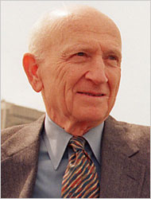
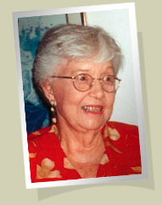

Life cycle giving
Financial Life
Charitable Life
Notes:
Every charitable estate planning program must realize to be successful your message must be present when either financial motivation or charitable motivation changes because of life events.
Financial capacity can vary for high to low as will motivation to support hospice and/or other charities.
For ay outfight gift, life income gift or bequest program to be successful it must be consistently presented to donors and it must fit into the fabric of their financial and charitable life.
The magic gift moment occurs when the nature of the financial life meet the motivation of the charitable life and then gifts happen.
A personal example would be when my first spouse died it forced me into a single tax bracket. She was a hospital administrator. The single bracket tax was significantly higher than the married tax brackets. I was the beneficiary of a six figure life insurance policy (received income tax free). I had the motivation to something for hospital so established a $100,000 college scholarship for employees children pursuing healthcare professions.
Surviving spouses or partners of patients served by hospice are a top prospect for future bequest support.

Slide 10


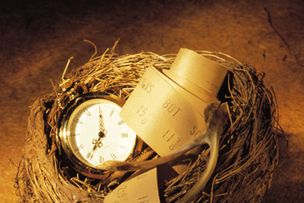
Three kinds of gifts
OUTRIGHT
GIFTS
ESTATE
GIFTS
LIFE INCOME GIFTS
Immediate
gifts & QCDs
Bargain sale
Installment
bargain sale
Retained
life estate
Will or Trust bequest
Beneficiary designations
Life insurance
Retirement plans
POD or TOD
Gift annuity
Charitable
trusts
Notes:
There are only three types of charitable gifts. Outright, life income and bequests. Each one has different benefits and various means to complete.
While the nature, timing and amounts of gifts will vary greatly bequests arrangement are by far the most popular types.
Bequests allow a person to control their assets until their death. Because the will, trust or other bequest arrangement may be completed in uncertain times the benefit of control of assets provides an extra level of comfort and financial security to most individuals.
We will cover various types of estate bequests in upcoming slides.
As you move forward to establish a life income program with gift annuities or charitable trusts those members of your legacy society will be top life income prospects.

Slide 11
Blended gift strategies
Something Now
Maximum current giving
$1,000
Something in Between
Charitable gift annuity
$50,000 for life income
Something Later
Will/Trust
IRA/Retirement plan beneficiary
Cash
Life insurance beneficiary
Estate gift of $100,000
Funded with mutual fund
Securities
Notes:
As your move forward with your program you may find individuals willing to consider a blended gift approach to meet certain campaign or endowment goals.
A blended gift may involve an outright gift today with a promise of an estate bequest. Another example may be an outright gift today, a gift annuity to provide income and tax benefits, and an estate promise.
Sometimes, as the below example from a recent Duke University March 2020 email report on gifts shows endowments and scholarships are established by the solid relationships built on multiple gift annuities and capped off with a bequest arrangement. “A $250,000 bequest from Mary and Rolf Shepard will endow a scholarship from their estate for the School of Nursing. The fund will also benefit from 15 $10,000 charitable gift annuities the Shepards established over the past 15 years.”
Another personal example. My client Chapters Lifepath Hospice, Tampa, FL was the beneficiary of 9 gift annuities totaling $251,300 from Fred Wiswall who left also left $1,000,000 from his estate. The wording of the bequest was very specific his lifetime gifts should be subtracted from his estate commitment. Fortunately, the gift annuity portfolio produced more remainder than the initial gift amounts and so his estate gifts exceeded $1,000,000. Lifepath named a building in his honor.

Slide 12

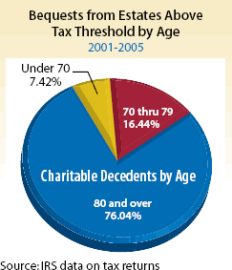
Estate tax basics
2020 individual basic exclusion amount $11.58 million
  Couple basic exclusion amount $23,160,000
Transferred assets receive a step-up in basis, no gain is tax at death
Charitable bequests of all types are exempt from taxes
$675,000 (2001)
$1.5 million (2005)
$5.4 million (2017)
Notes:
Here are the current estate tax rates for 2020. The current exemption amount is $11.58 million per person. With the 2018 tax law changes in the estate tax exemption amount means less then 2% of US taxpayers will be subject to estate taxes. Previously with lower exemption amounts avoiding estate taxes was a motivator for many individuals to consider charitable gifts rather than support the government. This motivator is no longer a major factor in estate planning except for the high net worth individuals.
One reason bequests to family and friends are a popular planning techniques is assets bequeath to others receive a step up in basis. An example: 100 shares of Apple stock purchased at $10 a share and transferred by bequest at an estate value of $100 has the new $100 basis when sold. All property transferred to heirs receive a step up in basis.
Most of the bequest support to hospice will come from nontaxable estates. The bulk of charitable bequests come from the older ages with most being over the age of 80.
If you would like to learn more about how the estate tax system works you can copy and paste the following link from the Tax Policy Institute into your browser (Note: the charts only go to 2018) If you need a current chart brochure on Income, Estate and Gift taxes send me an email and I will provide the most recent brochure from R&R Newkirk.
https://www.taxpolicycenter.org/briefing-book/how-do-estate-gift-and-generation-skipping-transfer-taxes-work

Slide 13
Traditional VS Planned Gifts
Tell donor about current needs that are real and urgent
Donor gives on the basis of a specific ask
Donor makes immediate gift or pledge
Ask donor what their needs and goals are
Donors give because of their values
Donors need time to plan how they will structure their gift and accomplish their personal, financial and estate objectives
Notes:
Planned gift legacy communications and solicitations are very different from traditional outright annual or campaign programs as the above slide indicates.
The driving force for legacy gifts is the individuals value system to give back to society because they value the charitable mission and services.
Legacy gifts must be structured into individual plans to transfer assets during life or at death to others. While legacy gifts may take many formats it takes action on the part of the individuals to complete vs a simple gift or pledge of support for annual or campaigns solicitations.
It has been my personal experience it takes between 12 to 30 months from initial contact to completion of a legacy commitment.

Slide 14
Traditional VS Planned Giving
Donor’s gift is from their income
Approach used involves
  List of current projects, programs and needs
  Identification of prospect
  Cultivation of prospect
  Ask for gift
  Special events
Donor’s gift is from their assets
Planned gift approach begins with identification of those who already have
  Ownership
  Gift history
  Leadership
  Volunteer history
Notes:
All legacy gifts will come from the prospect’s assets. When you meet with prospects provide them with an document whereby they can list their estate assets.
Commercial firms such as The Sharpe Group have brochures to help donors plan their estates using their Personal Financial Affairs Record:
https://sharpenet.com/product-category/booklets/
Some website providers such as Crescendo Interactive have both videos and brochures that can be downloaded after the prospect identifies their interest.
The more you can learn about donor assets the more comfortable you will become in making suggestions to donors on legacy gift strategies they might suggest to their advisors.
Don’t fee intimidated to discuss options. With increasing knowledge and experience you can point out areas for the donor to ask questions to their professionals. You do not have to be an expert on anything other than your mission.
A planned gift discussion begins with identifying those donors with a defined gift history for your hospice. I like to identify all donors who have given any amount in 5 of the last 8 years. With many seniors bunching deductions so they can itemize deductions your loyal donor group will be your top prospects.

Slide 15

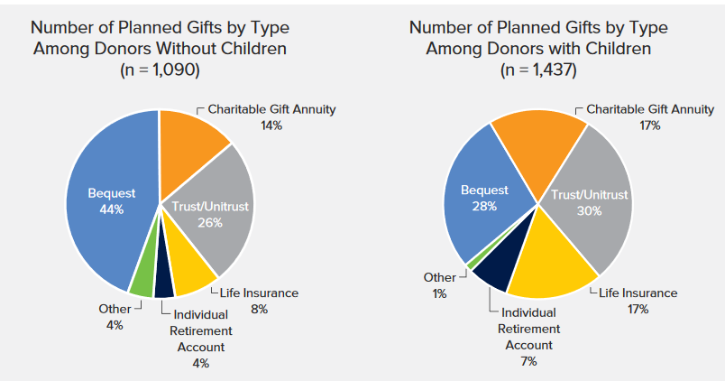
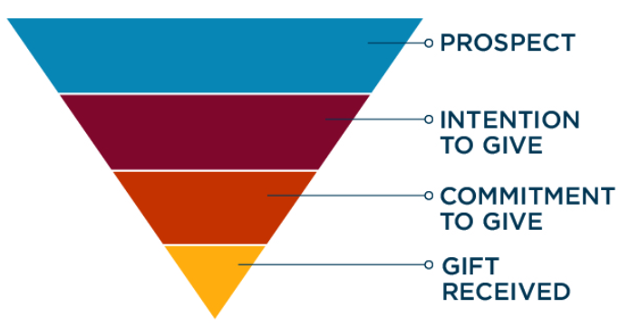
PG return on investment
Return on people
  Give today
  Resolving to give in future
Notes:
Legacy programs have the highest long-term return on investment of any fund raising efforts.
Remember you are dealing with the lifetime gift capacity of donors when you begin your legacy gift program.
IRS data shows charitable bequest are 2.74 time more than donors total lifetime charitable giving for larger estates. Since bequests are the most common legacy arrangement for donors with or without children, having a strong bequest and legacy program is a wise investment for any larger or small hospice.
78% of planned giving donors gave 15+ gifts to the nonprofits named in their wills during their lifetimes.
Screening methodologies may be effective in finding major gifts for campaigns but most do not accurately identify planned giving prospects. Beyond linkage to your hospice mission, programs: gift history, age of donor and family circumstance are prime indicators of potential bequest support.

Slide 16
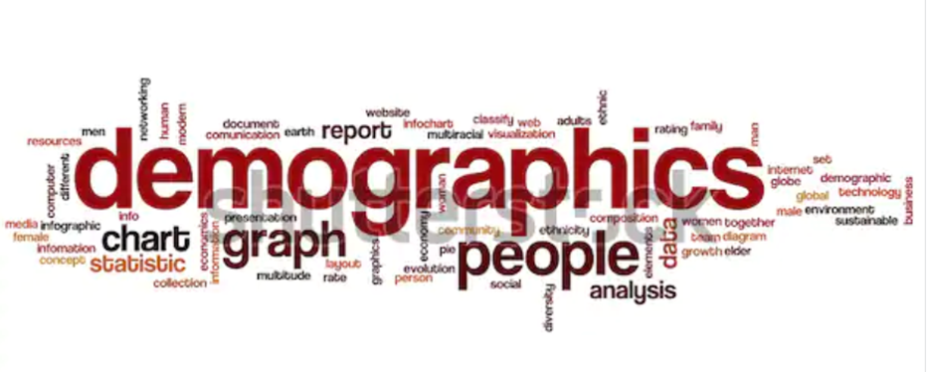
Demographic will drive
charitable giving
$41 trillion is expected to transfer to charity
  $12 trillion already going to charity
  $25 trillion could go to charity
  Balance is growth in asset value
    (Source: Community Foundation R&D Incubator, Social Welfare Research Institute @ Boston College)
Bequest donors are found in all income categories
  Bequest donors Median income $60,400
  Bequest donors Mean income $75,900
Notes:
As I mentioned before the “Silver Tsunami ” is here with an expected an estimated $59 trillion will be transferred from 93.6 million American estates between 2007 and 2061, a new study from the Center on Wealth and Philanthropy at Boston College finds. Of the total transfer $26.9 trillion is projected for total charitable giving
Despite the trend toward lifetime giving, it is both realistic and valuable for charities to remain encouraged about the potential for bequests. Charities should take whatever steps possible to obtain their share of the projected bequests and to expand the amount of bequests and, for that matter, all giving beyond our predictions."
Bequests will come from all income levers as income is not a great predictor of the potential wealth transfer to charity.

Slide 17
Demographic will drive charitable giving
80% of Americans engage in charitable giving each year
  Only 5-6% of those over 50 have a charitable estate plan in place
  Donors of $500 or more - only 1/10 have charitable bequest
7-8% of taxable estates have a charitable plan/gift,
  fewer estates are subject to estate taxes. <1%
  2020 exempt amount for single person is $11,580,000
13% of your loyal donors have a will with a charitable gift
35% have no will yet but would anticipate including a charitable gift
Notes:
Americans are a generous society both during life and at death.
One of the key challenges and opportunity for hospice is many of your supporters are very grateful for your services and programs. Hospice needs to find way to capture the high motivation to make outright gifts, memorials' and tribute gifts into loyal donors who make legacy gifts.
Your communications, website and social media posts need to provide information on how to structure legacy support, as well as, the impact of legacy and endowment gifts.

Slide 18
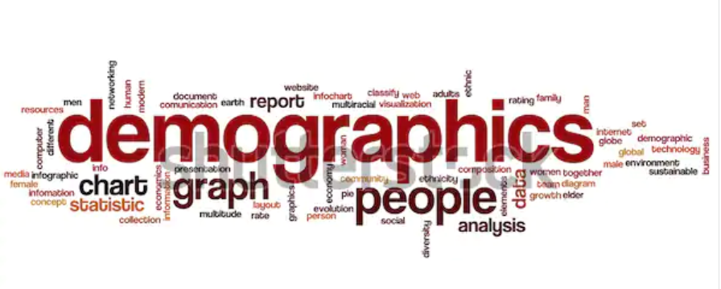
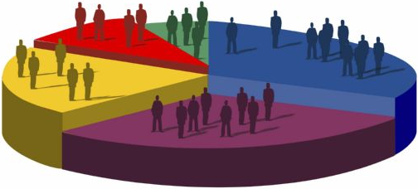
Demographic will drive charitable giving
Bequests and life income agreements are the fastest growing segment of philanthropy
+15.5% in 2018
Dr. Russell James
Texas Tech Study results
  1st will at age 40
  1st charitable bequest age 49
  79% had established relationship with charity
Notes:
While bequests and life income arrangements (gift annuities and charitable trusts) are the fastest growing segment of philanthropy studies reveal some interesting trends.
As I stated before there are three parts of an individuals financial life: Accumulation, Conservation and Distribution.
Those that plan well make their first will during the accumulation stage of their financial life because of the life circumstances dictate they must decide on who, when and how their life’s work will ultimately be distributed. Charitable bequest tend to come later as an appreciation thank you for what they have become and what they value in society.
Conservation tends to be a stage in life when they are planning on retirement and deciding if they have sufficient critical capital to continue their lifestyle in their retirement years. They may adjust their will to fit their family situation and needs of their heirs.
Distribution represents completed documents to find comfort in their decisions and financial state.
One key to changing circumstances every hospice spouse, partner or family member has to go back to the planning table, examine their documents and notify their plans to fit their net life status. That is the major advantage hospice has for legacy gifting.

Slide 19


Bequest facts and figures
8% will include a charitable bequest
>50% of bequests come from nontaxable estates
90% of bequests come from those who die after 70
77% - Idea came from donor (5% charity material)
47% - Left specific amount
51% - In will from 1-5 years
9% - Bequest removed
75% - Did not notify charity
44% - 10% or less of estate
NCPG Study 2000
Notes:
This slide presents some interesting facts to keep in mind as you promote and encourage bequests form your prospects.
Around 8% of you donors properly approached will include your hospice in some for of a bequest arrangements. Once established only a few 9% will remove a bequest for personal or financial reasons.
While this study is 20 years old the statistics have been generally verified from other studies.
Note many individuals do not notify a charity about their bequest. This could be they do not want to be pestered for additional gifts or they view their estate plan as a very private matter.
With the increasing attention to social media posts I predict more of the idea for estate inclusion will be forthcoming from the charity.
While charities encourage residuum bequest options most individuals leave a specific amount to charity with residuum's going to various family and friends.

Slide 20

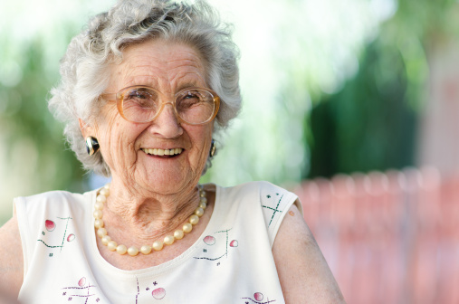

Finding and soliciting prospects
Notes:
Let’s briefly discuss activities you can implement to find the best prospects to discuss an estate inclusion and typical approaches to its discussion.

Slide 21
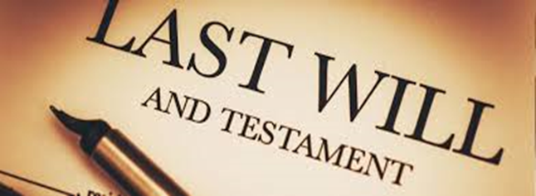


Indicator grid for building a list to be interviewed
Linkage – who is the logical connection
Interest – program, project, service or individual they are fond of
Age – logic tells us to work with the oldest first
Signals – verbal, mail, personal indications of an ownership connection
Values – personal and family concerns about their health, finances and welfare
Ability – indicated or hidden net worth, personal social capital
Notes:
One of the first steps to a successful bequest program is to identify your top 25-50 prospects.
Prospects may identify themselves in many ways. Develop a grid for on an Excel spreadsheet with six topics across the top with prospect names down the left axis. Once the prospects are listed check all the topics they are involved in. Those with the most complete information are the prospect that should rise to the top to be visited to discuss your legacy program or society.
I would not concentrate to much on net worth since bequest will come from assets rather than income.
A top prospect example would be: a long time volunteer, widow, age 70, with an 8 year hospice gift history and a commitment to help various charities.

Slide 22
Freedman bequest study summary
Donors with no children (or grandchildren) are more likely to make a planned gift than donors with children
Donors with a college education (or post-graduate work) are more likely to make a bequest
Donors who give above average annual gifts are more likely to become bequest donors
Neither wealth nor income are predictors of bequest likelihood
Younger donors (age 40-60) are in some respects, prime bequest prospects
Source: Phyllis Freedman, www.plannedgivingblogger.net
Notes:
Phillis Freedman has long tracked prospect characteristics for bequests and planned gifts. Her identification matrix concentrates on family status, education, gift history and age.
Studies have also indicated getting into the will of younger donors may be key to long term success. Hospice concentrates mostly on services to older individuals so the bequest inclusion tends to be a post-service rather then a pre-service process.

Slide 23
Mommy, “Where do bequests come from”
Look to folks with 5 -7 of the following characteristics
5 or more years of regular, consecutive giving
Sustained long-term giving that may not be consecutive
Family has been involved in some way
Recognized by your organization
  Board member, giving society member, volunteer service
No heirs
Few family obligations
Securely retired
Age 65+
Been kept informed on mailing list over a period of time
Has been called on regarding legacy giving
Has requested information on legacy giving
Has demonstrated an interest in an organization similar to yours
Just experienced a major life event
Notes:
Here are additional indicators of where bequests come from. You can add them to your indicator grid or use them to refine your prospect list.
The post-service identification of prospects after a major event and change in lifestyle, such as hospice care and bereavement services, must be considered as you develop your top prospect files.

Slide 24
Lifetime predictors of post- mortem charitable bequests
1. % of giving years
2. No offspring
3. Highest giving
4. % years reporting funded trust
5. Female
6. Last reported wealth
7. Not married
8. Last reported giving
9. Growing wealth
10. % of years volunteering
Source: American Charitable Bequest Demographics 1992-2012, 26,000 participants
Notes:
The most comprehensive long-term study of charitable bequest has been a multiyear 26,000 study by Russell James and the National Institute on Aging. The same individuals were surveyed every two years to track the changes and triggers associated with these changes. It was not specifically a survey of charitable behavior but it did include charitable questions in addition to a health and retirement survey.
Over 10,000 of the respondents died during the survey and so postmortem distributions were examined.
You will find many of the previous characteristics listed in this post-mortem study.
For hospice

Slide 25
Factors predicting when charitable plans are added
1. Approaching death
2. Becoming a widow/widower
3. Diagnosed with cancer
4. Decline in self-reported health
5. Divorce
6. Diagnosed with heart problems
7. Diagnosed with a stroke
8. First grandchild
9. Increasing assets
10. Increasing charitable giving
Source: American Charitable Bequest Demographics 1992-2012, 26,000 participants
7 out of 10 triggers for
adding charity to estate
plans deals with one’s mortality
Notes:
For hospice this list of predictive factors indicates a significant change in health status is a strong indicator for prospects to look at the their lives and include charitable plans in their estate distribution plan.

Slide 26
Factors predicting when charitable plans are dropped
1. Decline in self-reported health
2. Approaching death (final pre-death survey)
3. Becoming a widow/widower
4. Divorce
5. Diagnosed with cancer
6. Diagnosed with heart problems
7. Diagnosed with a stroke
8. First grandchild
9. First child
10. Exiting homeownership
Source: American Charitable Bequest Demographics 1992-2012, 26,000 participants
Notes:
As this chart indicates when you have a significant lifestyle change charitable plans can be included but also dropped as family concerns take priority.

Slide 27
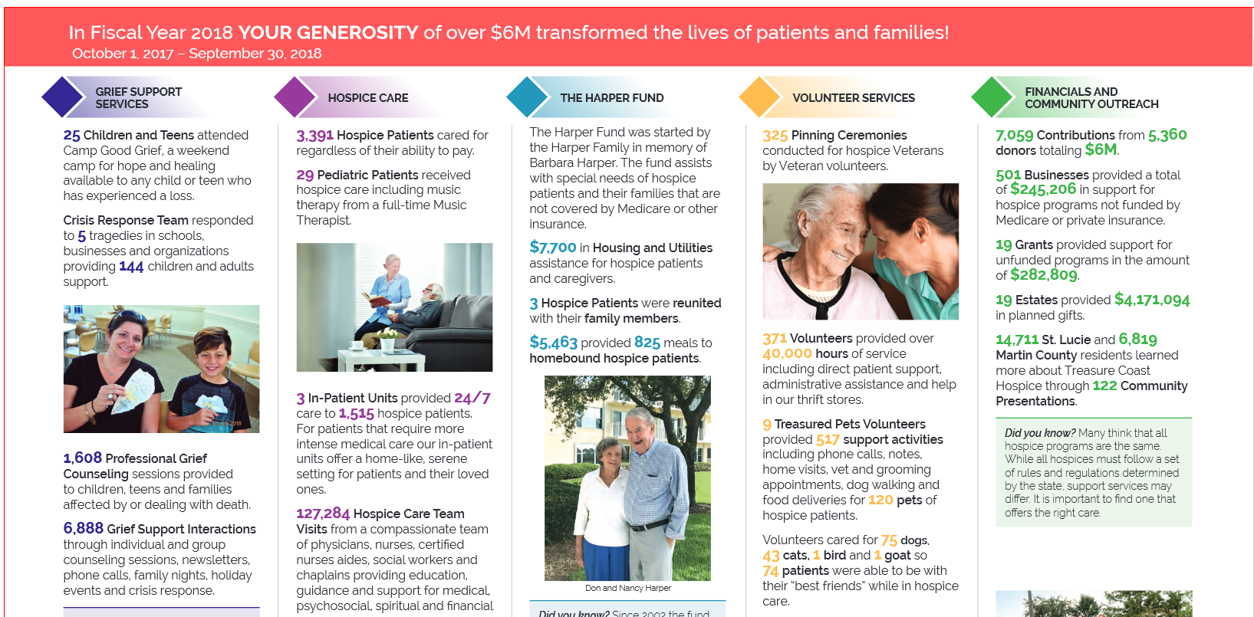
Treasure Coast Hospice
70% revenue from 19 estate
Notes:
As a sample of the power of bequests to create revenue for hospice this is a page from recent annual report to donors from Treasure Coast Hospice, Stuart, Florida.
During fiscal year 2018, 70% of their gift revenue was from distributions from 19 estates. 19 of the 5,360 donors provided $4.1 million in support or less than 1% of donors provided this significant revenue boost.

Slide 28

Website survey
“What would I find if I wanted to make a bequest of $100,000 to your hospice?
  22 organizations
How do I reach bequest information?
Does site list bequest types
Does site list bequest options
Is there general and/or specific bequest wording?
Notes:
Earlier this year I was an invited speaker to a forum sponsored by the National Partnership for Hospice innovation, of senor hospice directors to talk about bequests and planned gifts programs.
Prior to the talk I did a review of each hospice website with special attention to access to “Ways to Give and Bequest Intentions.”
I wanted to know if I wanted to make a $100,000 bequest to each hospice what information would be provided.
There we 22 organizations represented and the following slides show what I uncovered.

Slide 29
Website survey
Professional site?
  Crescendo -4
  Stelter -2
How many legacy societies? – 11
  No explanation – 4
  Members listing - 1
Circle of Life
Circle of Care
The 1979 Society
Sally Werst McKeen Legacy Society
June B. Harmersam PG Society
Helen Kassay Society
Agnes Coburn Legacy Society
Harlan & Margaret Swift Legacy Circle
Gibbons Pathway Society
Legacy Society -2
Notes:
Six (6) of the sites used copy from commercial providers, either Crescendo or Stelter. There is a complete list of website providers at the end of this presentation.
Eleven (11) mentioned they had Legacy Societies but 4 had not explanation of what the society was, how to join, or membership benefits.
Having a detailed information on what the society is, how it functions, how to join and recognition activities is a must for any successful legacy society.
One (1) had listing of current members. Member listing indicates other value hospice services and support the mission. If living and deceased members were to be included they should be separated with a special tribute to deceased members.
This is a listing of the various names for the societies. I always encourage a personalized name or relevant date for societies and it make a strong connection for members moving forward. It also provides for a personalized membership gift and mementos for donors.

Slide 30
Website survey
No bequest wording – 13
No PG info – 3
Legacy Society brochure download -1
Importance of Legacy Society being the first stop on websites
  Tangible marketing tool to promote legacy gifts
  Identify a Legacy champion
  Create a name
  Create a brochure
  Include content to reflect mission and all gift options
  Survey for current members
  Create a recognition event
  List members in pubs & website
  Educate members about creative options
Notes:
Concentrating on bequests 13 of the 22 sites had no specific or general or specific bequest wording. It is an absolute necessity each and every hospice site include basic wording on how to make a bequest, including each hospice IRS tax-exempt ID number.
As the next step forward into more planned gift information each website should include a listing of the many “Ways To Give” via estate arrangements, donor advised funds (DAF) and IRA gifts using the benefits of Qualified Charitable Distributions(QCD).
Central to a successful planned and bequest gift program is having a vibrant Legacy Society. Members in a legacy society may be used a measure of success for a planned gift effort.
I am in favor of multiple page, 8 ½ x 11 inch booklet as the main document for the legacy program. The brochure should look the same as any capital campaign brochure. It is a brochure which may be used both in single prospect meetings and also group seminars. It must include a summary of current and future gift options and endowment options. Member benefits should be listed and it should have information on all the ways to contact specific staff member in charge of the program.

Slide 31
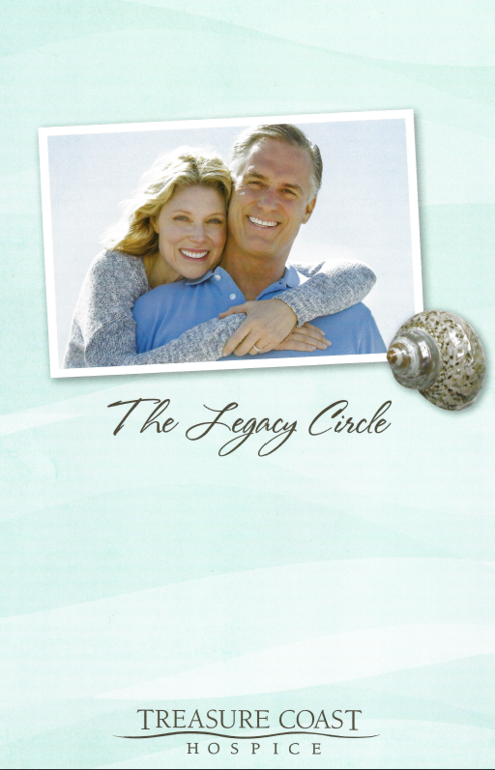
Bequest & Legacy Society
Brochure should include all donor-
centric gift options
Mission
Asset options
Revocable gift transfer strategies
Irrevocable gift transfer strategies
Response vehicle
Membership form
Notes:
As mention in the previous slide a keystone for legacy planning is a vibrant Legacy Society program with a name personalized to you to your hospice history.
It should review your history and mission to remind people of the impact they can make with current and future gifts. Current gift options are mentioned because during your legacy discussion the prospect may realize they wish to see the impact of their gift while living.
Your Ways to Give list should cover gift of Cash, Appreciated Assets, Real Estate, Bargain Sales, Qualified Charitable Distributions and Life Estates. Short paragraphs should be sufficient. Life income arrangements should cover Gift Annuities, Charitable Trusts, Charitable Lead Trusts. Bequests should cover all the options: specific amounts and property, specific percentage of assets, contingent bequest and life income bequests. Beneficiary Designations of account assets such as retirement plans and life insurance should be covered.
Benefits of membership should be listed and a membership form included for new and future members to indicate the provision that indicates they are joining your Legacy Society. Finally, a listing of who and how to contact for additional information is critically important. Make this a personal as possible.
Email me for PDF samples of various legacy brochures.

Slide 32
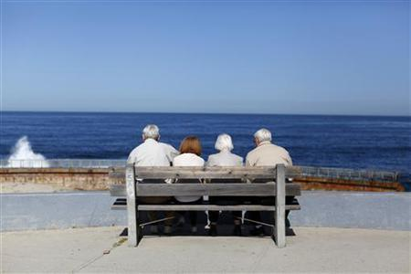
Bequests overcome fears and emotional barriers
Fear of dying too soon
Fear of living too long
Fear of loosing control
Fear of economic misfortune
Fear of mental and/or physical disability
Fear of taxes consuming assets
Not wanting to relinquish control
Fear of facing death...indecision
Fear of what children will think
Analysis paralysis
The majority of bequests will come from non-taxable estates in the future
Notes:
Bequests are the most popular legacy support arrangement because they are so flexible and remove many fears as people age.
I want to state again the majority of bequest you will receive will be from non-taxable estates.
I have had occasion to work with individuals who could not make up their mind because of over analysis of their situation. One individual brought a 5 page Excel spreadsheet on their entire plan to their projected date of death with assets and income projections to an interview. They could not make a simple decision on changes for legacy support as they were so concerned about the projections changing every years. Truly overthinking how to make legacy support.

Slide 33
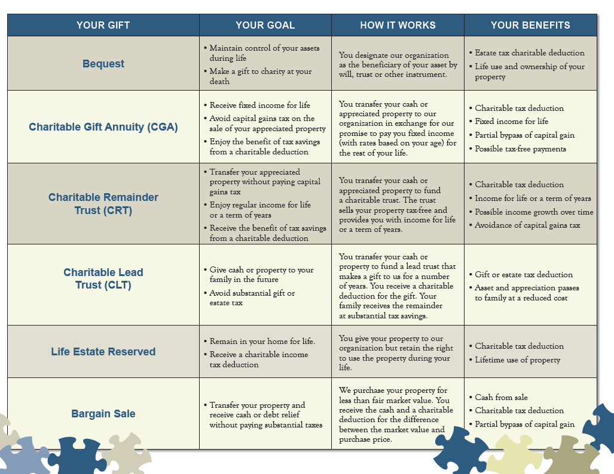
Notes:
Above is a standard chart of the various benefits of bequests, gift annuities, charitable trusts, life estates and bargain sale agreements. It includes some but not all of the revocable and irrevocable arrangements for legacy gifts.
You can use it as a template for copy in your legacy brochure. There are many more examples you can access using a Google search.

Slide 34
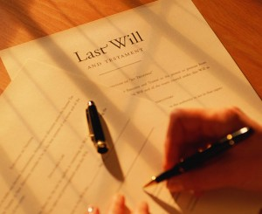
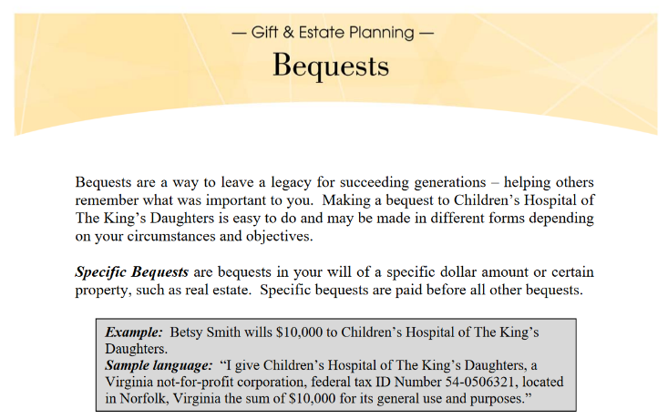
Gifts by will, trust or beneficiary designation
1. Bequest of specific $$$$$ amount or specific property
  Example: $10,000 to favorite charity or my house at 123 Main Street to favorite charity
2. Bequest of a specific percentage amount of estate assets
  Example: 25% of my estate to favorite charity and
  the balance to my church
3. Residuum of specific amount or percentage
  Example: 25% of estate after specific bequests
  to friends and family to favorite charity
Notes:
Now lets begin with a discussion of all the examples you can include in your bequest promotional information.
It should include a full discussion of the various bequest wording options and examples tailored to your hospice.
The first is a bequest of a specific dollar amount or a specific property i.e. an individual’s personal residence or a specific stock holding such “100 shares of my Apple stock.”
Second, bequests may be structured as a specific percentage of an estate asset. “I give 50% of my Apple stock to hospice and 50% to my next door neighbor John Smith.
Third, bequest may be listed to provide for a specific amount or percentage of an estate after all previous bequest are fulfilled. Depending on the size of the estate and the previous bequest which get fulfilled first there may or may not be anything left in the residuum of the estate.

Slide 35

Gifts by will, trust or beneficiary designation
4. Contingent bequests
  Example: If my brother does not survive me I give his share to my favorite charity
5. Life insurance beneficiary designations
  Specific amount or percentage
  New or existing policy
  Charity owner and beneficiary with
  donor paying premiums makes
  the premium deductible
Notes:
Fourth: A common alternative bequest option is to provide a contingent bequest options. This option provides wording if a previous named beneficiary is not alive a charity or another individuals is named to receive the bequest.
A contingent option may be applied to any of the previous bequest options.
For example if a specific charity is named and it is not in existence upon the death of the bequestor then it could be paid to other individuals or charities. The options hear are endless.
Fifth: Individuals should not overlook the option of including or revising the beneficiary of some of the assets they own. Life insurance is a common assets individuals own for various reasons. If the original reason is no longer relevant to the original purchase reason they might consider including charity/hospice as a whole or partial beneficiary.
The person could simply, at not cost to them, make a new beneficiary change form and file it with the insurance company. They may take out a new policy for the benefit of charity in that case the charity should be the owner and beneficiary of the policy. Premium payments to the charity for the policy are fully deductible for income tax p
For more information on charitable gifts of life insurance copy and past the following link. https://www.pgdc.com/pgdc/charity-owned-life-insurance

Slide 36


Gifts by will, trust or beneficiary designation
6. Retirement plan beneficiary designations
  Specific amount or percentage
  IRA, 401(k), 403(b), Roth IRA, Keogh plans
  Recommended because of possible double taxation
  SECURE ACT changed how a non-spouse now has to take IRA
  distributions within 10 years
7. Pay on death (POD) for bank accounts
8. Transfer on death (TOD) for investment accounts
Notes:
Six: Another asset bequest option is to make a retirement plan the whole or partial beneficiary of a retirement plan. There are various retirement plans in the USA approved for the tax-free accumulation of retirement assets. Perhaps the most popular retirement plan is the individual IRA account.
Again the bequest option could be a set dollar amount or a percentage amount. It does not have to be the whole account. Many individuals have spendthrift children and may not want give the whole account to a child.
Under the new SECURE ACT when a non-spouse is a beneficiary the account must be distributed to the beneficiary within 10 years. Account withdrawals are subject to ordinary income. Upon death depending on the size of the account it may also be subject to estate taxes.
Some charities receiving notices of a beneficiary designation may be asked to set up separate account at the IRA sponsor. This is never necessary as IRA accounts are trust and must be immediately distributed to the beneficiary.
Seven and Eight: Bank and investment account may be registered in a Paid on Death (POD) or Transferred on Death (TOD) registration and a charity may be beneficiary. As an example an older donor may have multiple Certificates of Deposit with either individuals or charities as beneficiaries.

Slide 37
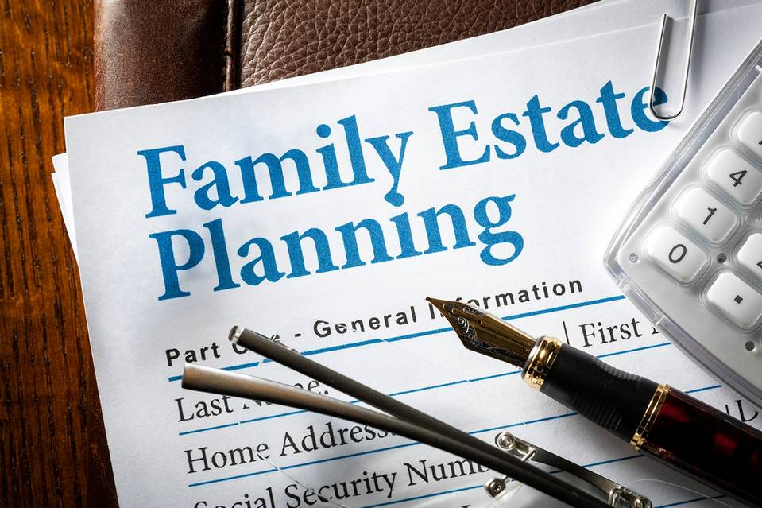
Gifts by will, trust or beneficiary designation
9 Bequest to create a life income for a beneficiary with
the residuum to favorite charity or multiple charities
  Charitable gift annuity
    Fixed income for life, balance to charity
  Charitable remainder trusts
    Fixed or variable income for life
    Payments to one or more beneficiaries
    Balance to one or multiple charities
Notes:
Nine: It is possible to leave an income to an individual and the ultimate assets to charity. The most common way to accomplish this goal is to set up a beneficiary designation with specific instruction for the charity to establish a charitable gift annuity or a bank to set up a charitable remainder unitrust.
For example: One of my clients has a senior donor who dies at age 92. This donor set up two charitable gift annuities one for his housekeep and one for his sister-in-law with the Medical Center Foundation as ultimate beneficiary of the residuum of each annuity. Each annuity was funded with a $1,000,000 bequest and paid 5% guaranteed lifetime income to each beneficiary.
The donor wanted to take care of each individual but wanted the charity to benefit at the end of the agreement. This donor also left the charity his IRA account and another sizable bequest. He also left significant fund to the local community foundation.
There are many reasons to consider this approach when discussing charitable strategies with prospects that fit into their personal and financial goals.

Slide 38
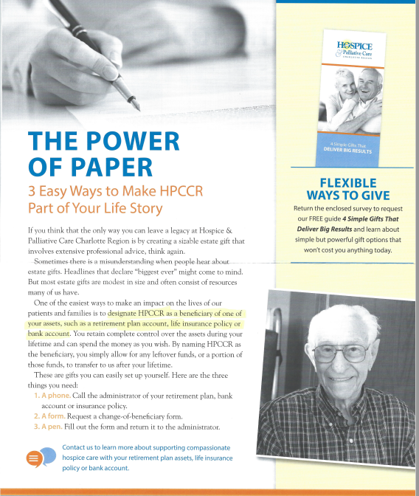
Hospice beneficiary
Life and human interest
stories are one of the best ways
to explain options
See Margo Wallace story on her
gift in gratitude for the care her
mother received
Notes:
Human interest stories create a powerful message of the impact the support has on hospice care.
At every opportunity hospice publications and social media posts should include stories about bequests received and bequests planned.
I would draw your attention to the Margo Wallace story at the following link: https://journeycare.giftplans.org/index.php?cID=241
It shows how the extended family is sometimes a top prospect for a legacy gift.
Asked for words of advice for anyone considering making a planned gift, Margot recommends:
Give to an organization where you feel loyalty and affinity; don’t just give to an organization you visit once a year because it’s pretty.
Give to an organization you’re proud of, want to help, and you feel is part of your family.
Give to charities you love and respect.
Give to an organization over the long haul and throughout the year.
Give to an organization you want to survive for the long-term, you believe has the capacity to do so, and that your grandchildren will be proud to donate to as well.
Give to an organization that shares your values.

Slide 39

Haven Hospice beneficiary download language
http://futurefocus.net/Haven/scenario1.htm
For information, please visit our living trust page. Look at examples of bequest language for more information. Also, please download our PDF brochures,
Haven Hospice Bequest Arrangements (some suggestions on how bequests can be structured),
Charitable Endowment Insurance Policy (our PDF regarding notification for insurance policies and instructions for the use of the proceeds), and
Haven Bequest Letter to Attorney (a sample letter to send to your attorney to add Haven as a beneficiary to you estate documents). There is also some additional information available about the benefits of utilizing a charitable bequest and how bequests enable you to keep control of your assets. Also, bequests are often used to build an endowment, a fund that provides a legacy for you and provides for the future of Haven.
Codicils are a simple and easy way to make changes to an existing will.
Notes:
While it is important to have information on your website is also important to have forms and flyers that prospects and donors can easily download.
Haven Hospice has a multipage flyer on bequest arrangements
Haven also has a bequest letter to an attorney to include a bequest arrangement, a Codicils to add or change current plans and an example of a Charitable Endowment life insurance policy arrangements.
Make it easy for the prospects and their advisors to print information. Double check to make sure it is 100% accurate.

Slide 40

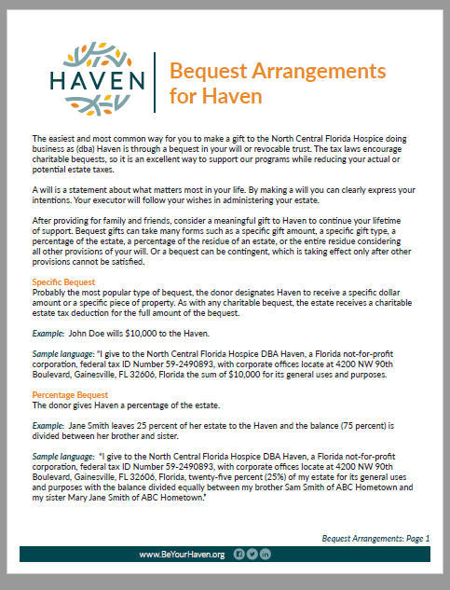
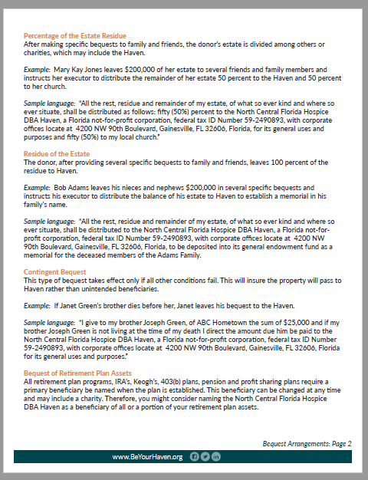
Haven Hospice beneficiary download language
Notes:
Here is a sample of the Haven Bequest Arrangement flyer, pages 1 & 2.

Slide 41
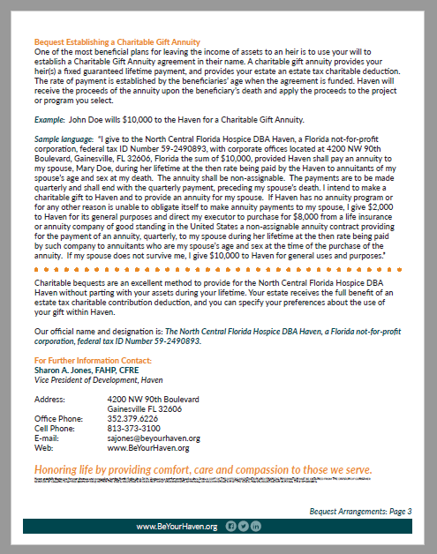
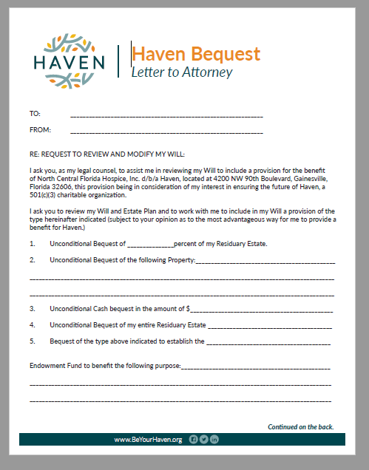
Haven Hospice beneficiary download language
Notes:
Haven Hospice beneficiary flyer, page 3. Haven Hospice sample letter to an attorney to add Haven Hospice to an individual estate plan.

Slide 42
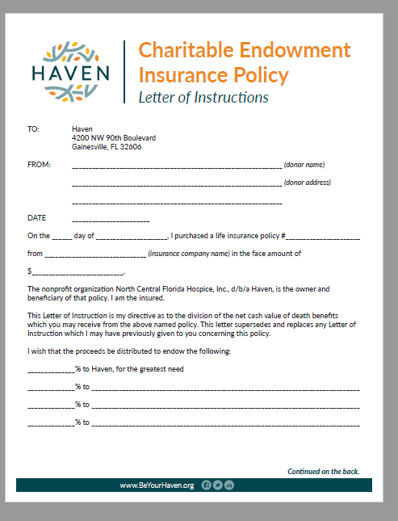
Haven Hospice beneficiary download language -insurance
Sample will codicil from Delaware Hospice
  https://delawarehospice.plannedgiving.org/sample-gift-language
  Page down to Word document download
Notes:
Haven Hospice letter of instructions to create a charitable endowment of an existing insurance policy.
A codicil to a current existing will may all that will be needed to receive a future bequest.
Delaware hospice produced a Word document that may be modified to suit a bequest inclusion. Most codicil directions need to be adapted to wording appropriate to the state of residence for you prospects.
Follow this link and tab down to download the Delaware hospice sample.
https://delawarehospice.plannedgiving.org/sample-gift-language

Slide 43

FreeWill.com
…..a new software offering may be one of the most advanced concepts to effect the planned gift field in the last decade.
FreeWill makes it easy for charities to encourage donors and non-donors to care for the people and causes they love by creating valid bequests.
20 minutes, print your documents, official language, assets allocated according to your wishes
Notes:
One of the most exciting new products in legacy giving is the services offered by FreeWill.com
FreeWill provides a website link to their product that is specifically designed to help individuals write a valid will in each state of the USA.
As stated before anywhere from 40% to 60% of individuals do not have a will. The older the individual the higher percentage of those age cohorts have a will or revocable living trust to distribute their assets upon their demise.
If an individual wishes to complete their will and have it reviewed or executed by a local attorney they always have that option.
FreeWill chargers for charges for their services and in addition to their website service provides a package of promotional postcards and flyer services for interested prospects.
I believe FreeWill provides a valuable service and deserves consideration if it fits into your budget.

Slide 44
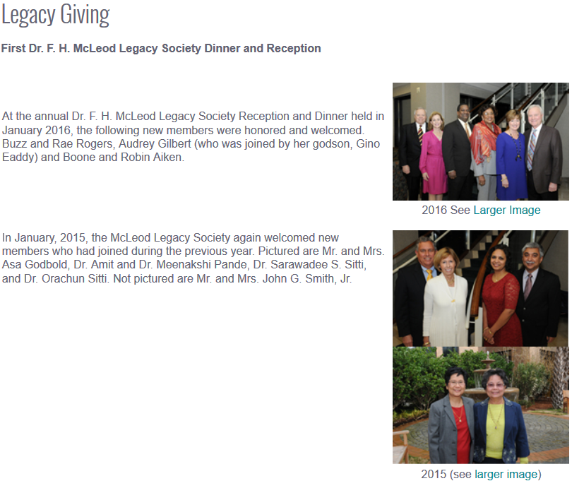
Recognition and Stewardship
Create a legacy society
Recognize all past and current legacy givers
  Separate tribute listing of deceased members
Recognize in printed materials and web
Host annual event
Invite to ongoing educational activities
Notes:
Once you have created your legacy society as the central keystone of your planned gift program you need to implement the next stages.
It is promote but recognize both current and deceased members in listing in newsletters, annual reports and websites.
Hosting an annual or semiannual event is important to use it as an induction ceremony for new members and as a thank you for continuing members.
Sometimes the recognition may be held at an educational event on estate planning. This would show new prospects how your hospice values long term estate support.
You need to activate your creative side to see how your hospice can provide an additional thank you to current member, future prospects and the extended family members of current and future donors.

Slide 45
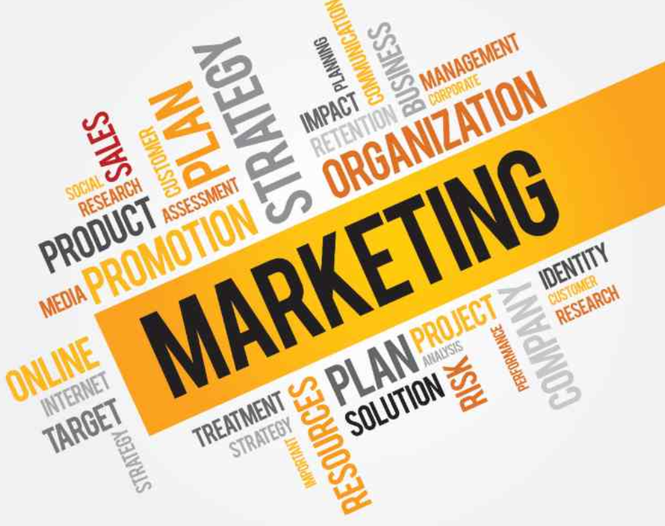
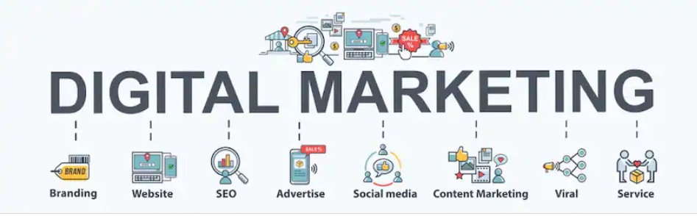

Simple marketing opportunities
Notes:
While we would all admit we live in an increasing digital age. But let me remind you with a few exceptions legacy promotion and solicitation is mostly a face-to-face experience.
60% of Americans between the ages of 50-64 actively use social networking sites like Facebook, YouTube , LinkedIn, twitter and Pinterest only 42% of Americans age 65 and older are social (Stelter white paper).
In the following slides I will provide some simple marketing techniques you can accomplish with both social media and good old in-home relationship building.

Slide 46
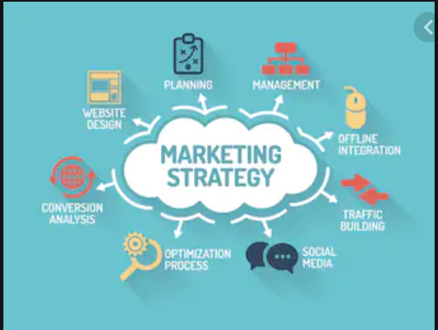
Simple marketing opportunities
1. Consider a bequest challenge campaign to increase
your living endowment which also has an annual giving component
2. Put - “Remember XXXXXX in your will or living trust and estate plan” on your letterhead and in your email signature
3. Put - Bequest wording examples on your web site. Be sure to include your exact name and tax exempt number in wording.
  Revise if you change your name or merge
4. Print – Sample bequest wording flyer and send it to all attorneys and professional advisors in your area (see Haven Hospice material)
Notes:
First, I would like everyone to consider developing a Legacy and Bequest Challenge. One of the most successful challenges I have encountered over the years the challenge mounted by the Holland Michigan Community Foundation.
Here is the link to their campaign brochure Today-Tomorrow and Forever 5% match: http://www.connellandassoc.com/pdf/HollandMichiganEndowmentCampaign.pdf
Today” Match - The first $2 million in gifts to our Community’s Endowment will be matched by $1 million in lead donor gifts. For every $2 received “Today,” $1 will be added to the Community’s Endowment from the matching funds.
“Tomorrow” Match - The first 100 individuals/couples who commit to including the Community’s Endowment as a beneficiary of their estate plans will be matched by a total of $2 million in lead donor gifts “Today.” For each new “Tomorrow” commitment, $20,000 will be added to our Community’s
Endowment from the matching funds.
It simply involves a pool of donors who will make gifts today to match future documented gift commitments. The challenge is often a 1:10 challenge where a pool of donors will band together to agree to make a $1 gift today in return for a future pledge of $10 in an estate arrangement. There is often an upper limit that will be matched. The match is determined by looking at your prospect pool and setting a reasonable goal.

Slide 47
Simple marketing opportunities
5. Write – Separate articles on each type of bequest options for your publications and social media
6. Write – Stories on bequests received
7. Stuff – Bequest options and gift annuity (Word) flyers in gift thank you notes or receipts
8. Place – Bequest society brochures in a convenient place next to recognition plaques or on a brochure takeaway table
9. Website – Put current Bequest Society brochure as a downloadable file
  See link: https://www.frederickhealthhospice.org/documents/HFC-Living-Legacy-Brochure.pdf
Notes:
Sample marketing opportunities

Slide 48
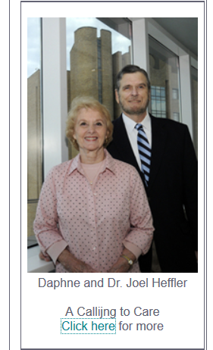
Simple marketing opportunities
10. Web site - Put downloadable file of bequest flyer developed for professional advisors
  Add a codicil example in print format
11. Web site - Put current list of bequest society
members on your web site
  Alternative is a PDF download file of current and
  deceased members as separate tribute listing
  Add pictures of current members being inducted to society at your
  recognition event
Notes:
Sample marketing opportunities.

Slide 49
Simple marketing opportunities
12. Web site – Construct a mission video for your main page or development page which links to your support/ bequest/planned giving pages
13. Social media – Place a bequest story on your social media page
14. Social media - Construct an estate planning quiz that drives inquires to your web site
15. Turn your board into Bequest Ambassadors by creating a Planned Giving and Bequest Handbook
Notes:
Sample marketing opportunities.

Slide 50
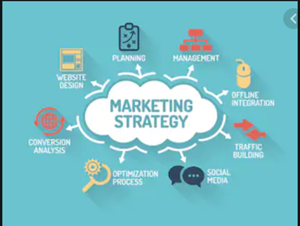
Simple marketing opportunities
16. Put a Meet Our Donors with pictures and stories on your website. They have powerful messages
  see link: https://journeycare.giftplans.org/index.php?cID=163
17. If you form a Professional Advisor Counsel put a Meet Our Advisors page with pictures and full contact information on your website.
  See link: https://journeycare.giftplans.org/index.php?cID=326
18. Develop laminated 4X6 card with stock transfer information for advisors and include bequest wording on back
Notes:
Sample marketing opportunities.

Slide 51
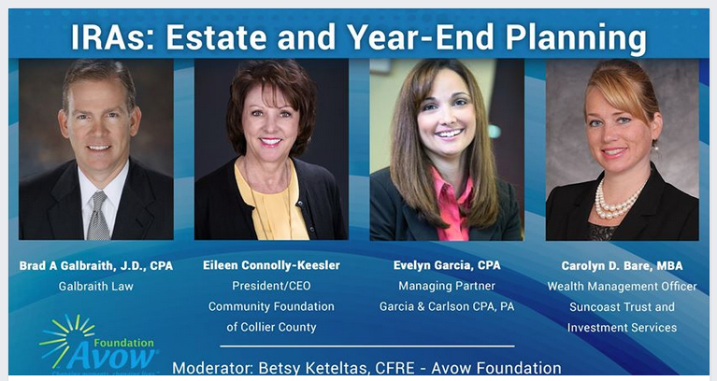
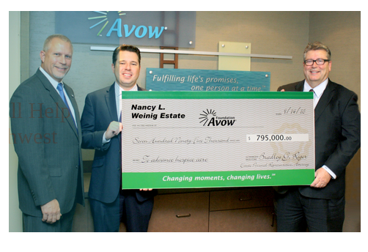
Exposure and recognition
Community seminar
Recognize financial professional who participate in bequests
Notes:
Here are two examples of social media of a public seminar promotion and financial advisor recognition from Avow Hospice in Naples, Florida.
To few programs give recognition to the various financial advisors who are involved in showing donors the power in legacy giving and the impact they can make both during their lifetime and after they pass.

Slide 52

Web site providers
Crescendo Interactive
  www.crescendointeractive.com
  Various costs estimate $5,000
Future Focus
  www.futurefocus.net
  Set up $500, Annual $799, plus optional calculator
Pentera
  https://pentera.com
  Various price options
Plannedgiving.com
  https://plannedgiving.com
  $495+ set up for various levels
Sharpe Group
  www.sharpenet.com
  Various costs estimate $5,000, includes calculator
Stelter Group
  www.stelter.com
  Various plans estimate $2,000 - $5,000
Notes:
Here is a resource list of website providers and an estimate of the costs involve.

Slide 53
Links to handouts
Haven Hospice - 3 page bequest arrangements
  http://futurefocus.net/Haven/HavenHospiceBequestArrangements.pdf
Haven Hospice – Bequest letter to attorney
  http://futurefocus.net/Haven/HavenBequestLettertoAttorney.pdf
Notes:
If you wish to download the sample handouts from Haven Hospice above are the specific links.

Slide 54

Creating an Omnipresent Legacy Bequest Program
Presentations:
    www.nhpco.org/LAC2020
Presenter contact information:
    James E. Connell FAHP, CSA
    Connell and Associates
    910-295-6800
    james@connellandassoc.com
Thank you

