Slide 1
Building a Professional Advisory Council &
Agents of Wealth Program
(Challenges, Opportunities, Basics and Beyond)
James E. Connell FAHP, CSA
Connell & Associates
Charitable Estate and Gift Planning Specialists
www.connellandassoc.com

Slide 2

Session objectives
1. Goal: Create a Professional Advisory Council (PAC) to work with staff, leadership and other professionals to make your charity the charity of choice when individuals create an immediate gift, life income agreement and/or charitable estate plan
2. Develop a plan of attack
3. Identify and recruit professionals

Slide 3

Session objectives
4. Educate professionals on planned gift options and strategies
5. Recognize, promote and honor the professional’s involvement with appropriate promotion, publicity and rewards
6. Case studies: Medical center, Community foundation, College

Slide 4
Professionals are invaluable for several reasons
1. Number of cultivation and solicitation visits a PG officer can make by themselves are limited
2. Professionals may speak on behalf of your charity in ways a paid staff never can
3.Philanthropy is now a wealth management tool for high net worth individuals (HNW)
  “Philanthrocapitalism” - 80% of HNW individuals give time, money and expertise to good causes (Source: Scorpio Partnership)
3. Professionals give you access to individuals otherwise out of reach to PG officer

Slide 5

Professionals are invaluable for several reasons
4. Professionals provide continuity and will remain committed to the charity long after paid staff has left
5. Professional inspire others by example
  Promoting practical planned gift strategies which fit into the donor’s financial and charitable goals
6. Professionals are prospects themselves
    Top prospects for flexible deferred CGAs

Slide 6
Survey says: Involve professionals for the right reasons
1. PGO must demonstrate competency and instill confidence in your ability to work with professionals and their clients
2. May give visibility and exposure to charity and its work
3. Have a broad base of current contacts with relationships that may open doors
4. Possible assistance with areas of law, money management, insurance, banking and accounting

Slide 7
Survey says: Involve professionals for the right reasons
5. Possible training for higher leadership positions
6. Participate in ad hoc committees to help develop events for prospects and other professional
  Be seminar participants themselves
  Attend events and encourage their peers to attend
7. Must be able to put own economic self-interests aside

Slide 8
Survey says: Involve professionals for the right reasons
8. Involved professional may prevent the “torpedo” of your gift proposal
  Modification to prevent lost or severely altered plans
9. Targets of opportunity for sponsorships of seminars, etc.
10. Not every charity is a candidate to form a PAC

Slide 9
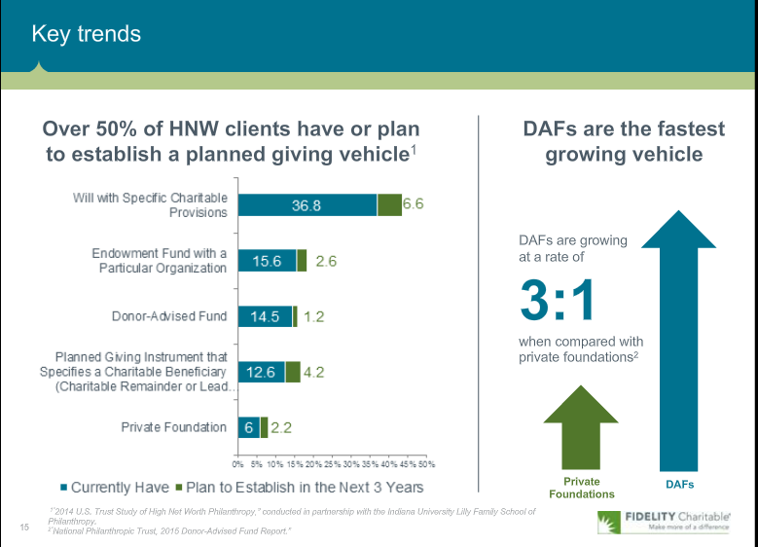
Fidelity Charitable: Key trends

Slide 10
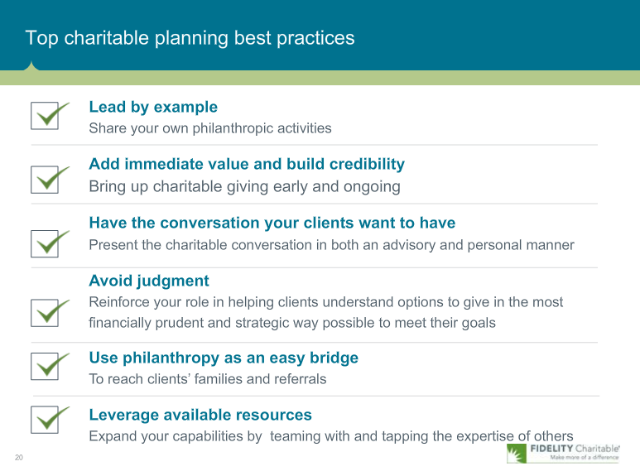
Fidelity Charitable: Top charitable planners

Slide 11
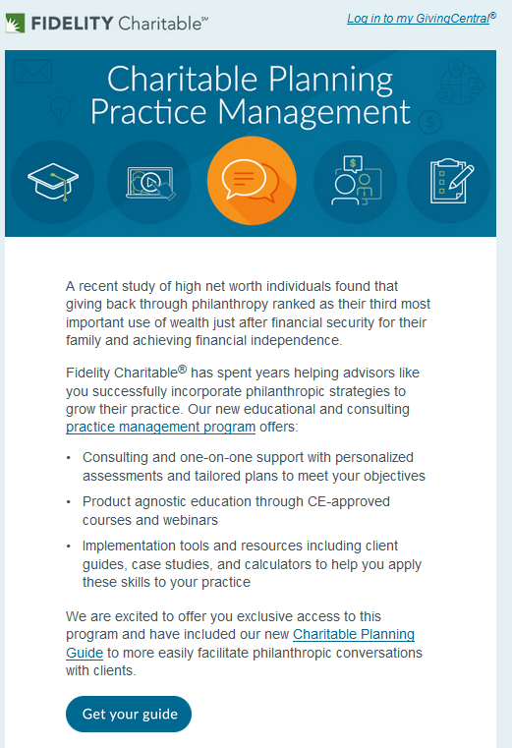
Fidelity Charitable:
Practice Management
As more financial advisors get training in wealth option strategies of charitable giving it is increasingly necessary for charities to assume their rightful place as the charity of choice

Slide 12
Professionals to involve
Accountants/CPA
Attorney
Financial and investment advisors
  Fee and commission advisors
Insurance brokers and agents
  Right mindset important
Real estate brokers and agents
Trust officers
Philanthropic consultant or gift planner?
Funeral home professionals?
Medical management professionals?
Business brokers?

Slide 13

Professional skills: Accountant/CPA
Primary tasks is taxes,
  income and estate
  gift and capital gains
  Alternative minimum tax
  Unrelated business income tax
Meets with clients frequently
Long term relationship
Primary contact when client is faced with increased tax bill or sale of property or other interests
Understands clients risk tolerance, capacity and decision making
Conduit to those with personal business interests
Paid on a fee for service basis
Many firms are beginning to offer financial services to clients
Bring example of CGA or CRT to meeting and show positive effects of increasing retirees income and reducing their taxes

Slide 14
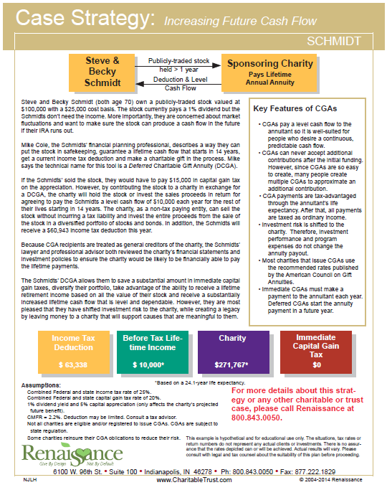
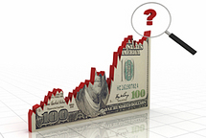
Case study example
www.reninc.com

Slide 15
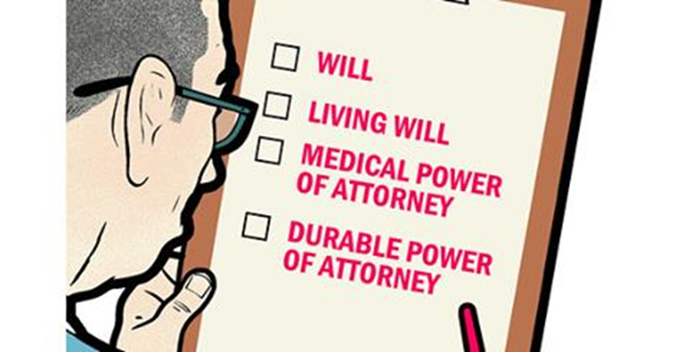
Professional skills: Attorney
General practice is to be transactional and reactive
  Client protective
Primary focus is prepare legal documents
  Will and living trust
  Power of attorney
  Healthcare POA
  ILIT
Typically not well trained in charitable strategies and income agreements
Sale of property documents
Periodic contact only when necessary to revise or update documents due to lifestyle changes
Paid on fee for service
May be executor of estate and receive percentage fees from probate

Slide 16
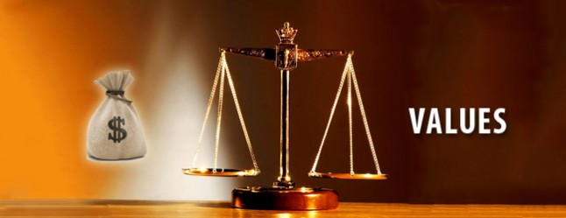
Professional skills: Financial advisors
Primary focus is on sale of financial products
Provides wealth management and wealth strategies
Keeps client assets invested during life stages
  Accumulation
  Conservation
  Distribution
May defer to other’s expertise to have clients fund managed but will handle transactions
Maybe agent for donated assets
Internet has opened up individual self choice
Now must act as fiduciary for retirement plans (DOL)

Slide 17
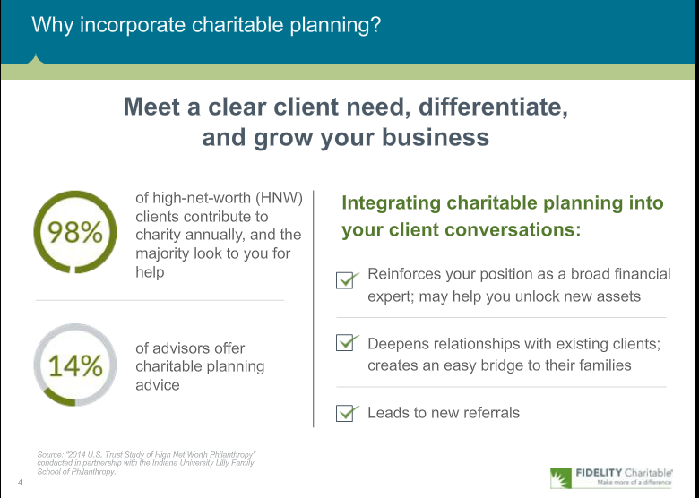
Fidelity Charitable:
Webinar for financial advisors

Slide 18
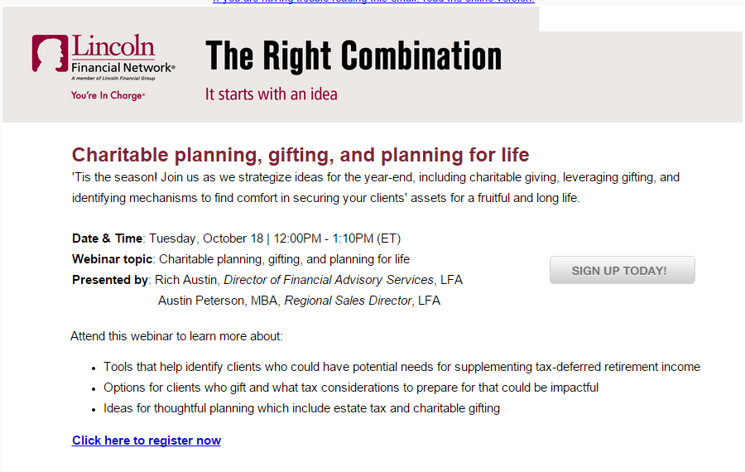
Lincoln Financial:
Webinar for financial advisors

Slide 19

Professional skills: Trust officers
Have dual responsibilities for management and administration of principal entrusted under legal agreements or relationships
Compensated based on size of trust assets under management
Normally have long term relationship with clients
Minimum trust size may be an issue for attracting clients
May be the administrator and investment advisor for CRTs and maybe CGAs

Slide 20
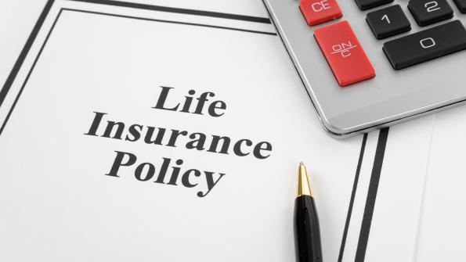
Professional skills: Insurance professionals
Primary focus is sales:
  Life insurance
  Disability insurance
  Annuity contracts
  Long term care
Asset protection
Have many products for different life stages
Paid by commission on sales
Expanding into mutual fund and variable annuity sales
May provide asset replacement life insurance for those making gifts

Slide 21
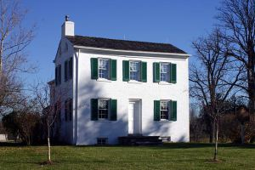
Professional skills: Real estate brokers
Primary focus is sales of residential or commercial real estate and land
May manage real estate for others
Paid on commission basis, may share with others
Not concerned with financial aspects of how transaction effect clients personal financial planning
No knowledge charitable strategies
May sell donated property

Slide 22

Professional skills:
Philanthropic consultant/gift planner
Focused on assisting charity to maximize planned gift potential
Compensated on flat fee for services
Directly involved in securing gifts
Technical knowledge of gift strategies
Coordinates with staff, professionals and prospects
Provides periodic case studies, updates on law changes, and giving trends

Slide 23
Identification of professionals
Canvass leadership for referrals
Review local estate planning council lists
Miree: developing a spreadsheet for recruitment
  Donor history, family support, community influence, history on use of services, time available, previous commitments, leadership skills, MINUS commitments to other organizations
Consult the yellow pages
Do a Google search of area professionals
Do a www.finra.com search to determine brokers with tainted client history
Do an www.investor.gov search for registered investment advisor check

Slide 24
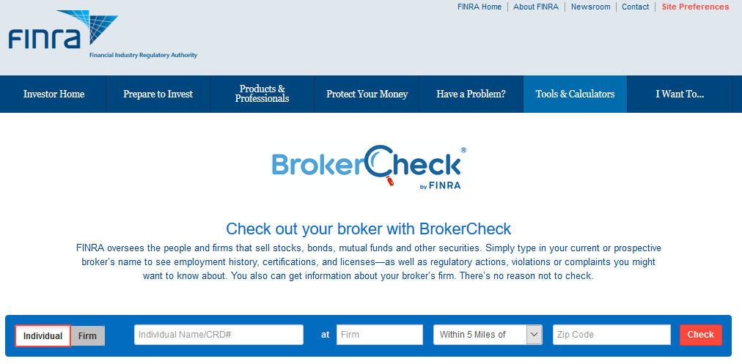
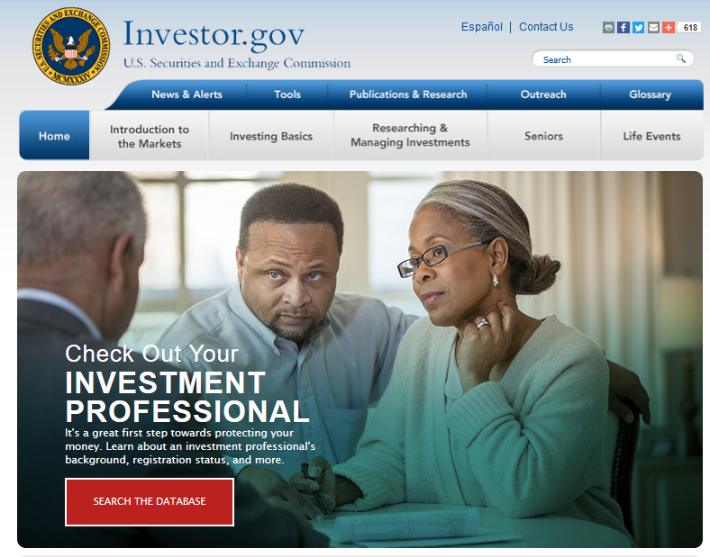
Website page samples
www.finra.com
www.investor.gov

Slide 25

Planned Gift Advisory Council (PAC)
Roles and responsibilities
Purpose: Increase the number of people who are aware of charity planned gifts program, and charitable estate and gift planning strategies that may assist their personal, financial and charitable planning
Structure: 12 to 15 members

Slide 26
Planned Gift Advisory Council (PAC)
Roles and responsibilities
Composition: Professionals with expertise plus individuals representing donors, board and community interests
Committee responsibilities: Assist charity in building a living endowment and increasing support through giving methods which fulfill their charitable interests while meeting their financial, charitable and estate planning needs

Slide 27
Planned Gift Advisory Council (PAC)
Roles and responsibilities
Individual responsibilities:
  Advise and assist staff
  Advise on technical matters
  Advise board and staff on effective methods of educating constituencies
  Participate in cultivation program
  Help in identifying probable donors or donor groups
Meetings: Once every other month for the first year then quarterly thereafter

Slide 28
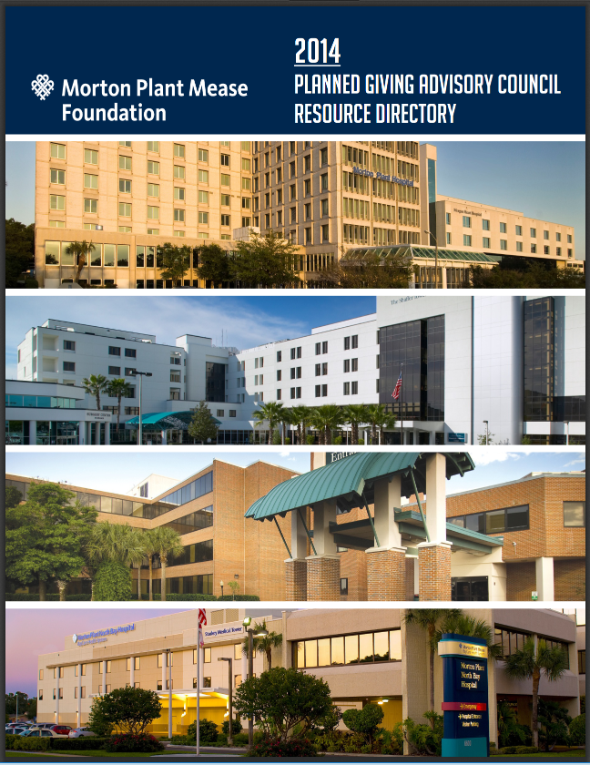
Typical meeting format/directory
Publish a roster of all involved
Have new members fill out bio form and share their CV
Consider publishing a directory of members
  publish and available as PDF on web site
    Keep PDF updated with changes
  150+ members
www.mortonplantmeasefoundation.org/images/pdf/14pgac1.pdf

Slide 29

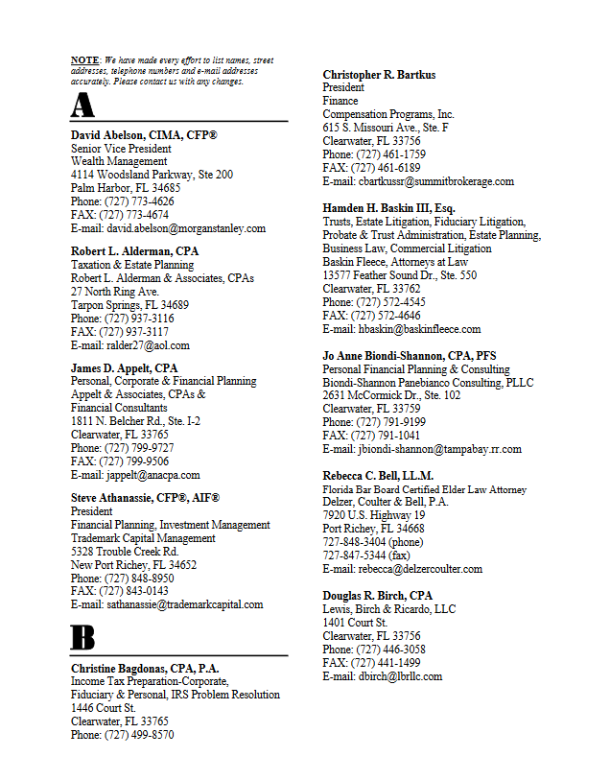
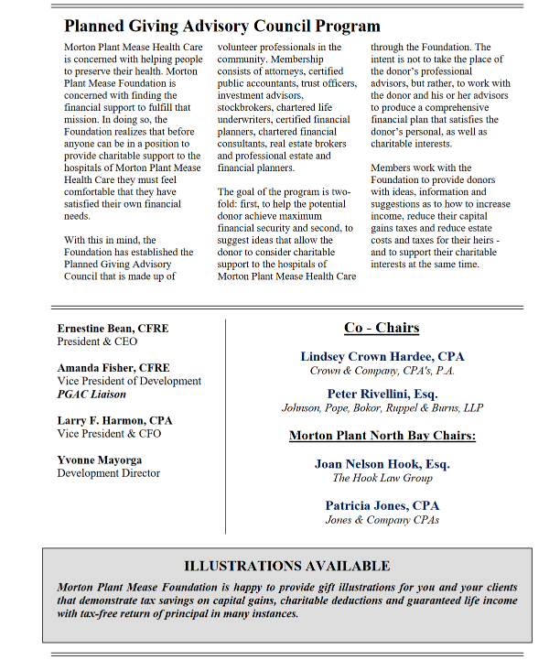
Morton Plant Mease Foundation
PAC directory

Slide 30
PAC directory format
Introductory letter from CEO, Chairman
Statement of mission
Listing of members by profession
Options for giving
Sample bequest wording
Anonymous confidential planned gift confirmation form
Request for confidential gift benefit analysis
Shelf life about 1 - 2 years

Slide 31


Typical meeting format/agenda
Introduction of members
Mission oriented presentation
Legacy Society update
Committee activities, if available
  Seminar presentations
  Gift involvement
Planned gift strategy and hot topic updates
  IRA rollover, lRA Legacy Act, DOL Fiduciary compliance

Slide 32
Recognition and benefits
Certificate suitable for framing
Complimentary subscription to planned giving or financial publication newsletter
Planned gift pamphlets to but in advisor’s offices
Access to charitable gift software to provide sample proposals, documents and answer technical questions
Invitations to annual social events
Listing in financial professionals directory
Tickets to events
Access to seminar facilities
Seminar presentation activities
Mailing privileges to donor lists
Continuing education for licensing purposes

Slide 33

Marketing ideas
Author articles
Speaker at seminary
Sponsor reception for charity at seminar they sponsor
Profile on web page
Profile in weekly mailing of GiftLaw
Featured speaker at home reception
Sponsor newsletter issue to professionals
Write copy for brochures
Write and sponsor Planned Gift Minute radio advertisement or public service
Develop PAC letterhead for planned gift proposal showing members
Sponsor tour for other professionals
Write tax tips for distribution to employees
Write copy for “Do your know” postcard promotion for prospect lists and their client list

Slide 34
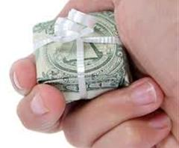
PAC member compensation
Ways must be found to pay professionals who engage in gift planning –Frank Minton
  Fair and ethical
  No regulatory repercussions
Finders fees never appropriate
Commissions paid by charity
  Broker who sells donated securities or purchases investments , real estate agent, life insurance agent
  Gift annuities, donor advised funds, pooled income fund
American Cancer Society reimbursement of legal expenses limited to 2% of the present value of the gift
Charge membership dues or not?
Minton article: www.pgdc.com/pgdc/compensation-gift-planning-and-financial-services-professionals

Slide 35
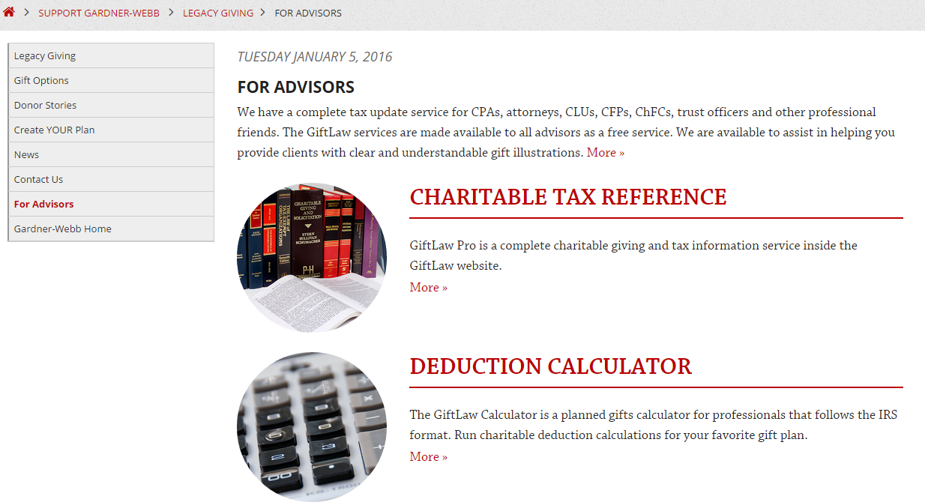
Crescendo: For advisors

Slide 36
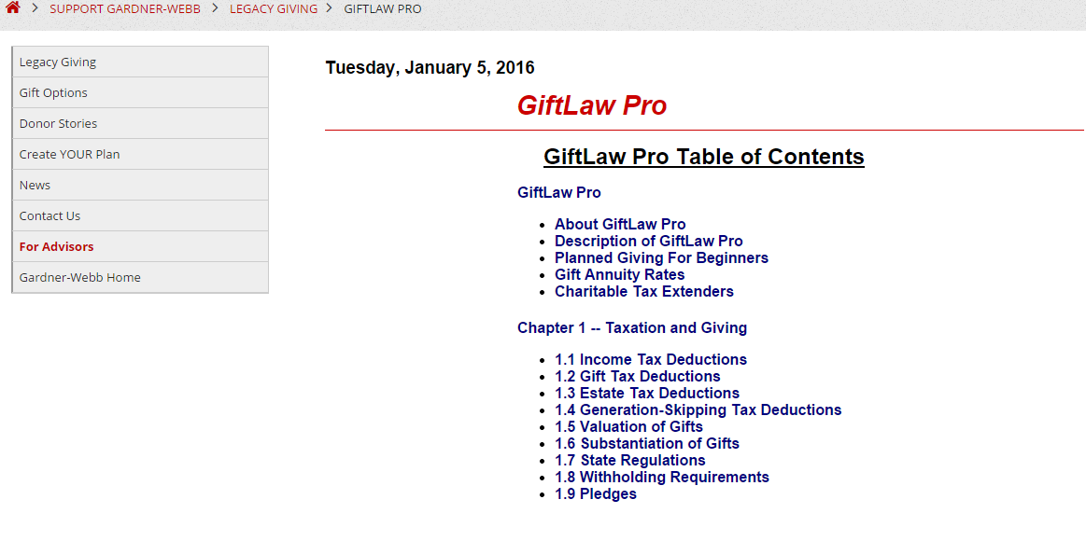
Crescendo: For advisors

Slide 37
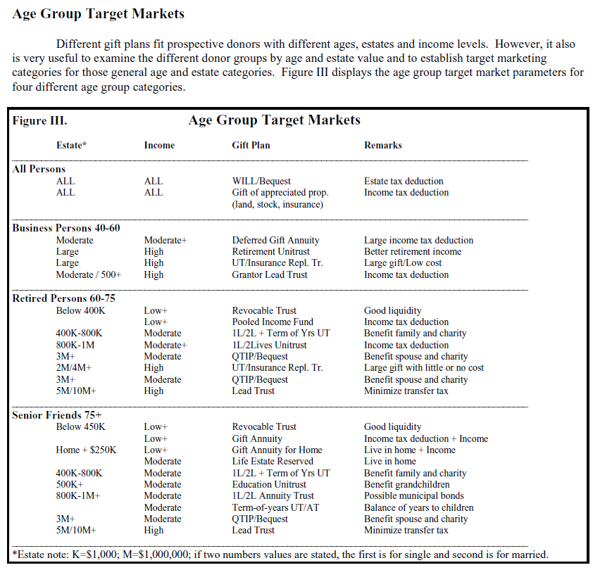
Crescendo
Target markets

Slide 38
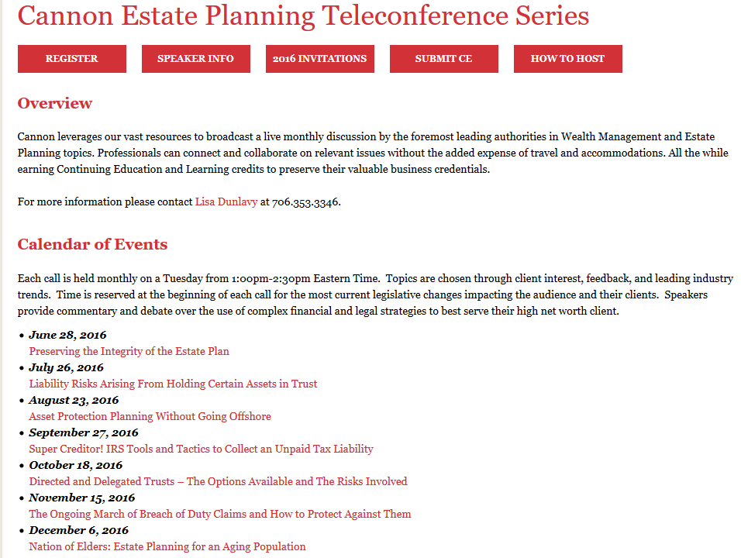
CEU dilemma
One way to provide Continuing Education Units for professionals is to use a national service which sponsors quality presenters and offers to do the back office work for CEUs
Not all topics appropriate for charitable objectives
www.cannonfinancial.com/teleconference

Slide 39
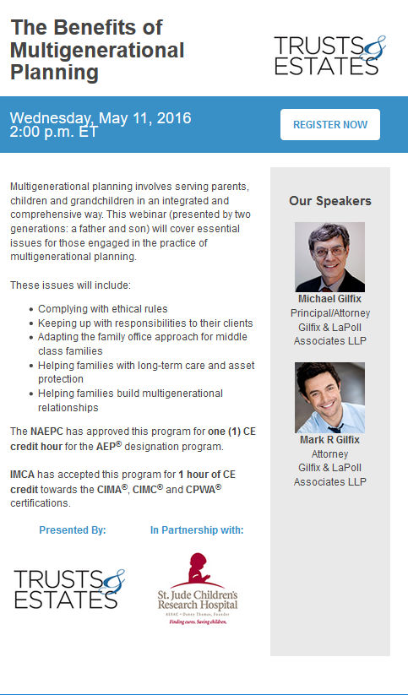
Targeting advisors
Targeting advisors using webinars
Exposure with trusted content provider
Sixty second commercial at start of presentation
Exposure to major advisor Email list
Direct link to planned giving pages from logo

Slide 40
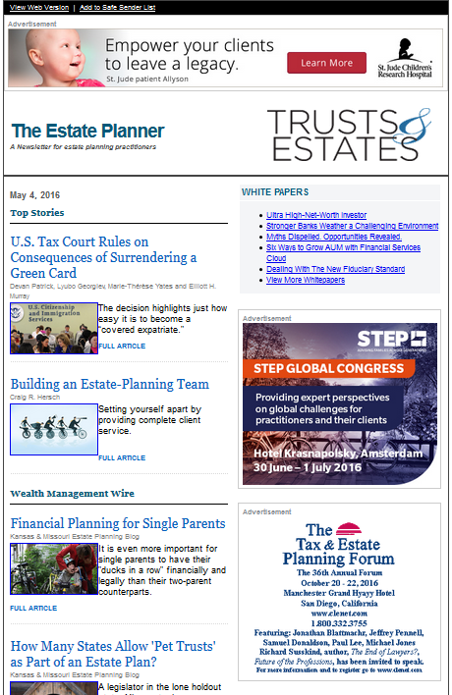
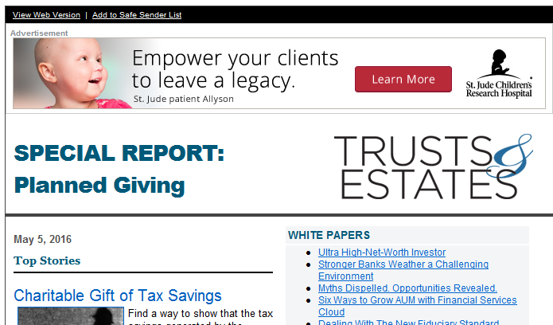
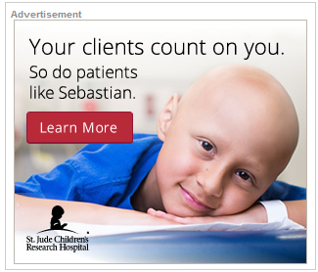
Targeting advisors

Slide 41
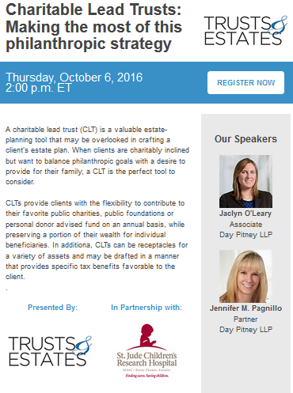
Trust & Estates:
Targeting advisors with webinar sponsorship

Slide 42
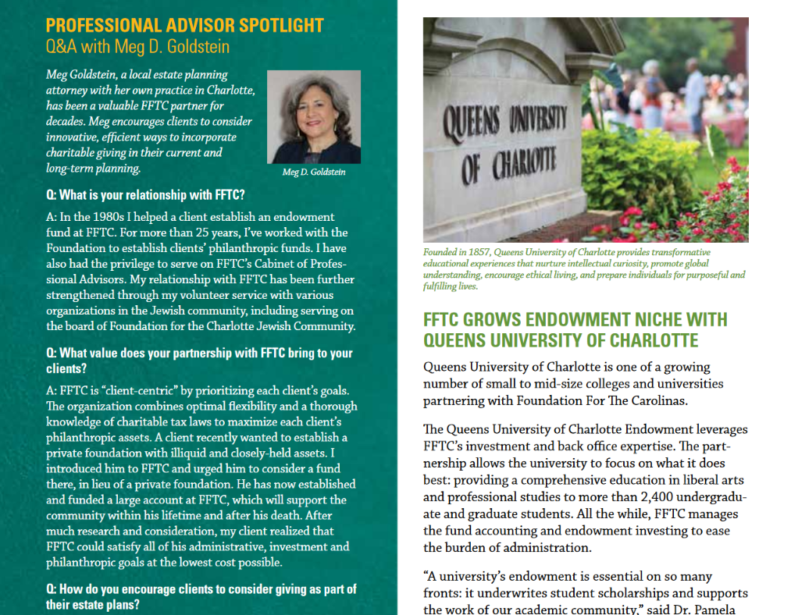
Marketing ideas for advisors
Feature in publications

Slide 43
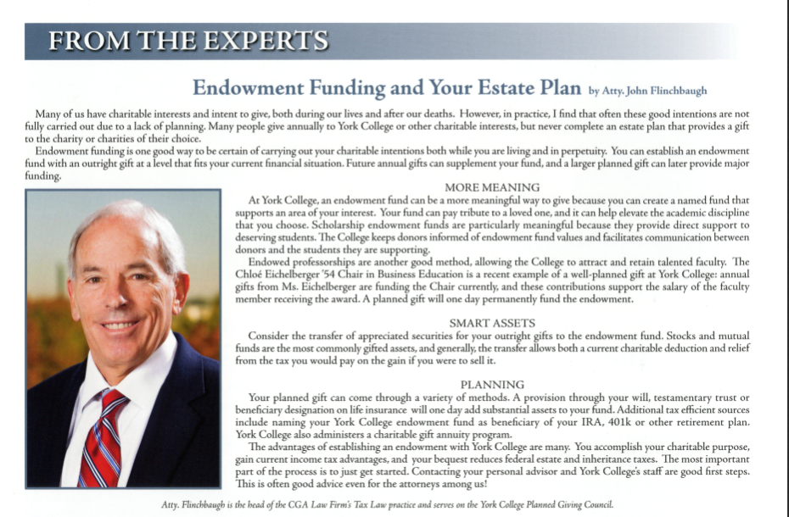
Marketing ideas for advisors
Author articles for publications

Slide 44
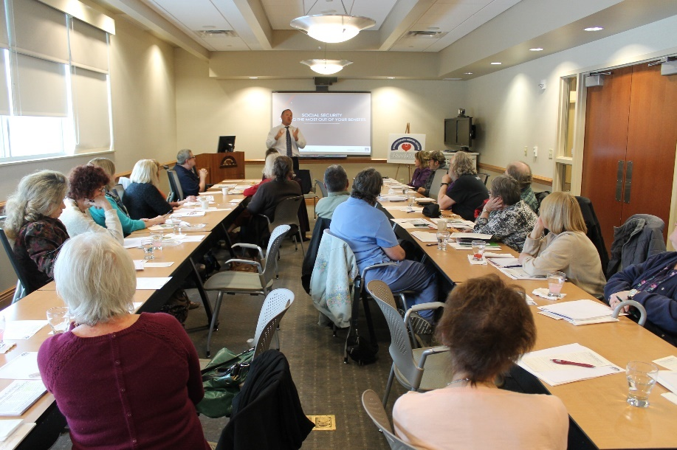
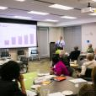
Marketing ideas for advisors
Participate in seminars
General estate planning topics
  Tools and techniques
  Basic of gift and estate taxes
Specific interest topics
  Social security
  Succession planning

Slide 45
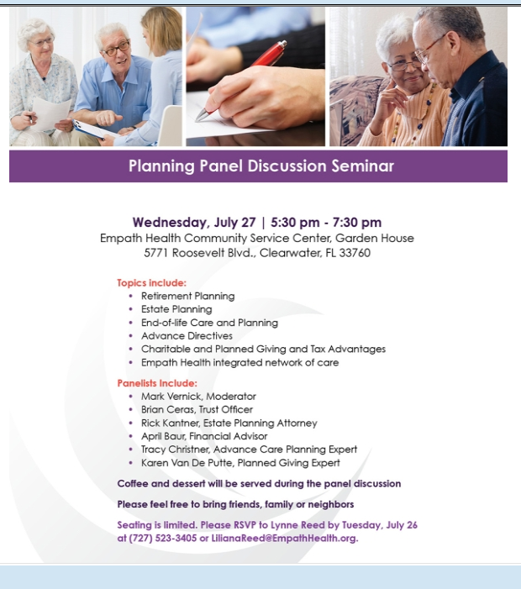
Marketing ideas for advisors
Participate in seminars
Hospice of the Suncoast
E-mail blast
Welcome to Suncoast Hospice Foundation’s E-Newsletter, bringing you closer as a friend, partner and supporter. We are pleased to announce Suncoast Hospice Foundation’s next ‘Panel Discussion’ seminar. These seminars take you through the next phases of life, helping you to understand, plan and be prepared.

Slide 46


Marketing ideas for advisors
Forums for Philanthropy
Assist advisors in creating a charitable strategy forum for their clients on individual philanthropic strategies
  Help donors to understand opportunities, motivations, values and goals for their philanthropy
  Regional meeting of advisors
  Family office presentation on the wealth strategies
  Investment office lunch or before hours presentation

Slide 47
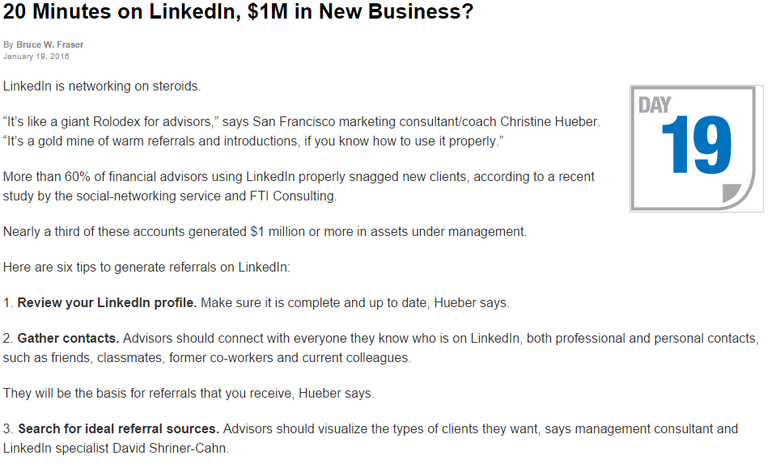
Advisors on Linkedin

Slide 48
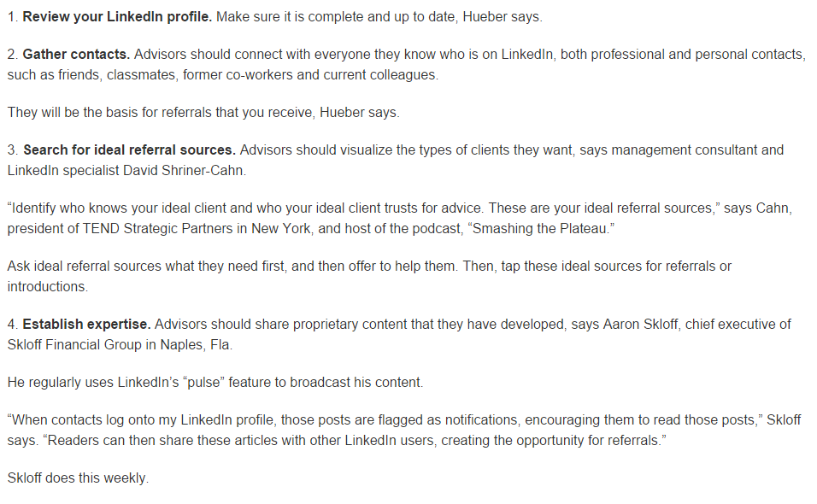
Advisors on Linkedin

Slide 49
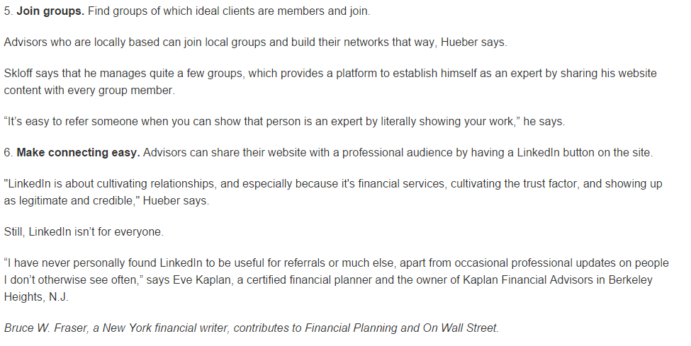
Advisors on Linkedin

Slide 50
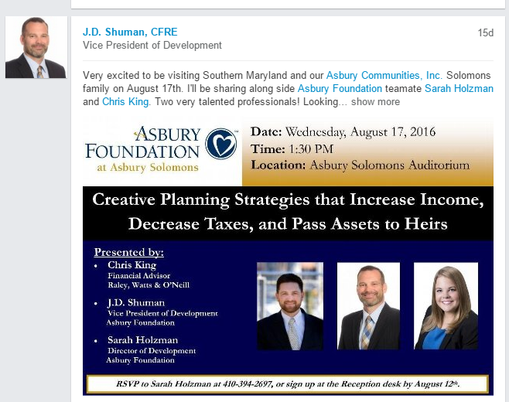
Linkedin promotion

Slide 51
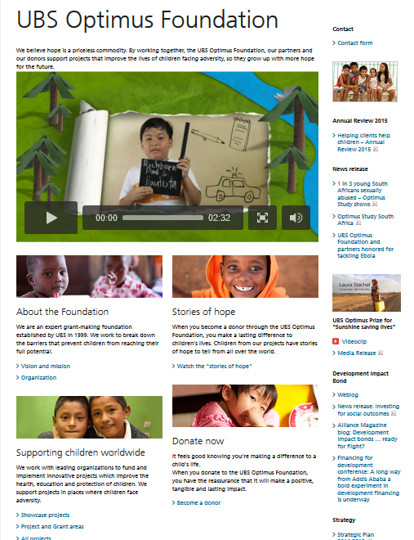

Advisor competition
Vision
A world where all children can reach their full potential.
Mission
Ensuring children are safe, healthy, educated - and ready for their future.
Values
We focus on the most vulnerable children
We engage local expertise in identifying promising opportunities, solving problems, and ongoing learning.
We promote and pursue practical innovations based on high quality evidence.
We effectively steward the resources entrusted to us.

Slide 52
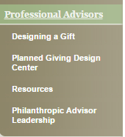
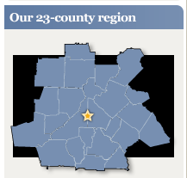

www.cfgreateratlanta.org/
Structure: 2 different groups,
  18 PAC members, 3 year terms, 2 meeting per year
  1,500 cultivated by email blasts,
  Professional staff members of professional groups
Advisors: 80% of donors come via professional advisors
  100 referrals per year, 60% stick rate
  Biggest challenge is valuable engagement, unique gift assets
    Art requests, race horse, statue of “wall street bull”

Slide 53
Case study
Greater Atlanta Community Foundation
Activities: www.cfgreateratlanta.org/Professional-Advisors/Resources.aspx
  Professional Firm Presentations
  Each year, The Community Foundation conducts many “lunch and learn” presentations for local professional firms on a variety of charitable planning and family philanthropy topics. If you would like to have us conduct a presentation for your firm, please email Christy Eckoff, director of gift planning.
  The Balser Symposium
  The Balser Symposium is an annual continuing education opportunity sponsored by The Jewish Federation of Greater Atlanta, United Way of Greater Atlanta and The Community Foundation. The symposium focuses on charitable and estate planning issues, with prominent local and national speakers.
  The Philanthropic Advisor Leadership Institute
  The Philanthropic Advisor Leadership Institute is a annual, multi-session leadership development program sponsored by The Community Foundation, The Jewish Federation of Greater Atlanta and United Way of Greater Atlanta for a select group of Atlanta area professional advisors.
  The purpose of the Institute is to deepen participants’ understanding of how values motivate philanthropic clients, hone existing estate and income tax planning skills as they relate to charitable planning, and forge strong and lasting professional ties between the various participants. Cost $750.

Slide 54
Case Study
Morton Plant Mease Foundation, Clearwater, Florida
Structure: Original board 10 members, recruited 10 other members, chair is Ex-Officio board member, now peer referrals
Advisors:
  3 meeting, social and educational
  198+ advisors, multiple counties
  Crescendo GiftLaw weekly mailings
  Membership application procedure and review by executive committee
  Application download at: www.connellandassoc.com/pdf/MPMPGACApplication.pdf
Challenge: Building collegiality among members, donor restricted gifts
Advisors most often provide future gift notification
Provide 50% of referrals to probable donors, 80% known donors

Slide 55
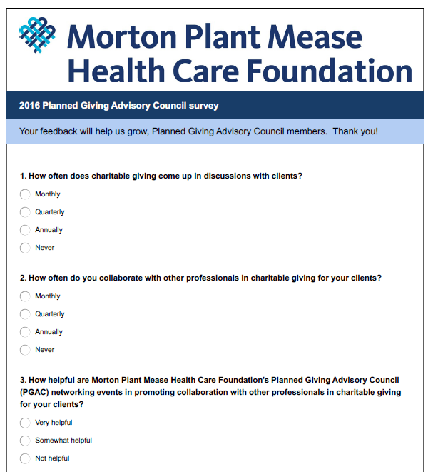
Case Study
Morton Plant Mease Foundation -PAC Survey
For the complete 15 question survey download at
www.connellandassoc.com/pdf/MPMPGACSurvey.pdf

Slide 56
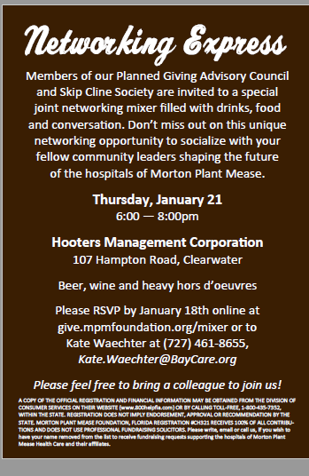
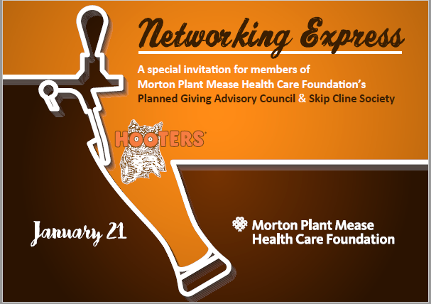
Case study
Morton Plant Mease Foundation: Networking Invite

Slide 57
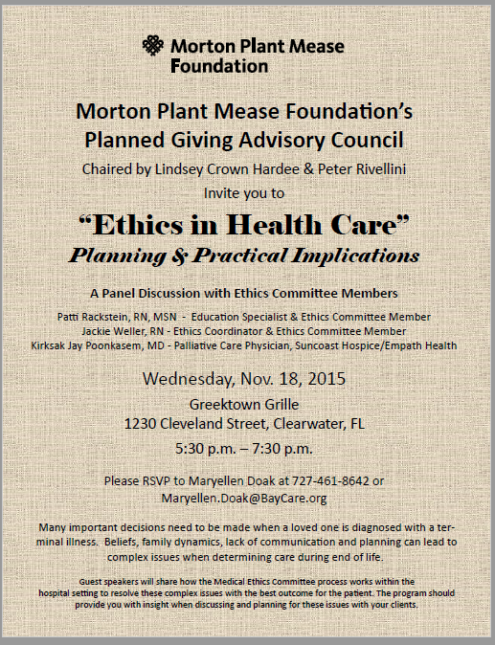
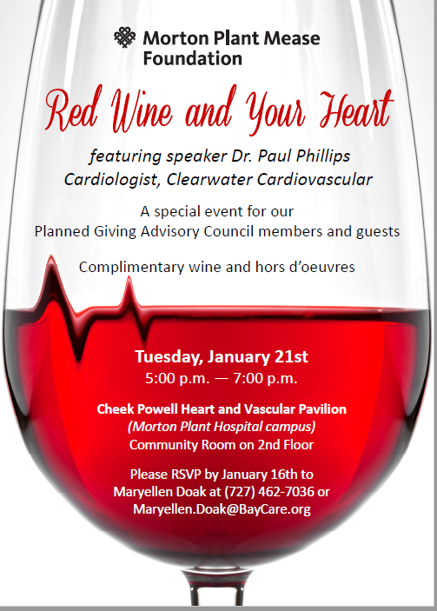
Case study
Morton Plant Mease Foundation: Current hot topics

Slide 58

Case Study
York College of Pennsylvania
Structure: Advancement organized, no formal board relationship
Advisors: 15 members, alumni professionals and other who have expertise in financial planning professions
  Attend meetings, advise on technical matters related to planned gifts
  Identify potential donors and donor groups, provide input on PG program
Activities: 1 yearly meeting, social & educational and “insider” view of priority programs
  Recent topics: Gifts of supporting organization, real estate gifts and family foundation formation

Slide 59
Resources: Building and advisor network
www.connellandassoc.com/PGMentorpromotion/BuildinganadvisornetworkAugust05.pdf
www.carolynmappleton.com/building-relationships-with-professional-advisors/
www.kathrynmireeandassociates.com/PDF
www.pgdc.com/pgdc/professional-advisors-guide-working-non-profit-organizations
www.givingforum.org/sites/default/files/resources/Work%20with%20Professional%20Advisors%20%20Focus%20A%20Tactic%202.PDF
www.pgdc.com/pgdc/interview-todd-fithian-inter-disciplinary-professional-collaboration

Slide 60
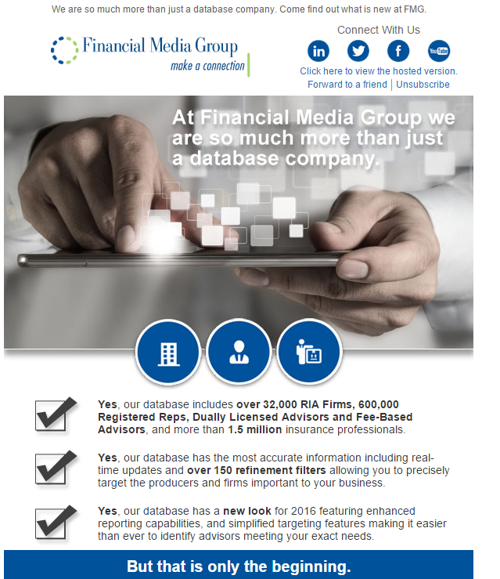
Additional thoughts: Financial Media Group
Source for registered investment advisors

Slide 61
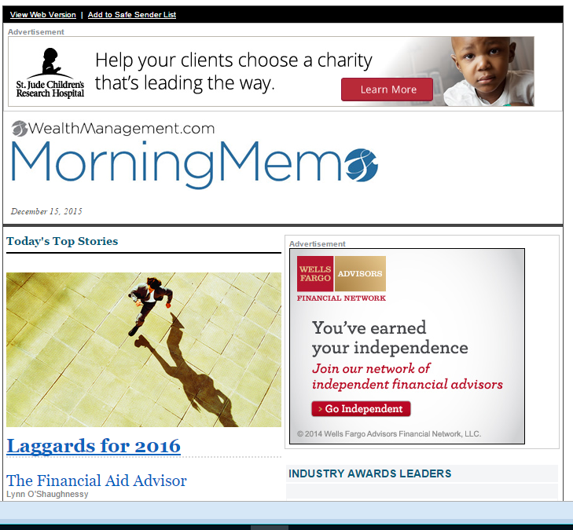
St. Jude advertisement on WealthManagement.com
Additional thoughts:
Daily national Email
blasts to advisors
tag along promotions

Slide 62
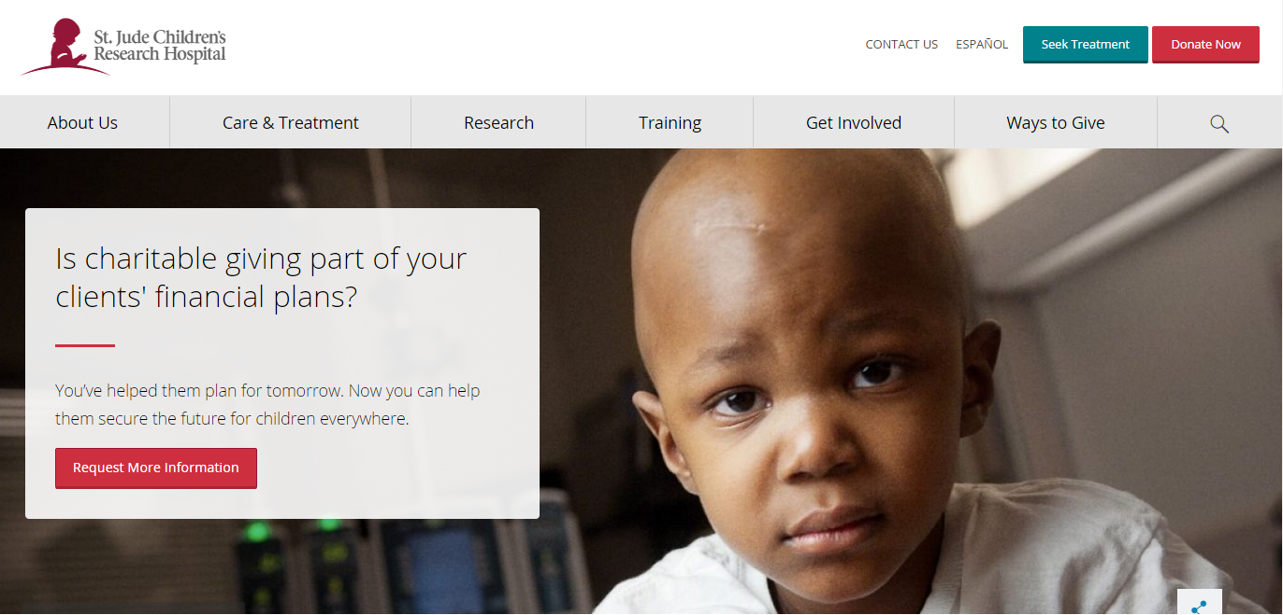
Additional thoughts:
National effort to target advisors
https://www.stjude.org/give/legacy-giving/legacy-giving-at-st-jude-for-financial-professionals.html#requestinfo

Slide 63
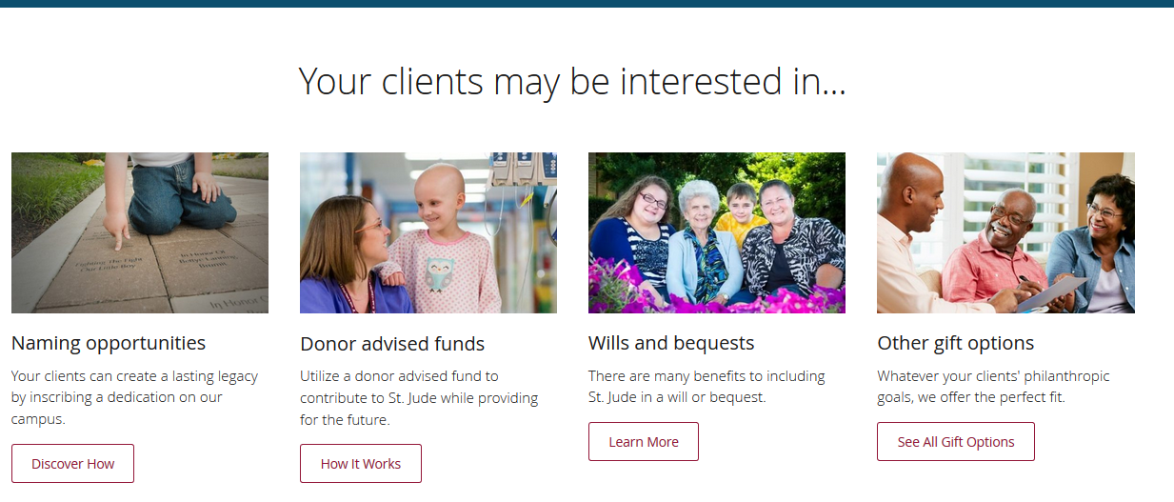
Additional thoughts: Full service charitable strategies

Slide 64
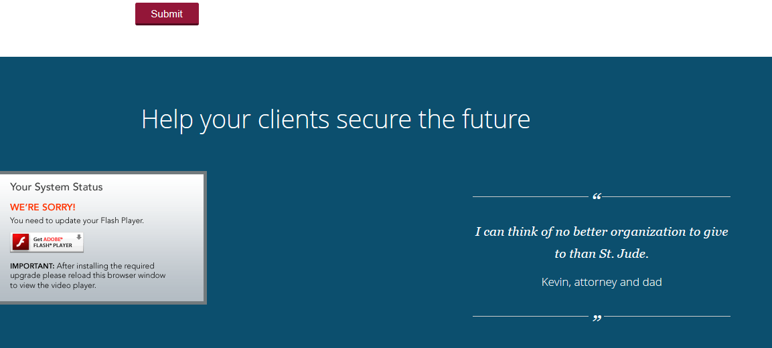
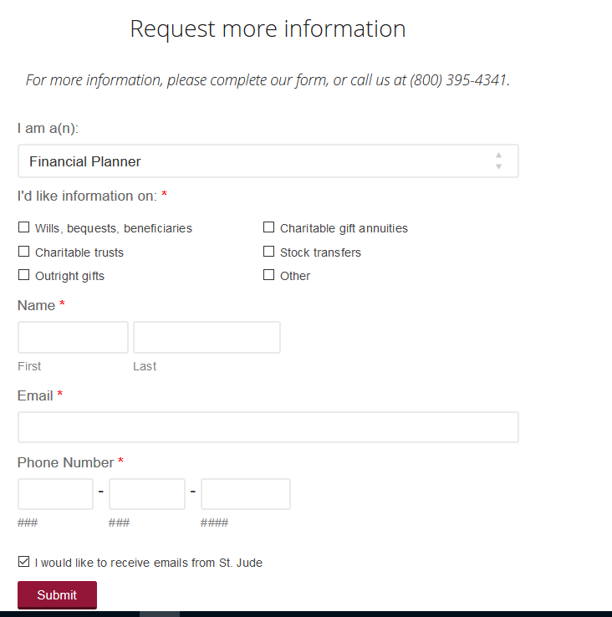
Additional thoughts:
Endorsement from professional advisor
Attorney
Other

Slide 65

Thank you!
© Connell and Associates. James E. Connell, FAHP.
1992-2016. All Rights Reserved.
This is copyrighted material.
Any use, reproduction or distribution of this material
in whole or in part is possible only with
express written permission of the author.
Thank you.

