Slide 1


IRA Charitable Rollover (QCD)
Strategy and Options
James E. Connell FAHP, CSA
Charitable Estate and Gift Planning Specialists
P.O. Box 3335, Pinehurst, NC 28374
Email: jec42644@aol.com
Internet: www.connellandassoc.com
Copy of this presentation available at:
www.connellandassoc.com/articles.html

Slide 2
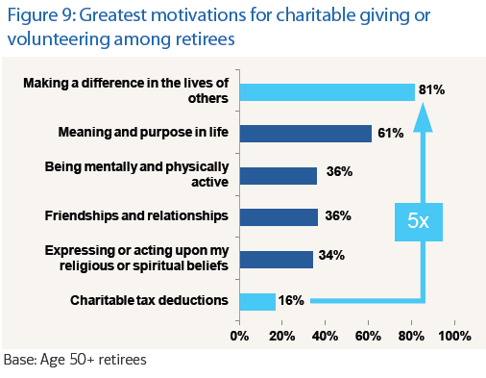
Retirees lead the nation in giving

Slide 3
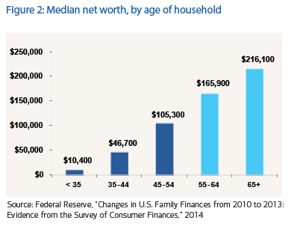
Retirees lead the nation in giving
80% of 65+
contribute to charity

Slide 4
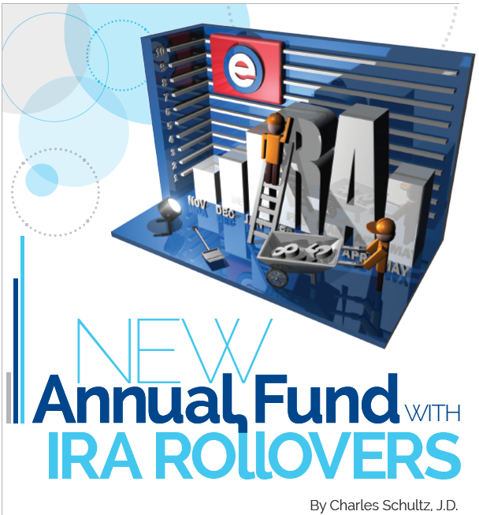

Slide 5
What to call it?
Fundraisers call it the “IRA Charitable Rollover”
  But it is not a rollover at all
  Rollovers are when an individual takes one retirement account and transfers the assets to another type of retirement account, normally an IRA account
Tax law names it the Qualified Charitable Distribution (QCD)

Slide 6
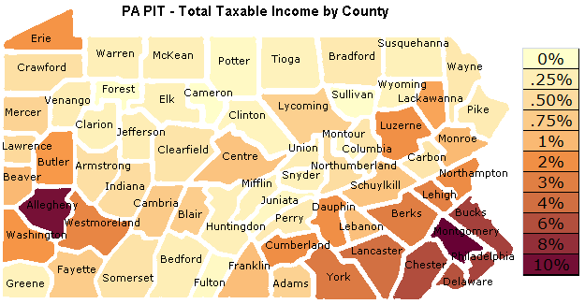
Pennsylvania income tax system
Pennsylvania does not tax Social Security benefits or any eligible Pennsylvania public or private pension plan
No tax on distributions from 401k, 403b, IRAs, deferred-compensation plans or other retirement accounts
Property taxes can be steep in some communities

Slide 7
Pennsylvania income tax system
Pennsylvania has one of the highest percentage of people age 65+ at 15% of the population
No deduction for charitable gifts
Charitable gifts receive only the Federal Income Tax benefits

Slide 8
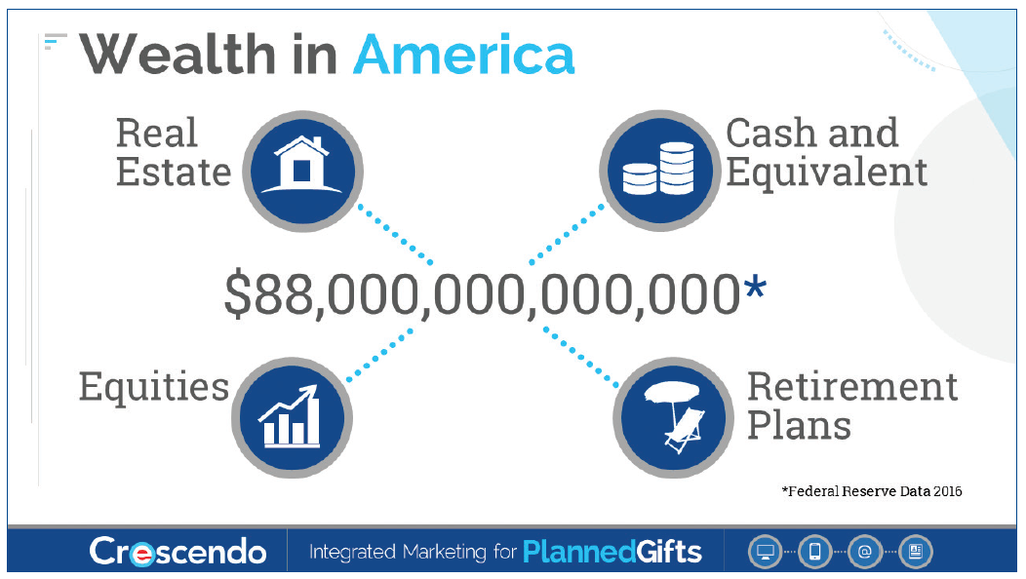
What America owns?

Slide 9
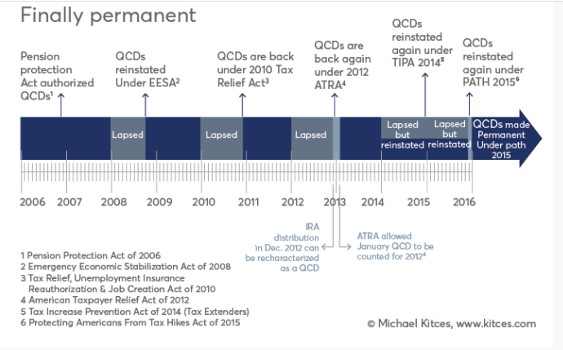
History of the QCD

Slide 10

IRA statistics
2.5 million people will turn 70 this year
First baby boomers take their RMD in 2016
  10,000 baby boomers turn 65 each year
$7.4 trillion invested in IRA account
  Vast majority of the funds are held by those over 65
Ed Slott: DOL fiduciary rules require advisors to explain the charitable rollover option to those who qualify: www.ira help.com

Slide 11
About the IRA Rollover Law(QCD)
On December 18, 2015, IRA rollover became permanent part of tax code
IRAs available for tax-free lifetime gifts
Donors must be 70½
Up to $100,000 per IRA holder per year
Satisfies all or a portion of an individuals required minimum distribution requirement (RMD)

Slide 12
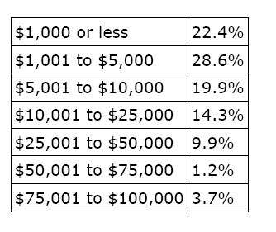
A Guide to IRA Charitable Rollovers(QCD)
IRA account owners 70½ or older may make a direct transfer to charity up to $100,000 per year
5 Donor profiles
  Convenience donor
  Standard deduction donor
  Generous donor
  Major donor
  Social security donor
Amount received in IRA gifts
of Various Size
Notes:
While the IRA Chartable Rollover option for 2012 has been approved by the Senate it has yet to be fully approved by Congress.
It allows individuals in the RMD years to transfer up to $100,000 to charity without reporting the transfer as income. In essence individuals receive the full benefit of a charitable deduction with having it reported on their tax reports.
The single largest category of potential users of the IRA rollover strategy are those with sufficient IRA balances but do not itemize their taxes.
Only 32.5% of the 141 million tax returns filed by American taxpayers for the 2009 tax year (the latest year for which tax data has been released by the government) claimed itemized deductions (source: Internal Revenue Service).
There are several additional rules to make an effective IRA rollover gift and individuals should consult their advisors for full details.

Slide 13
A Guide to IRA Charitable Rollovers (QCD)
Allows for IRA distributions to charity
    Both regular IRA accounts and Roth IRA accounts (5 year rule) are eligible
    IRA checkbooks (must be payable to charity)
Charity must be eligible
Individual must be 70½ or older on the date of contribution
    Qualified Charitable Distribution (QCD) will qualify for the Required Minimum Distribution requirements of IRA
$100,000 limit
    $200,000 from couple with separate accounts
Transfers from other pensions and profit sharing plans, i.e. Keogh, 401k, 403b, etc., are not allowed
    Possible to rollover above accounts to IRA if plan and time permit
Notes:
The slide lists the basic requirements for an individual to be eligible and for a charity to receive a rollover from a IRA or Roth IRA account. It also lists those retirement plans which are not eligible for the transfer.

Slide 14
Charities and those not eligible
Charities must be public 501(c)3
  Eligible for charitable deductions under IRS section 170
No private foundations
No donor advised funds at community foundations
  Field of interest funds are OK
No supporting organizations classified as 509(a)3

Slide 15
A Guide to IRA Charitable Rollovers(QCD)
NOT permitted transfers/gifts, QCDs
  Outright gifts only
  No split interest gifts
    No charitable gift annuities (CGA)
    No charitable remainder unitrusts (CRT)
    No charitable remainder annuity trusts (CRAT)
    No pooled life income funds (PIF)
  No “quid pro quo” gifts
    No personal benefits
    No special events
    No athletic tickets

Slide 16
A Guide to IRA Charitable Rollovers(QCD)
Suggested procedures
  1. Notify charity of potential gift
  2. Instruct custodian/trustee of IRA on the proper form and if no form send a complete letter of instructions with payment/gift to the charity as a “third party payment”
  Transfer will be mostly cash but in-kind transfers (i.e. securities) are permitted
  3. Keep records of transfer
    substantiation from charity
  If appropriate, elect out of withholding

Slide 17
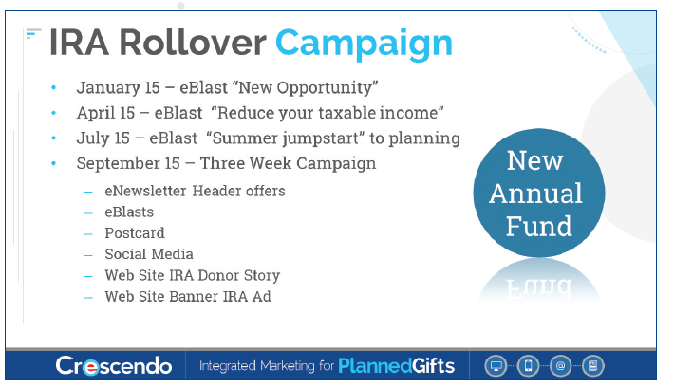
Marketing campaigns

Slide 18
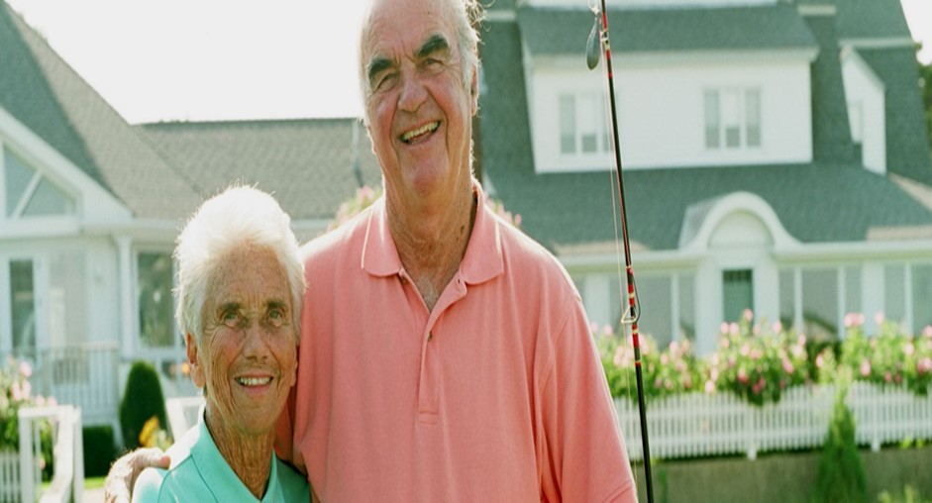
Questions to help donors decide
1. Are your planning to leave a charitable legacy through your estate plan?

Slide 19

Questions to help donors decide
2. Have your designated your favorite cause as the beneficiary of retirement assets?

Slide 20
A Guide to IRA Charitable Rollovers(QCD)
Donor Profile – Convenience Donor
  Most delay taking distributions until the last quarter of the year in order to grow the invested funds tax-free
  If actively making charitable gifts may consider the benefits of making gifts from their IRA account(s)
      No inclusion in income
      No income tax deduction
      Qualifies for RMD

Slide 21

Questions to help donors decide
3. Have your retirement savings and investments growth exceeded your expectations?

Slide 22
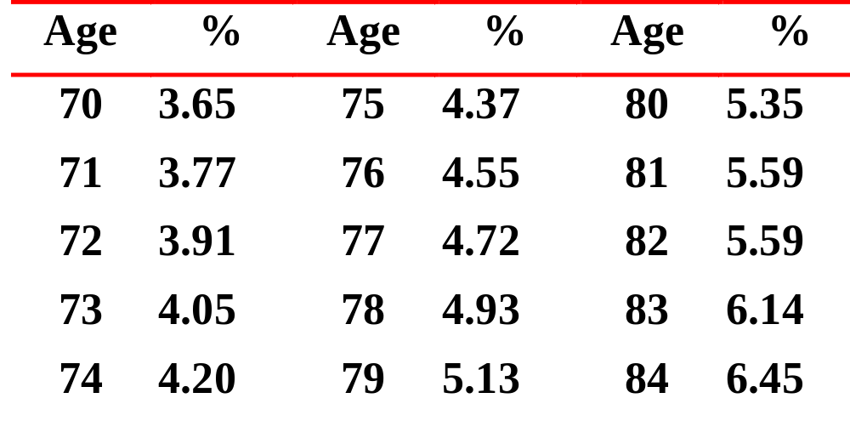
Required Minimum Distribution (RMD)
IRS table percentages

Slide 23
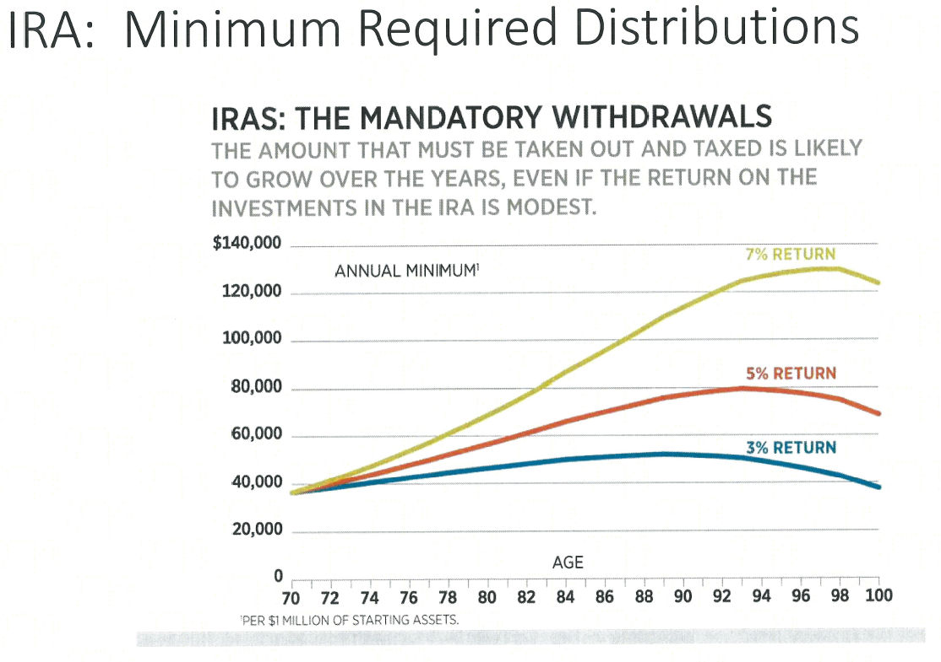

Slide 24
Questions to help donors decide
4. Are your itemized deduction reduced by 3% because of the reduction on itemized deductions for higher income individuals?
For example: A married couple filing jointly has $500,000 in adjusted gross income (AGI) and because their AGI exceeds the $305,050 threshold, the 3 percent reduction applies to this couple’s itemized deductions.
AGI $500,000
Excess of couple’s AGI over $305,050 = $194,950
3% reduction x 3%
_______________
Reduction of itemized deductions $5,848.50

Slide 25
Questions to help donors decide
5. Do you take the standard deduction on your tax return and make annual gifts to your favorite charities?
For example: the standard deduction for a married couple is $15,100 in 2016; if donors have no mortgage and low state/property taxes, they may not itemize and deduct charitable contributions—the new law allows for charitable contributions from IRAs to be excluded from income which is a special advantage for non-itemizers.

Slide 26
A Guide to IRA Charitable Rollovers(QCD)
Donor Profile – Non-Itemizers
    May be donors with modest IRA account balances, but sufficient retirement income from personal investments and tax-exempt accounts
    Taking MRD may not significantly increase their lifestyle
    Do not have significant tax deductions
      State and local income taxes
      Interest expenses
      Medical expenses
      Charitable deductions
    So the standard deduction applies (2016), over 65
      Married/Joint - $13,850 one / $15,100 two
      Single - $7,850
      Head of household - $10,850
Notes:
Non Itemizers are the most significant group who should consider the IRA rollover option.
Only 32.5% of the 141 million tax returns filed by American taxpayers for the 2009 tax year (the latest year for which tax data has been released by the government) claimed itemized deductions (source: Internal Revenue Service).

Slide 27

Questions to help donors decide
6. Do your take minimum distributions from your IRA but have adequate alternative sources of income?
  You do not need it for your lifestyle!
For example: By age 70 ½, individuals must start to withdraw funds from their IRAs based on an IRS schedule, a 75 year old with $1,000,000 in IRAs must distribute at least $44,000.

Slide 28

Questions to help donors decide
7. If you take greater distributions from your retirement plans, does doing so affect the amount of Social Security benefits that are taxed?
For example: provisional income < $32,000, no tax on SS;
$32,000 to $44,000, 50% of SS is taxable; greater than $44,000, 85% of SS is taxable

Slide 29




Questions to help donors decide
8. Is there a special cause you care about?
Would you like to benefit your community?
Do you want your charitable gifts to have the greatest impact?

Slide 30
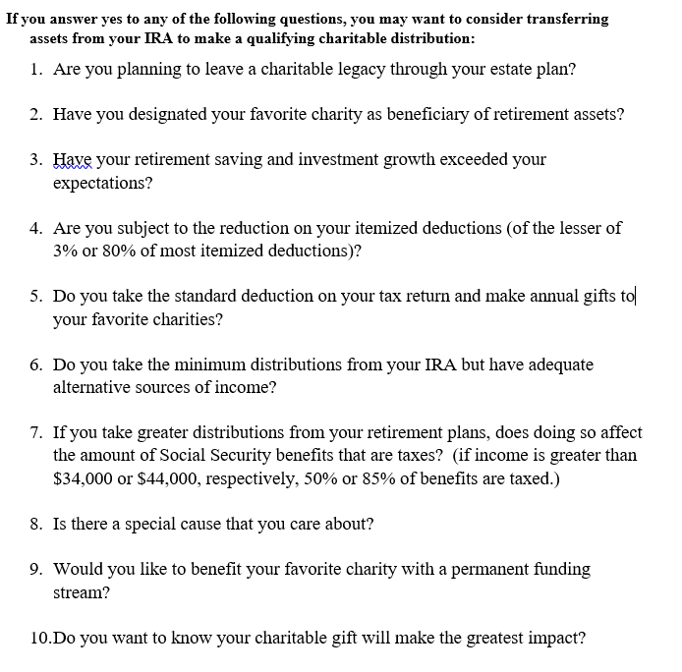
Sample questionnaire

Slide 31
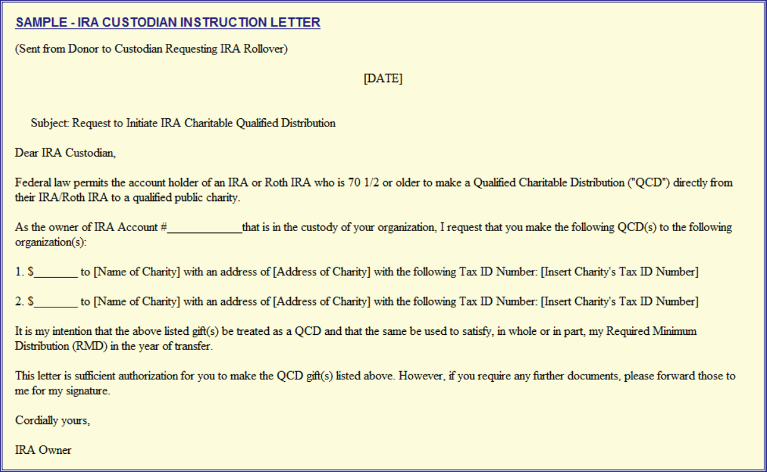
Custodian notification letter

Slide 32
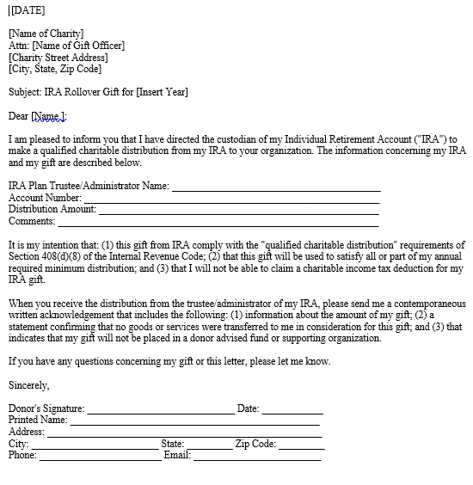
Charity notification letter

Slide 33
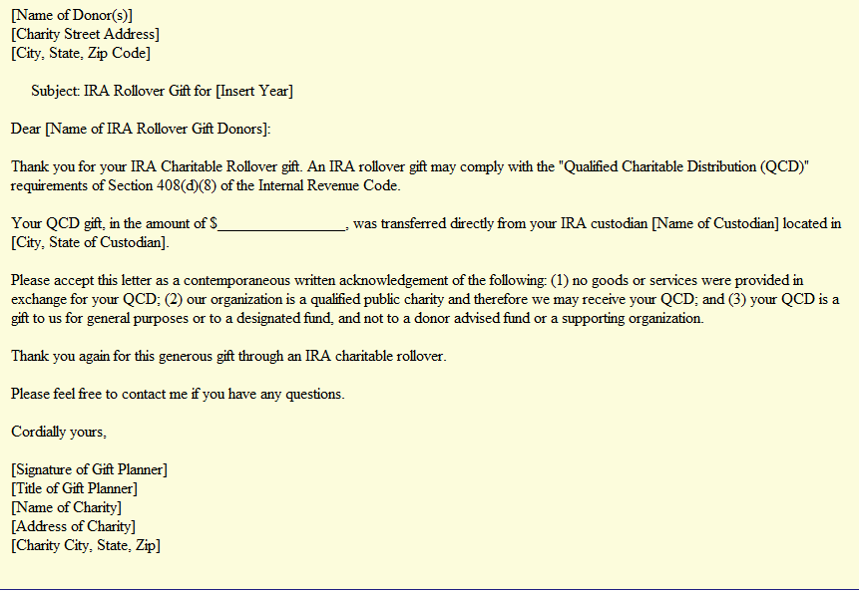
Charity acknowledgement letter

Slide 34

IRA Legacy act: the future
Legacy IRA Act (HR 5171), proposed federal legislation that would significantly expand the current-law IRA Rollover (QCD) to allow for life-income gifts, including charitable gift annuities and charitable remainder trusts.
CGAs and CRT, no PIF
$400,000 ceiling for 65+ individuals
Minimum payout 5%
Payments: all ordinary income – no tax-free
4 year trial period
Cost: $100 million over 10 years

Slide 35
QCD – pledges and delivery
IRA Rollovers To Pay Pledges – Because the IRA funds are owned by the IRA owner, they may be used to fulfill a legally-binding pledge. The transfer from the IRA owner to the charity is treated as a receipt by the owner under Sec. 4975(d)(9) and therefore the IRA rollover is not a prohibited transaction.
IRA Owner Delivers Check – Most IRA custodians transfer IRA rollover funds by check or electronic transfer directly to the charity. However, some IRA custodians issue a check payable to the charity, but send the check to the donor for forwarding to the charity. This transaction will still qualify under Sec. 408(d)(8)(A) as an IRA rollover if the check is issued payable to the charity and the owner delivers the check prior to December 31 of the applicable year.
IRA Custodian May Rely on IRA Owner Representation of charity

Slide 36
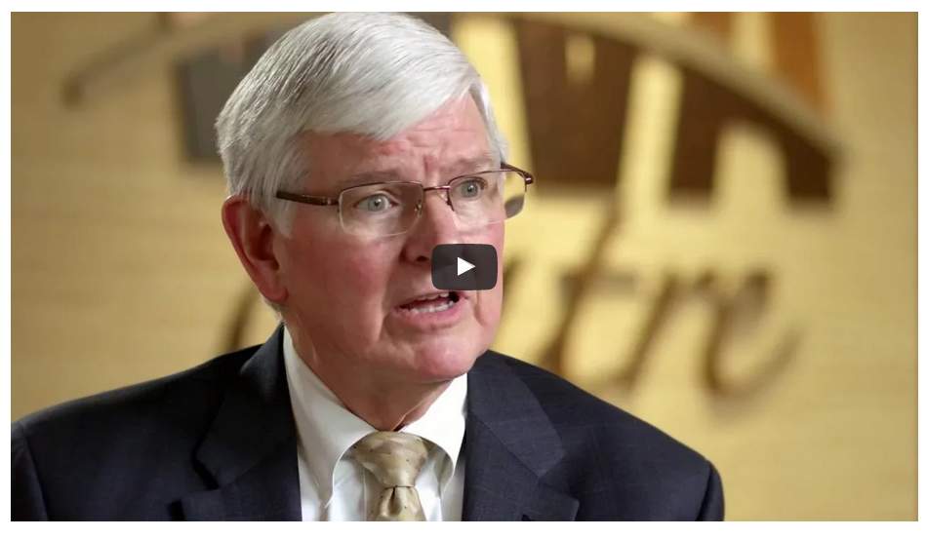
Video on QCD
http://www.goodnewsqcd.com/
Greg Pierce & CPA interview

Slide 37


IRA Charitable Rollover Strategies…..
The New Annual Fund
Thank You

