Slide 1
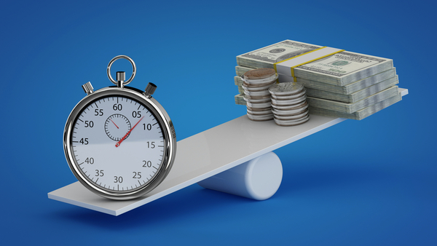
7 Charitable strategies to increase income and decrease taxes
James E. Connell FAHP, CSA
Charitable Estate and Gift Planning Specialists
P.O. Box 3335, Pinehurst, NC 28374
Email: james@connellandassoc.com
Internet: www.connellandassoc.com
Copy of this presentation available at:
www.connellandassoc.com/articles.html

Slide 2
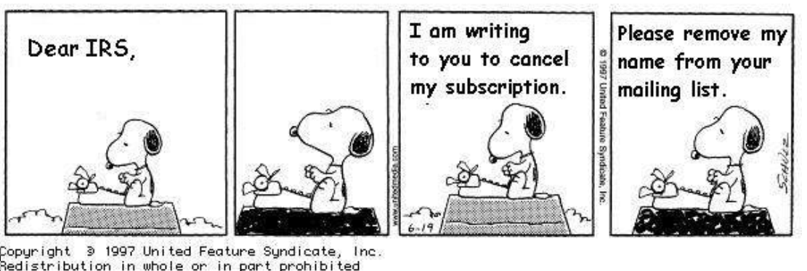
Snoopy and the IRS
Notes:
While taxes may drive you to the planning table
Study after study has indicated - Most charitable gifts are made because the donor believes in the mission of the charity/organization

Slide 3




Quotes for the day
80% of Americans engage in charitable giving each year.
Wealthy people are not necessarily philanthropists. But philanthropists are usually wealthy.
Which charity is part of your life story?

Slide 4
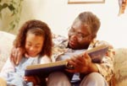

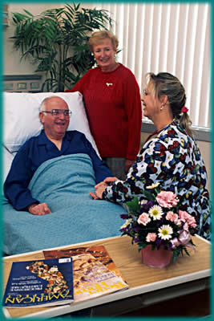
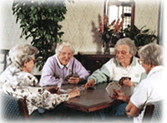

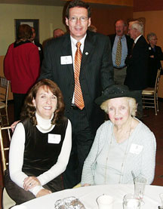
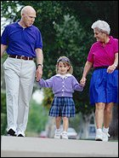



Your Goals

Slide 5
Agenda
Let’s start with reviewing the new 2018 income and estate tax laws
Discuss the stages of planning
  Ask yourself what, when and how would you distribute your life’s work
Review of assets
7 simple charitable strategies to increase income and/or decrease taxes

Slide 6
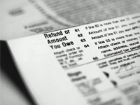
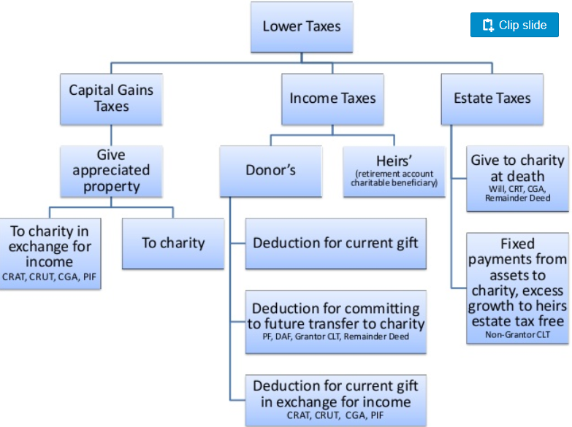
What gift can do for you
Notes:
This is a simple chart showing the first benefit of charitable giving is the lowering of taxes
The government Federal and some states (not Pennsylvania) are our partners in giving since when you itemize your taxes and report charitable gifts you reduce your tax burden therefore your gifts costs less.
A $10,000 gift made in the 30% marginal tax bracket the donor receives a tax reduction of $3,000 therefore the cost of the gift “Out of Pocket” is only $7,000
We have many taxes
Income taxes on what you make.
Capital gains taxes on successful investments.
Estate taxes (MAYBE) when you die depending on how much you own.

Slide 7
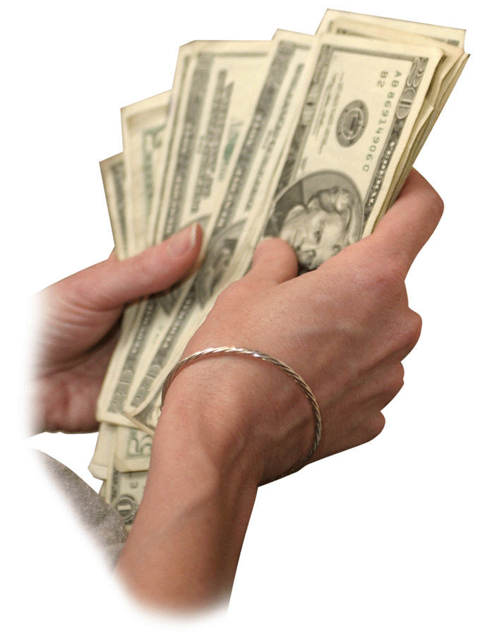
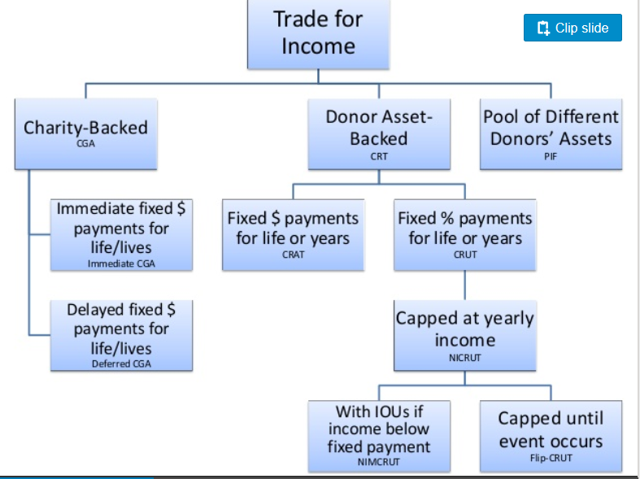
What gifts can do for you
Key: CGA – charitable gift annuity
CRT – charitable remainder trust, CRUT – Unitrust, CRAT Annuity trust,
NICRUT – net income makeup unitrust, Flip-CRUT
PIF – pooled income fund
Notes:
The other major benefit of charitable gifts is you may trade both income you earn and/or assets you own for income
There are many plans such as gift annuities backed by the charity
Charitable trusts backed by the gifted asset
And Pooled funds where your gift is invested with others.

Slide 8
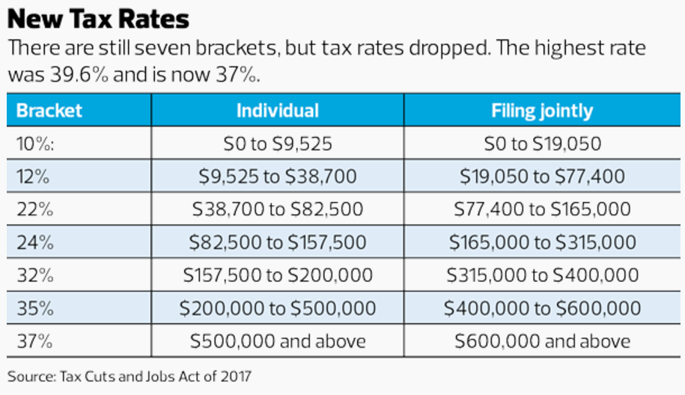
New tax rates

Slide 9
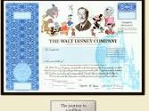
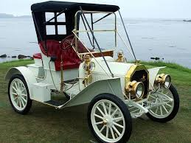
Capital gains rates unchanged
Capital gains rates on assets held 12 month+
  10% or 12% bracket = 0% tax
  22%, 24%, 32%, 35% brackets = 15% tax
  37% bracket = 20% tax
Net investment tax on AGI over $200,000 or $250,000 is +3.8%
Collectables tax = 28%

Slide 10
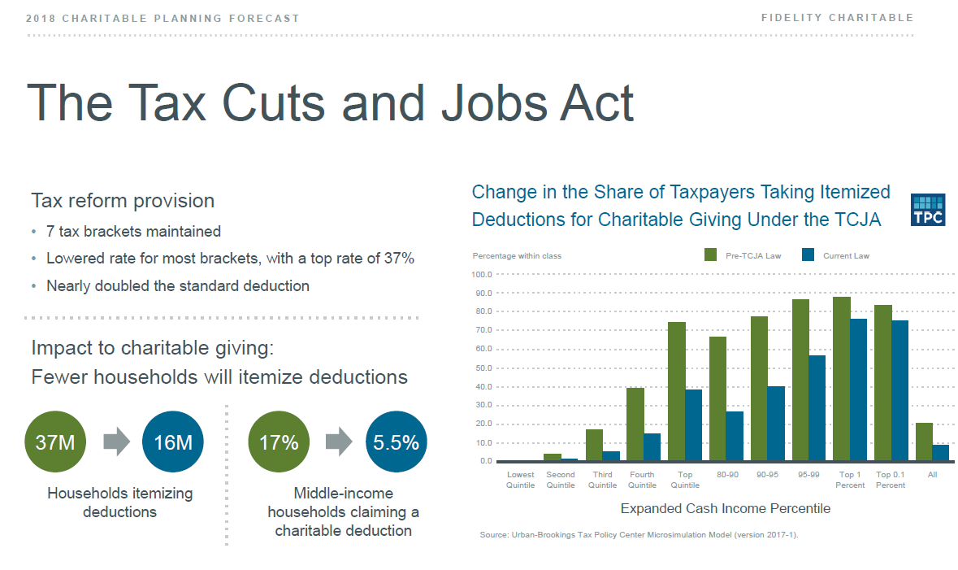
Fewer individuals will itemize

Slide 11
Know your standard deduction by filing status
 | Single | Joint | Head of household | Married filing separately
Basic | $12,000 | $24,000 | $18,000 | $12,000
Over 65 | $13,600 | $25,300 (1) $26,600 (2) | $19,600 | $13,300
Blind | $13,600 | $25,300 (1) $26,600 (2) | $19,600 | $13,300
Over 65 & blind | $15,200 | $26,600 (1) $29,200 (2) | $21,200 | $14,600

Slide 12
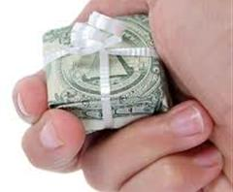
What qualifies as a deduction?
Itemized deductions include:
  State and local taxes: $10,000 limit
  Mortgage interest: $750,000 mortgage limit,
    no home equity interest deduction unless used to improve home
  Medical expenses: exceed 7.5% of AGI
  Charitable gifts: cash up to 60% of AGI
    Appreciated stock gifts up to 30% of AGI
  An itemized charitable deduction is the
  government bonus for being charitable
  today

Slide 13

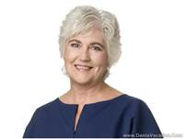
Standard deduction by filing status
Example 1: A couple both over 65 would have to have deductions over the threshold of $26,600 to itemize and receive an additional tax benefit.
  Under the threshold charitable gifts are
  not deductible.
Example 2: A single filer age 60 would have to have deductions over the threshold of $12,000 to itemize and receive an additional tax benefit.
  Under the threshold charitable gifts are
  not deductible.

Slide 14
Getting to itemize example #1
INTEREST
$5k
$10k
Sch A, line 9
Sch A, line 15
Sch A, line 19

Slide 15
Getting to itemize example #2
INTEREST
$10k
$10k
Sch A, line 9
Sch A, line 15
Sch A, line 19

Slide 16
Getting to itemize #3 - personal
INTEREST
$20,053
$0
Sch A, line 9
Sch A, line 15
Sch A, line 19
Note: +$8,000 in Qualified Charitable Distributions,
2017 Standard deduction $15,200

Slide 17
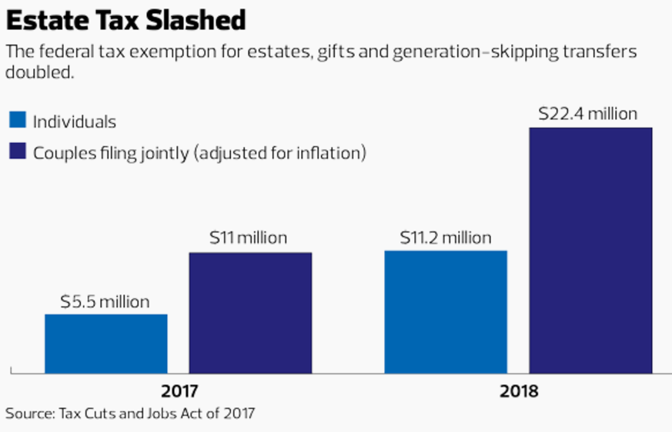
Estate taxes slashed

Slide 18
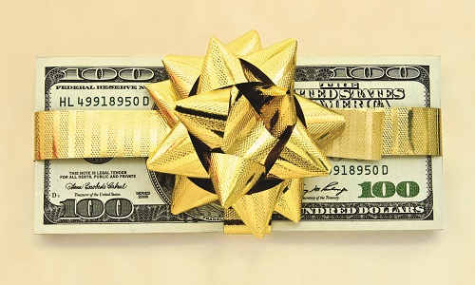
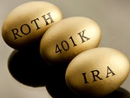

Effective giving
Bunching gifts in certain years
  Every other year gifts
Appreciated asset gifts
  Capital gains tax not taxed
IRA rollover gifts
  No deduction but no tax on income
  Must qualify
Donor advised funds
  Gifts to reach over threshold deduction amount

Slide 19
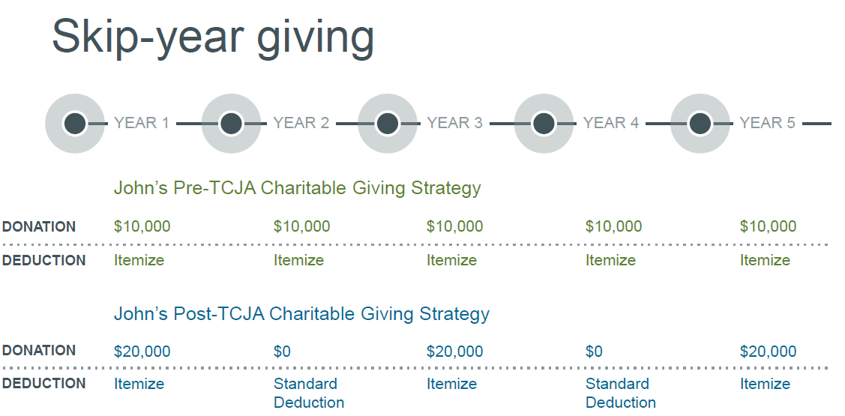
Effective giving #1
Bunching deductions
Skip year giving or bunching deductions will increase.
  Not a new strategy, have been used by seniors for years

Slide 20
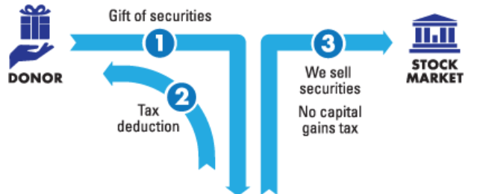
Effective giving #2
Give appreciated assets
Fair market value
Charity
Example: Sara has accumulated 1,000 shares of Apple stock over the last 5 years.
Her 1,000 shares are currently valued at approximately $160,000.
Her cost basis on the 10 shares of Apple she is gifting to charity is $60 per share.
She gets a deduction of $1,600 and avoids any tax on the $1,000 capital gains.

Slide 21

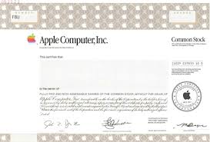
Effective giving #2a
Give appreciated assets
Charitable swap
1
Charity
3
2
Charity
No “wash sale” rule because this is gain property, not loss property

Slide 22
Effective giving #3
Qualified charitable distributions “QCD”
Allows for IRA gifts to charity
    Both regular IRA accounts and Roth IRA accounts are eligible, IRA check books
Charity must be eligible
Individual must be 70½ or older on the date of contribution
    Qualified Charitable Distribution will qualify for the Required Minimum Distribution requirements of IRA
$100,000 limit
    $200,000 from couple with separate accounts
Transfers from other pensions and profit sharing plans, i.e. Keogh, 401k, 403b, etc., are not allowed
    Possible to rollover above accounts to IRA if plan and time permit
Notes:
The slide lists the basic requirements for an individual to be eligible and for a charity to receive a rollover from a IRA or Roth IRA account. It also lists those retirement plans which are not eligible for the transfer.

Slide 23
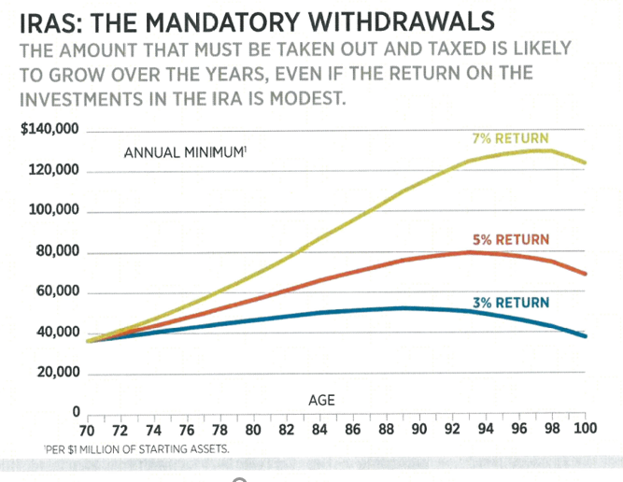
Effective giving #3
Qualified charitable distributions “QCD”

Slide 24
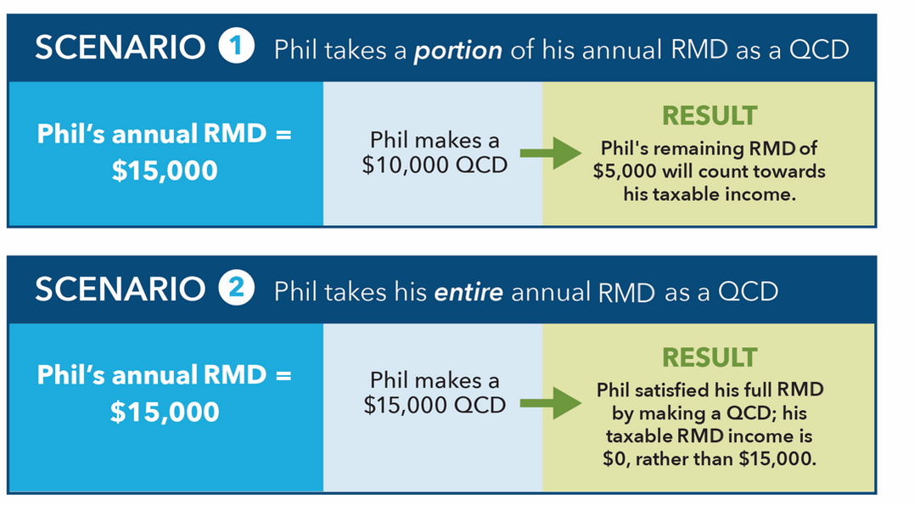
Effective giving #3
Qualified charitable distributions “QCD”
Note: No charitable deduction
1) Tax saving 24% bracket saved $2,400, 2) saved $3,600

Slide 25
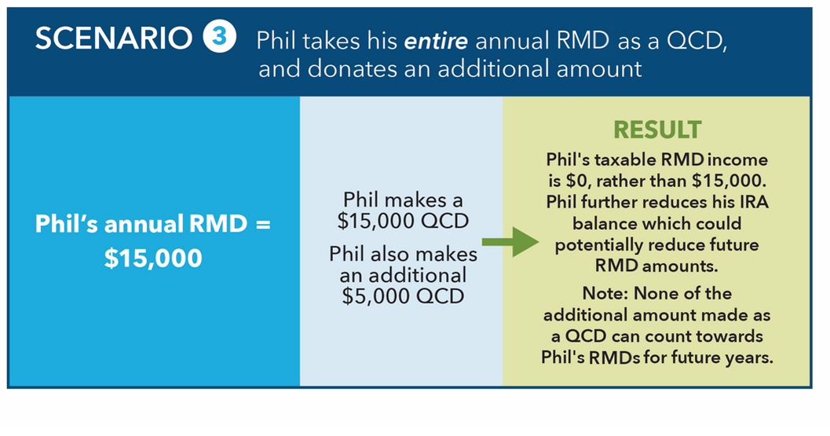
Effective giving #3
Qualified charitable distributions “QCD”
Note: No charitable deduction in this case but if Phil used appreciated assets or cash
he would receive additional $5,000 deduction but he must itemize to get
the government bonus for being charitable. If he does not itemize this is still a tax
smart approach.

Slide 26
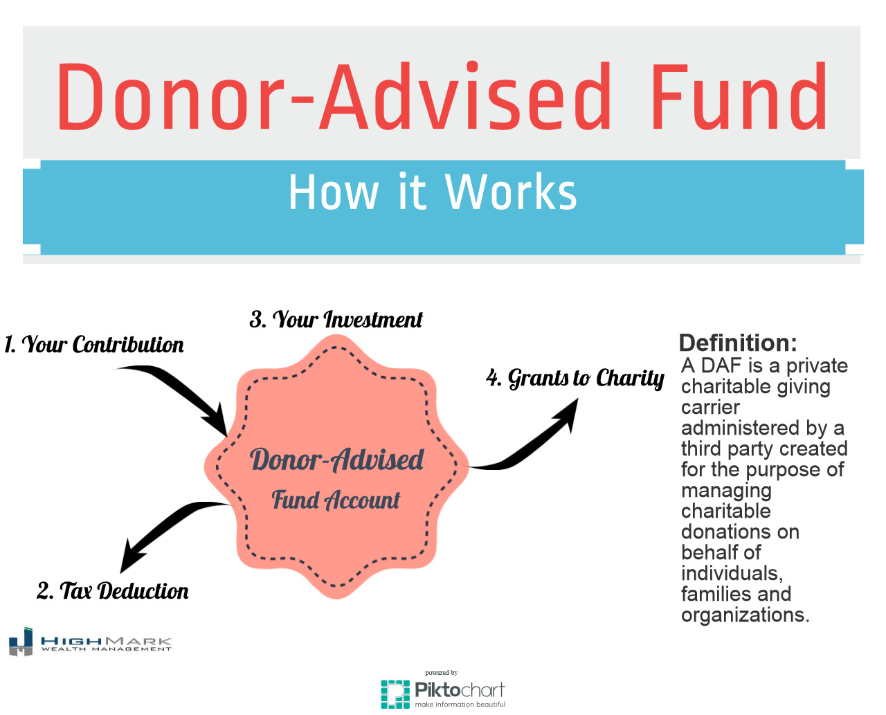

Effective giving #4
Donor advised funds “DAF”

Slide 27
Effective giving #4
Donor advised funds “DAF”
Give cash now
Maximize charitable deduction in year of your gift
Gift appreciated assets to save capital gains taxes
Gift complex assets
Front load gifts in high tax years
Grow your fund tax-free & determine investments
Time future gifts for maximum charitable impact
  No “quid pro quo” benefits
Can make gifts anonymously
Less expensive alternative to creating a private foundation

Slide 28


Three categories of gifts
Outright gifts – irrevocable gifts of entire interest
made today (cash or assets)
Expectancies – revocable gifts committed for the
future use (bequests & beneficiary designations)
Split-interest gifts – irrevocable gift arrangements
which give a portion to charity and a portion to a
non-charitable beneficiary

Slide 29
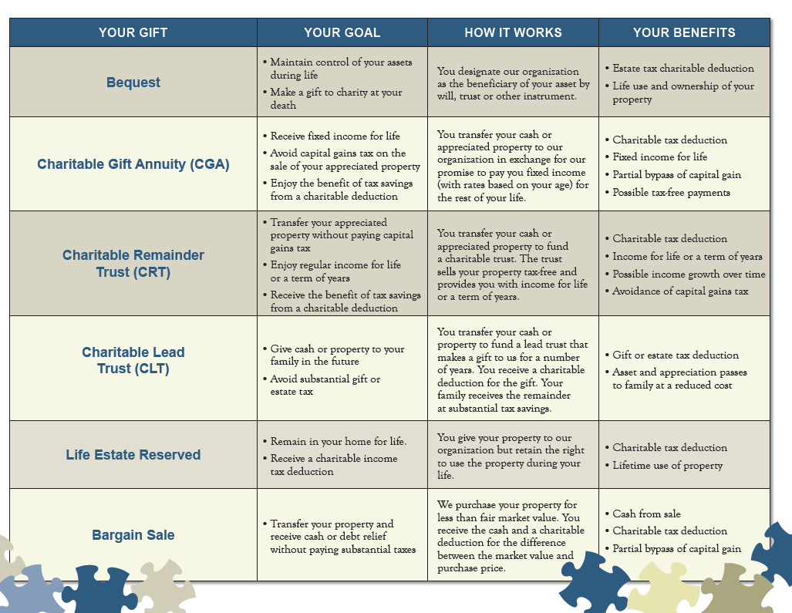

Slide 30


Types of gift assets
Life Insurance
Variable Annuity
Personal Property
Business Interests
  S - corp
  C – corp
Retirement Assets
  IRA
  Keogh
  Pension & Profit Sharing plans
  401k, 403b plans
Cash
Securities
Bonds - Corporate
Bonds - Municipal
Bonds - US Savings
Real Estate
  residence
  vacation home
  investment property
Mutual Funds

Slide 31

Major giving tools
Life income gifts
    Provide fixed or variable life income
    Partial income tax deduction
    Avoid/Reduce capital gains taxes in whole or in part
Most popular life income programs
  Charitable gift annuity
  Charitable remainder unitrust

Slide 32

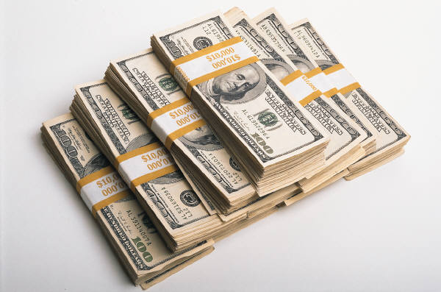
Gift annuity payment rates
Single Life
Age of Donor
60
65
70
75
80
Payment Rate
4.70%
5.10%
5.60%
6.20%
7.30%
Two Life
Age of Donors
60/60
65/65
70/70
75/75
80/80
Payment Rate
4.20%
4.50%
5.00%
5.50%
6.20%
ACGA rates as of July 1, 2018

Slide 33

Effective giving #5
Mr. Thomas and his cash gift annuity
Mr. Thomas
Recent widow
Age 67
Looking to retire soon
Well diversified investment portfolio
Several laddered certificates of deposit
Looking for more income in retirement
A consistent donor

Slide 34
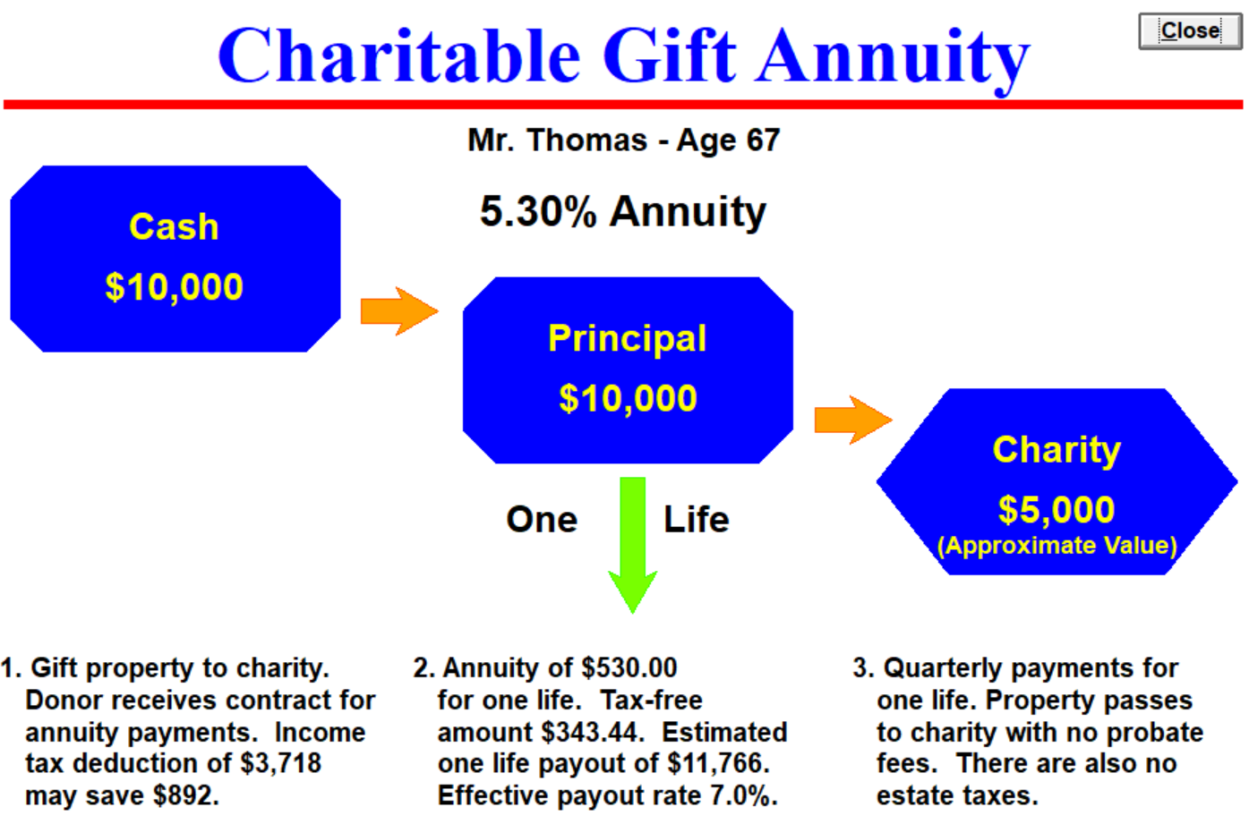
Effective giving #5
Mr. Thomas and his cash gift annuity

Slide 35


Effective giving #6
Mr. and Mrs. Wilson stock gift annuity
Both age 70
Both receiving social security
Mr. Wilson has fixed pension from employer
Mrs. Wilson retired school teacher
Will tap their IRA account at age 70½
Both active supporters
Concerned about financial future
Large Apple stock investment

Slide 36
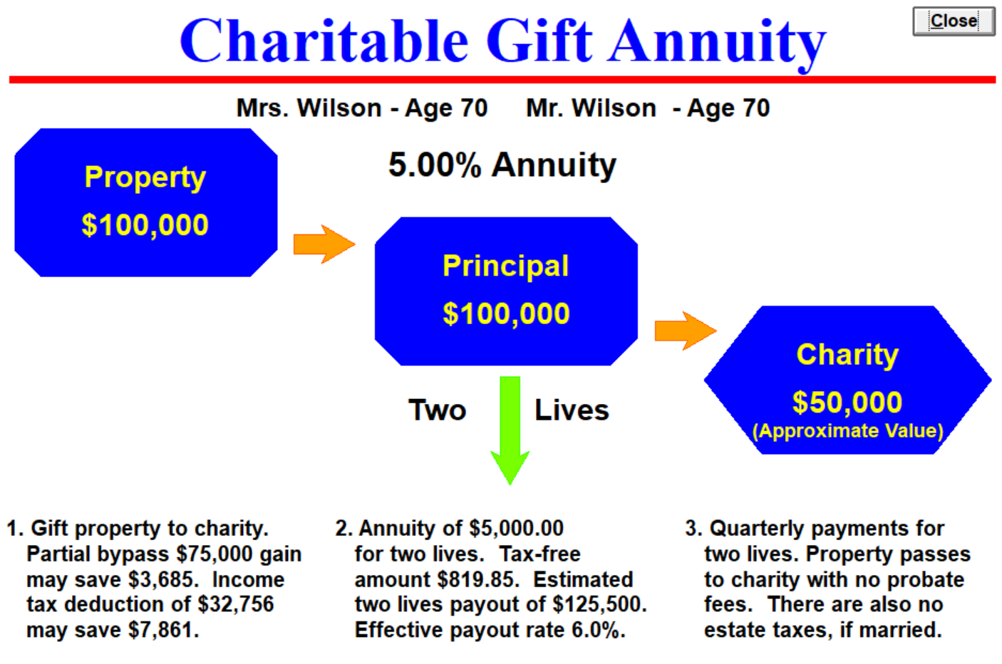
Effective giving #6
Mr. and Mrs. Wilson stock gift annuity

Slide 37
Effective giving #6
Gift annuity income enhancement- Stock
Prior to Gift
Invested in stock | $100,000
Dividends (2%) | 2,000
Tax (15%) | $300
Net spendable | $1,700
Capital if Sold
Fair market value | $100,000
Cost basis | 25,000
Capital gains tax (15%) | $11,250
Net capital | $88,750
After the Gift
Contributed | $100,000
Cost basis | $25,000
Payment rate | 5.00%
Total payment | $5,000
Ordinary income | $1,720
Capital gains | $2,460
Tax-free* | $ 820
Tax OI 24% | -$412
Tax CG 15% | -$369
Net spendable | $4,219
Bonus savings | $7,861
*tax-free to 2037
Notes:
Strategy 2: Comparison of Pre and Post Gift Annuity Financial Comparision

Slide 38
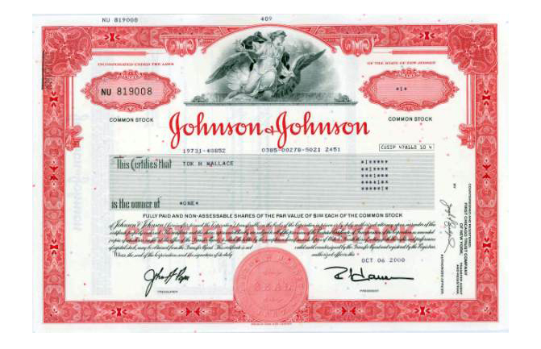
Effective giving #7
Gift plus gift annuity - Stock
Substitute gift annuity income for stock dividend
Make a major gift without significant reduction in retirement lifestyle
  Couple both age 75
  Asset – Johnson & Johnson stock, 1,666 shares @$120
  Fair market value $200,000
  Dividend rate 2.72%, annual payment $4,531 pre-tax and $3,851 after taxes
  Donors wish to make a major gift of $100,000
Solution: separate stock into two parts, give half and use half for a gift annuity

Slide 39
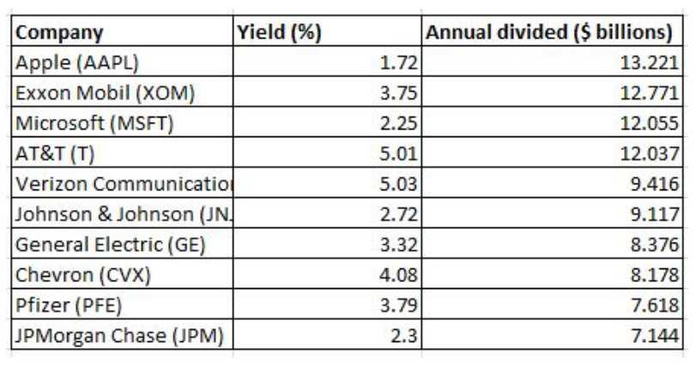
Effective giving #7
Biggest dividends in the S&P 500

Slide 40
Effective giving #7
Gift plus gift annuity - Stock
Prior to Gift
Invested in stock | $200,000
Dividends (2.72%) | $4,533
Tax (15%) | $680
Net spendable | $3,853
Gift $100,000
Stock gift 833 shares value | $100,000
Cost basis | 50,000
Capital gains tax avoided (18.8%) | $9,400
Deduction | $100,000
After the Gift
Contributed | $100,000
Cost basis | $50,000
Payment rate | 5.50%
Total payment | $5,500
Ordinary income | $1,700
Capital gains | $1,899
Tax-free* | $1,901
Tax OI 24% | -$408
Tax CG 18.8% | -$357
Net spendable | $4,735
Notes:
Strategy 2: Comparison of Pre and Post Gift Annuity Financial Comparision

Slide 41
Effective giving #7
Gift plus gift annuity -Stock
Outright gift deduction
  $100,000
  $9,400 capital gains tax savings
  $24,000 income tax savings
Gift annuity deduction
  $37,697
  $ 9,047 income tax savings
  Effective return on gift annuity 6.9%
Summary:
Two charitable deductions
  Outright …….$100,000
  Gift annuity…$37,697
Prior income
  Net dividend $3,853
Post gift income
  Net payment….$4,735
  Increase of…….$ 882
Bonus tax saving
  Outright……..$24,000
  Gift annuity…$9,047
  Total…….....$33,047

Slide 42

Effective giving #8
Bill O’Brien’s annuity for Sara
Bill age 75 married to Sara age 65
Bill’s retirement pension will end on his death
Bill wants to provide income for surviving spouse and could use a tax deduction this year to offset his stock gains
Has $100,000 cash available
What about health changes?
Could they/she get income earlier?

Slide 43
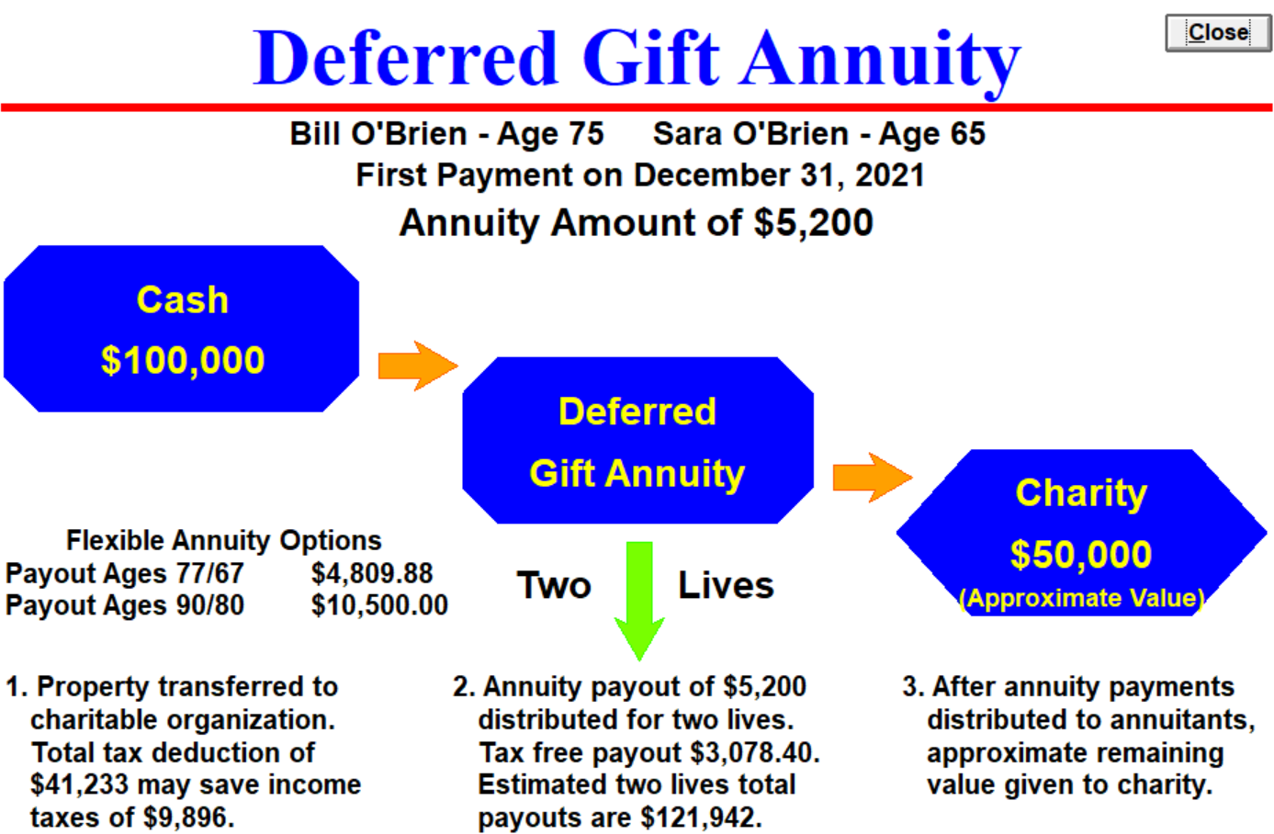
Effective giving #8
Bill O’Brien’s annuity for Sara

Slide 44

Effective giving #9
John’s charitable retirement plan
John age 60
Retirement target age 70
Reaching his highest income years
Maxed out on his retirement plans
Supports various charities with outright gifts
CPA suggested he start a charitable retirement gift annuity
John commits to $10,000 per year for five years

Slide 45
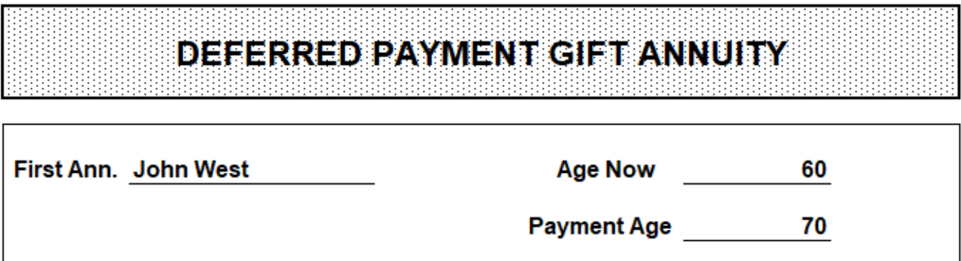
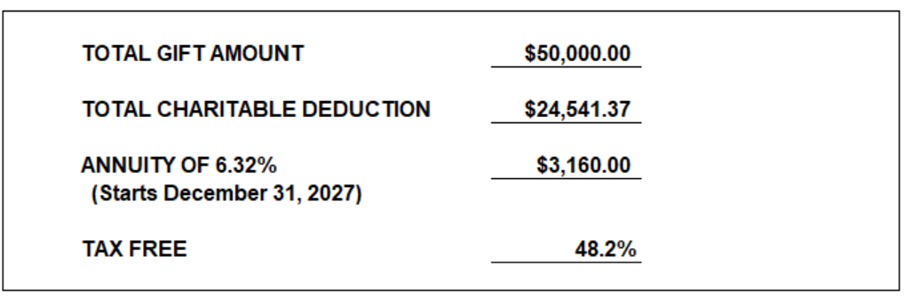
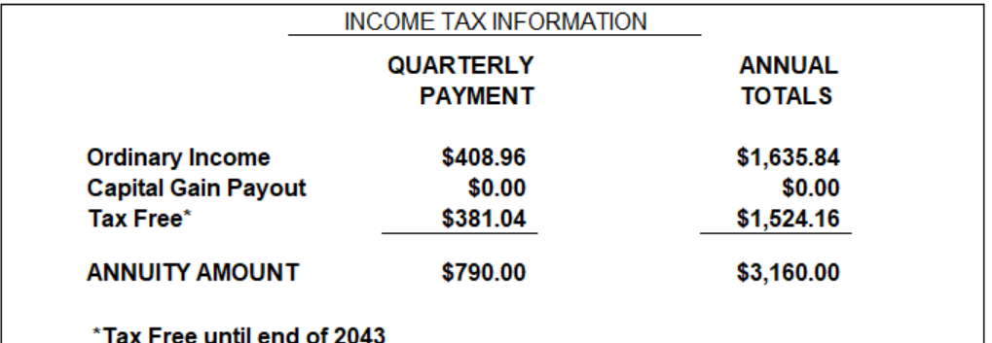
Effective giving #9
John’s charitable retirement plan

Slide 46

Effective giving #10
Nancy’s real estate chartable trust
Nancy age 65, inherited ($100,000) property that has grown in value
Sell highly appreciated real estate - $500,000 value
Pay little or no taxes
Keep 100% working for Nancy for life
Make future charitable gifts
Receive 50% of sale in cash proceeds - $250,000
Establish CRT with 50% of real estate
  Receive 5% variable income for life

Slide 47
Effective giving #10
Summary of real estate sale options
#1. Sell and pay tax @ 23.8%
Gain of $400,000
Tax on gain $95,200
#2. Keep 50%
Sell and pay tax on 50%
Gain of $200,000
Tax on gain @ 23.8% = $47,600
Net $152,000
Continue to pay expenses
#2a. Sell 50% in her name
Sell 50% in CRT
Bypass tax on 100% of CRT gain
Saves $37,000 (cap gain)
Charitable deduction for CRT = $112,743
Deduction saves $27,058 in taxes (24%)
Net cost: $20,542

Slide 48
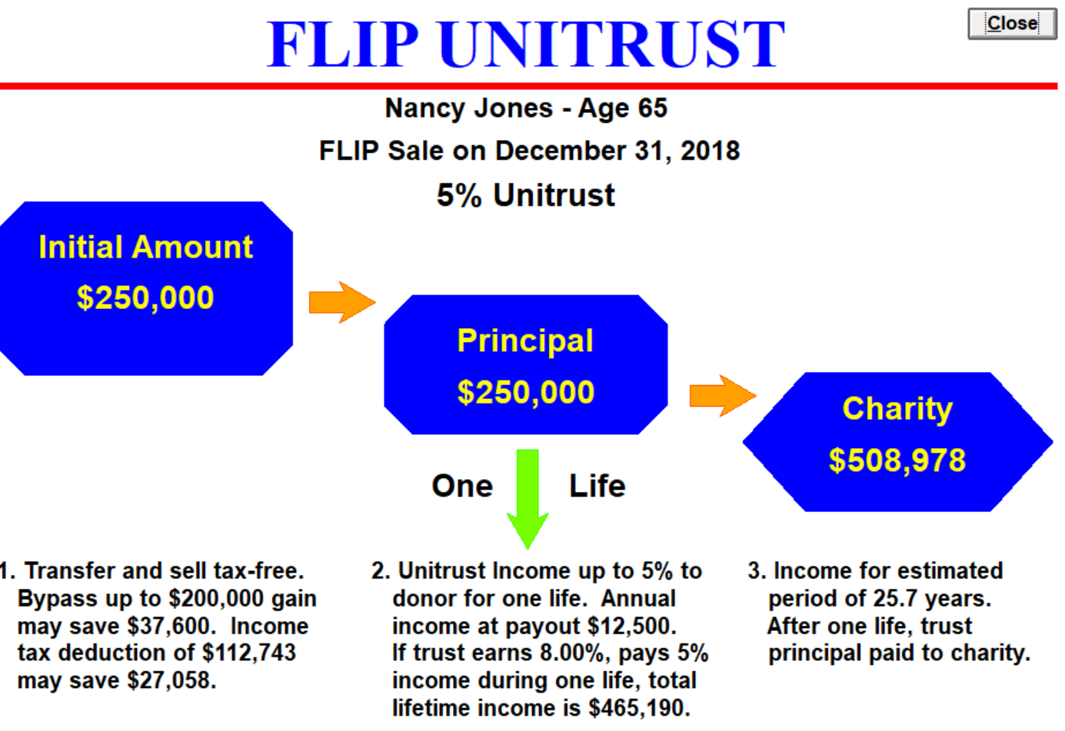
Effective giving #10
Nancy’s real estate chartable trust

Slide 49
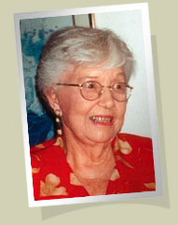
7 Charitable strategies to increase income and decrease taxes
Thank You

